Slide 1
Numbers and colors
1 – ONE
2- two
3 yellow
4 orange
5-blue
6-purple

Slide 2
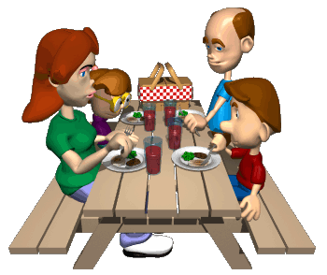
My family
A
Mummy____
2Daddy______
3Brother____
4Sister_____
D
B
C

