Slide 1
What time is it ?
Grade 5
Teacher : Abdikerimova Alfiya

Slide 2
Aims of the lesson are
In this lesson students practice asking for and telling the time. Students practice numbers 1-12, play fun games and activities, listen and read a funny story about clocks and make a clock craft.

Slide 3
New theme

Slide 5
Таңертең
Күн, Күндіз
Түн
Кеш

Slide 6
Good
Good morning- қайырлы таң
Good afternoon- қайырлы күн
Good evening- қайырлы кеш
Good night – қайырлы түн

Slide 7
New words
Time- Уақыт
Clock- сағат
Minute – минут
Past- кетті
To- қалды
Quarter – 15 минут
Half – жарым, жарты

Slide 10
Video

Slide 14
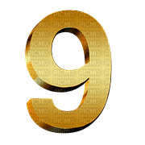
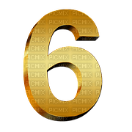
Play game
Find numbers

Slide 15
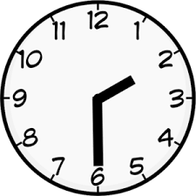
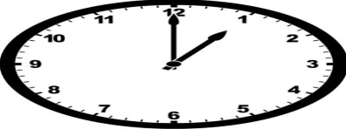
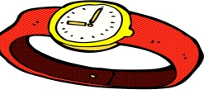
Make a poster and match
Afternoon
Watch
Number
Half past two
One o`clock
Night

