Slide 1
FOOD AND DRINKS

Slide 2
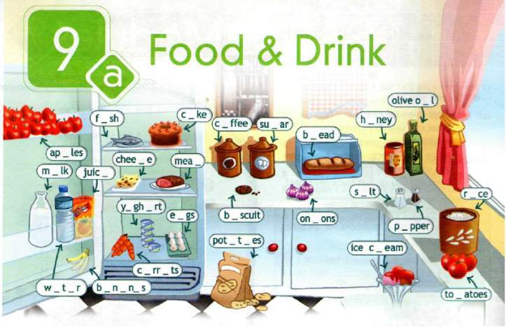
Module 9 «Food and refreshments».
Check it up (ex.1, p.86).

Slide 3
Fish, apples, milk, juice, water, bananas, cheese, yoghurt, meat, eggs, cake, coffee, sugar, biscuit, potatoes, bread, onions, salt, chicken, peppers, ice-cream, olive oil, rice, tomatoes, carrots.
Which of these items are fruit/ meat /vegetables /drinks /dairy products?
____, ____, ____ are fruit
____, ____, ____ is meat
____, ____, ____ are vegetables
____, ____, ____ are drinks
____, ____, ____ is dairy products

Slide 4
Fish, apples, milk, juice, water, bananas, cheese, yoghurt, meat, eggs, cake, coffee, sugar, biscuit, potatoes, bread, onions, salt, honey, pepper, ice-cream, olive oil, rice, tomatoes, carrots. Do you like ________(fish)?
Yes, it’s delicious / very tasty / great?
No, it’s horrible / terrible / awful?

Slide 5
Fish, apples, milk, juice, water, bananas, cheese, yoghurt, meat, eggs, cake, coffee, sugar, biscuit, potatoes, bread, onions, salt, honey, pepper, ice-cream, olive oil, rice, tomatoes, carrots. Which of the words are countable / uncountable?
Countable
Uncountable
apples, bananas,
eggs, cake,
biscuit, potatoes,
onions, tomatoes, carrots, pepper
fish, milk,
juice, water,
cheese, meat,
coffee, sugar,
bread, salt,
honey, ice-cream,
olive oil, rice, yoghurt

Slide 6
Study the rule:
some | We use some in affirmative sentences (утвердительных предложениях) | To make this dish you need some tomatoes, an egg and some olive oil.
any | We use any in negative/ interrogative sentences (отрицательных и вопросительных предложениях) | We need to go to the supermarket; we haven't got any eggs and we haven't got much olive oil. Are there any tomatoes in the fridge?
much / a little | We use much / a little with uncountable nouns ( с неисчисляемыми существительными) | I think we have a little milk but we have much juice in the fridge.
many / a few | We use many / a few with countable nouns (с исчисляемыми существительными). | There are many apples on the table. A few eggs are left.
a lot of | We use a lot of with countable and uncountable nouns ( с исчисляемыми и неисчисляемыми существительными). | We need a lot of olive oil and tomatoes to make this dish.
The exception | We use some in requests ( в просьбах) | Would you like some tea? Can I have some cakes, please?

Slide 7
Grammar test:
Fill in some, any. few, little.
1.Is there ……. milk?
2.There is ……. sugar in the cupboard.
3.There are not ……… apples on the table.
4.Would you like ……… biscuits?
5.We have got ……… potatoes at home.
Fill in much, many.
6. I don’t eat ………. fish.
7.There are …………eggs in the fridge.
8.Mary has got ……… oranges.
9.I want to make a cake. I need …….. sugar.
10.Pete eats………. sweets.
Fill in а few, а little.
11. She has got ……… jam.
12. There are …………carrots in the box.
13. We have got ………potatoes at home.
14. There is ………. juice in the bottle.
15. Buy ……… bars of chocolates, please.
Count the number of right sentences. Your score is …
15 -10 | 9-5 | 4-0
Well – done! ☺ | Good! 😐 | Try again! ☹

Slide 8
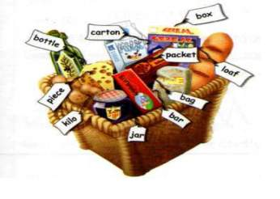
Make word combinations
packet
carton
bag
kilo
bar
piece
jar
bottle
loaf
box
milk
juice
cake
apples
sweets
honey
potatoes
chocolate
crisps
bread
a
of

Slide 9
Ex. 7, p. 87.
Which of the following sentences are true about British food?
1.The British eat a traditional English breakfast every morning.
2. Most British people have a sandwich for lunch.
3. Chinese food is very popular in Britain.
Work in groups.
Complete the gaps in the text.
Then give a small talk about Brutish cuisine.
What did you find special about it?

Slide 10
Students Check Form. Name _________________________ Class______________________
Now I know…….. | Very well | OK | Not very well
1. The names of food and drinks.
2. The names of containers / packaging.
3. To tell how much food there is.
4. To exchange opinions (обмениваться мнениями ) about one’s favourite food..
5. To tell about traditional meals in Britain.
Draw how you feel. ☺ ☹ 😐

Slide 11
Home task:
The home task for the next lesson is:
SB ex.9*, p.87;
Make a shopping list for your favourite dish. You may use these sentences as a model:
My favourite dish is ….
I need to buy ……to make it.
W.B. p.53.

Slide 12
An apple a day keeps the doctor away!
Be healthy!
Be happy!

