Slide 1
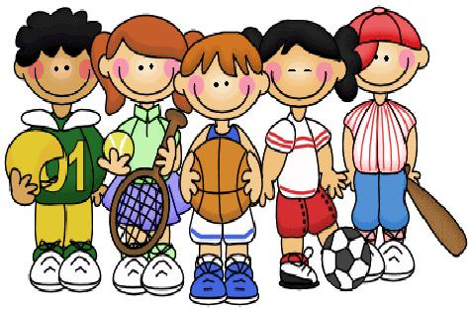
The Theme:
‘Clubs for young people’
Grade 5

Slide 2
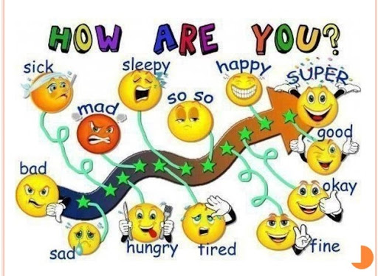

Slide 3

Lesson objectives
All learners will be able to:
understand new new words
Most learners will be able to:
work actively
Some learners will be able to:
share their opinion

Slide 4

Athletics team - жеңіл атлетика командасы
Swimming team – жүзу командасы
Volleyball team - волейбол командасы
Yoga classes - йога сабақтары
Sports cafe with TV- теледидармен спорт кафесі
Drama club – драма клубы
Chess club – шахмат клубы
Climbing club – альпинизм клубы
Dance club – би клубы

Slide 5
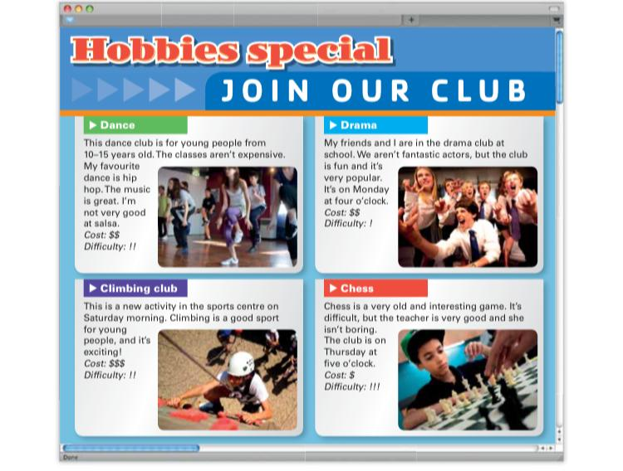
READING
Student’s book ex 1 p14

Slide 6
Read the text. Match 1-5 with a-e
Salsa and hip hop a is for young people
Chess b is on Saturday
Climbing c is a new activity
The dance club d are dances
The climbing club e is difficult

Slide 7
Check your understanding: gap fill
Complete the sentences with words from the box.
At the University of Hoburn you can play volleyball on________.
2. At the University of Hoburn you can join the athletics team on _______.
3. The rowing club is on Friday at ________________________.
4. The University of Hoburn needs players for the football team, athletics
team, volleyball team, rowing team and the ________________________.
5. The University of Hoburn also has a sports café with _________________.
6. The university sports teams are free ________________________.
3 p.m. swimming team Thursday TV to join Tuesday

Slide 8

Let’s speak a little
What is your sporting interest and why?
Do you play/prefer sport clubs or
individual? Why?
What sports are you good at?

Slide 9
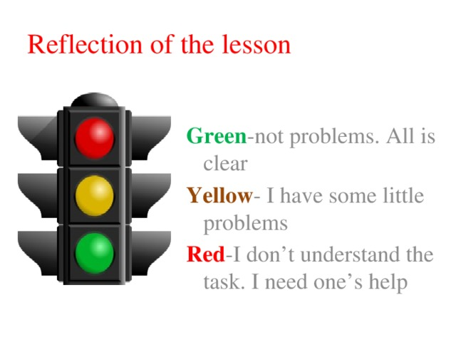

Slide 10

Student’s book ex 5, p 14
ABOUT YOU Look at the ideas for clubs. Give your opinion using words in the box.
Example: I think tae kwon do is difficult and dangerous.
Homework
interesting boring expensive cheap easy difficult

Slide 11


