Slide 1
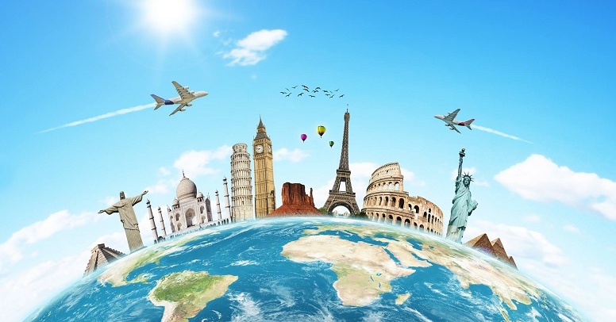
Holidays and travel

Slide 2
We are going to:
Read a travel brochure about adventure
holidays in Kazakhstan;
Talk about holidays and travel;
;

Slide 4
Doing exercises
Ex: 2 Listening.
Who said these things?
Ex:3 Complete the rules
Ex:5 Report the statements

