Slide 1
Permutations

Slide 2
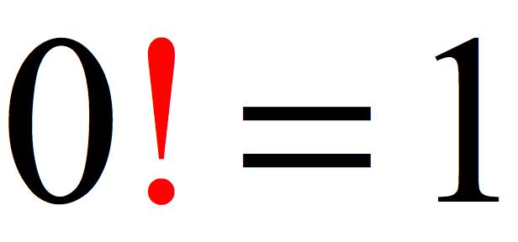
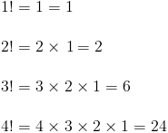
Permutations of n Elemets
An ordered arrangement of some or all of the elements of a given set is called a permutation. The number of permutations of all of the n distinct elements in a set is denoted by P(n,n), where P(n,n)=n*(n-1)*(n-2)*…*2*1=n!
“!”- factorial

Slide 3
What is the number of permutations of 5 different math books pilled on a table?
P(5,5)=5!=5*4*3*2*1=120

Slide 4
Murat has 5 different math books, 3 different biology books and 4 different physics books. In how many different ways can Murat arrange his books a. on a book shelf b. in three different file holders, if each holders is for a different subject?
P(12,12)
3!*P(5,5)*P(3,3)*P(4,4)

Slide 5
Permutations of r elements selected from n elements. $0≤r≤n$
How many different two-letter combinations can we form from the letters of the word DIAS if a letter can not be used more than once?
Answer is 4*3=12
DI DA DS
ID IA IS
AD AI AS
SD SI SA
The number of Permutations of r elements selected from a set of n elements is $P\left(n,r\right)=\frac{n!}{\left(n−r\right)!} (n,r∈N and 0≤r≤n$
$$P\left(4,2\right)=\frac{4!}{\left(4−2\right)!}=\frac{4!}{2!}=\frac{1∗2∗3∗4}{1∗2}=3∗4=12$$

Slide 6
$$Calculate P\left(5,3\right)∗P\left(7,2\right)$$
$$Calculate P\left(7,3\right)$$
$$Calculate P\left(n,0\right)$$
$$P\left(n,3\right)∗5=P\left(n,4\right) is given. Find n.$$

Slide 7
A three digit number is formed by choosing elements from the set (1,3,4,5,7,8,9) without repetition. a. how many numbers don’t contain the digit 5? b. how many numbers contain the digit 5? c. How many numbers contain 1 or 7or both 1 and 7?

Slide 8
HOMEWORK
A four digit number is formed by choosing elements from the set (1,2,3,4,5,7,8) without repetition.
a. how many numbers don’t contain the digit 4? b. how many numbers contain the digit 4? c. How many numbers contain 2 or 8 or both 2 and 8?

