Slide 1
Welcome to our lesson!

Slide 2
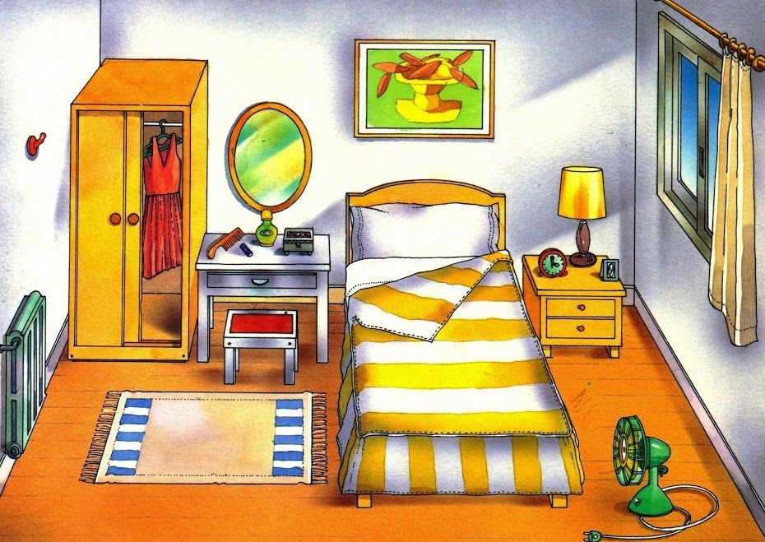
Make a pictures of mosaics

Slide 3
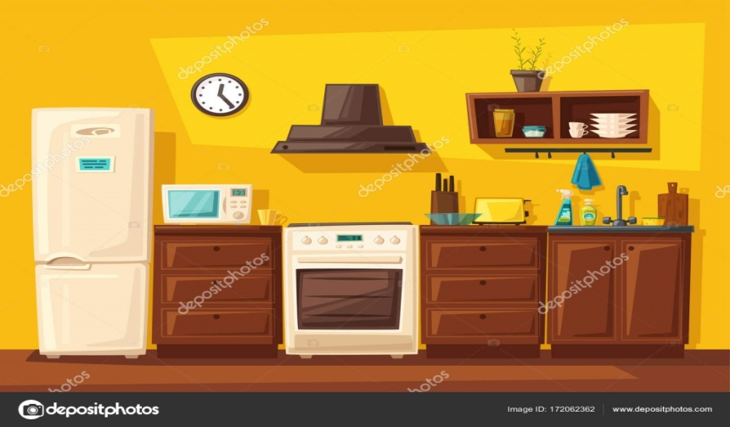
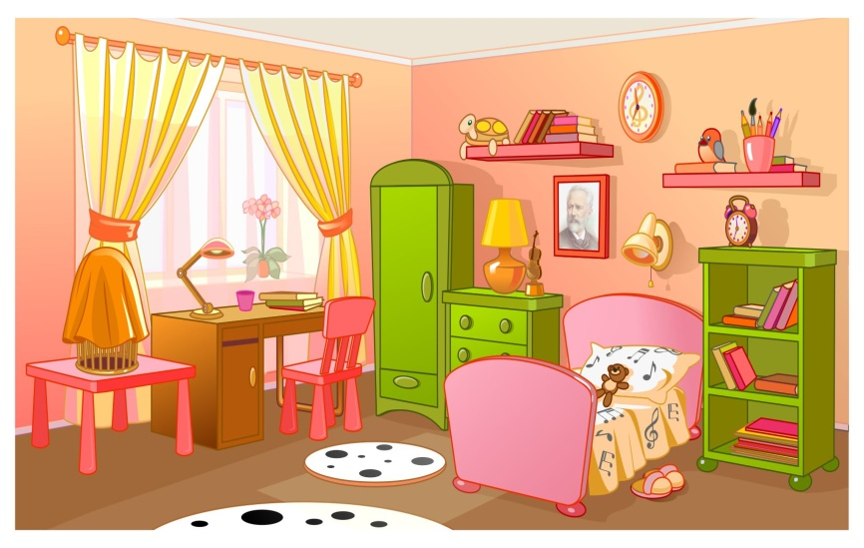
Divide into two groups
First group “Kitchen”
Second group
“Bed room”

Slide 4
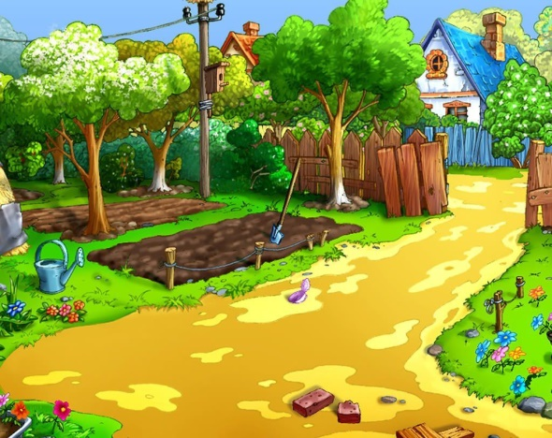
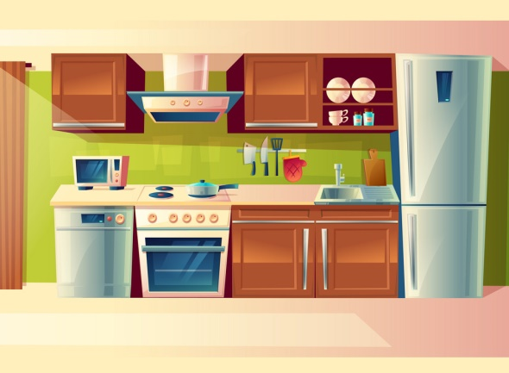
Today is the 26th of November
The world around us
Different places

Slide 5
Vocabulary
Kitchen-ас бөлмесі
Bedroom-жатын бөлме
Garden-бақша

Slide 6
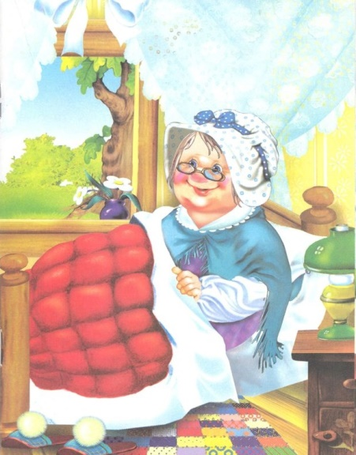
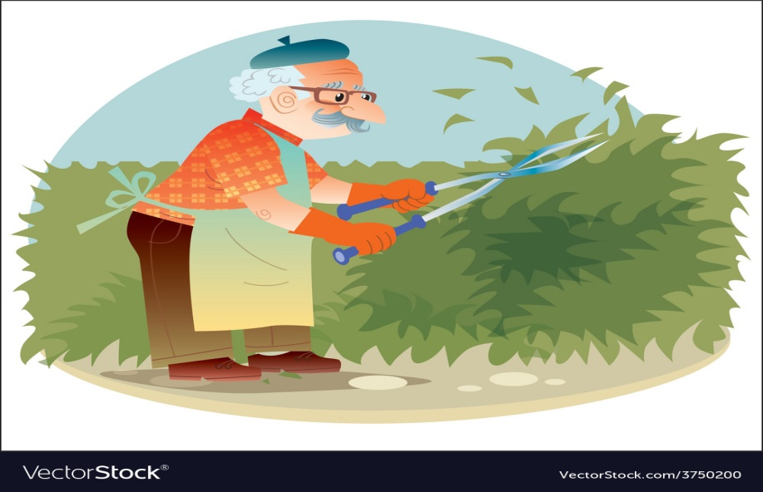
Ex 1 p 46

Slide 7
Feedback

Slide 8
Home work
Ex.2 p46 Learn song “Where is Charlie?”

Slide 9
Lesson is over Good bye!!!

