Slide 1
Grade: 4
Theme: Planets 1

Slide 2
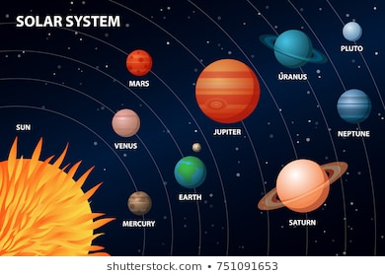
Task 1. Look at the picture . Do you know names of the planets?

Slide 3
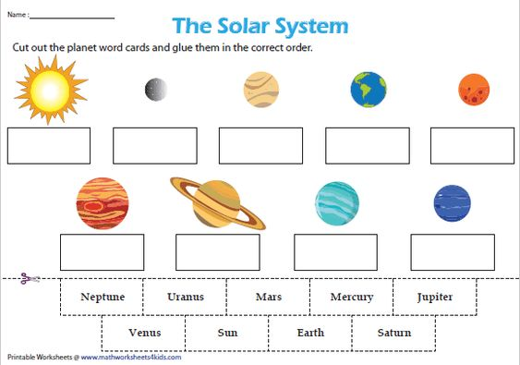
Task 3. Look at the picture and write the names of the planets.

Slide 4
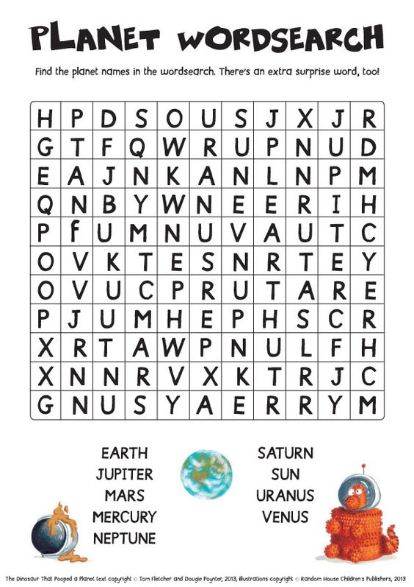
Home task: Learn new words . Complete the crossword

