Slide 1
Time and activities

Slide 5
Let’s do exercises

Slide 6
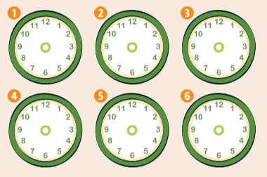
Ex 2 p.21 Listen and draw the times you hear.Then listen again and repeat

Slide 7
Ex.3 p.21 Listen to a conversation. What activity is Lily interested in? Ex.5 Listen and repeat the dialogue. What activity is Jim interested in?

Slide 8
Write down the key phrases

