Slide 1

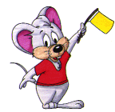


Quiz Time

Slide 2

Section A
Geography

Slide 3
Which country has the most people?
A. U.S.A
B. Russia
C. India
D. China

Slide 4
Which country has the biggest land area?
A. China
B. Russia
C. Jamaica
D. Canada

Slide 5
In which country is mount Everest?
India
Nepal
China
Pakistan

Slide 6
On which continent is the Sahara desert?
A. North America
B. Asia
C. Africa
D. Europe

Slide 7
Paris is the capital of which country?
Russia
France
Belgium
Norway

Slide 8
A man from Ireland is:
A. An Irelandish
B. An Irelander
C. An Irish
D. An Irisher

Slide 9
Which of these is not a capital city?
A. London
B. Rome
C. Beijing
D. Sydney

Slide 10
The longest River in Asia is:
A. Yangtze River
B. Nile River
C. the Amazon River

Slide 11
Which is the largest ocean in the world?
A. Atlantic ocean
B. Pacific Ocean
C. Indian ocean

Slide 12
One of these countries was not hit by the 2004 Tsunami:
A. Indonesia
B. Thailand
C. Somalia
D. Sri Lanka
E. Kenya

Slide 13
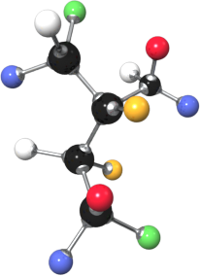


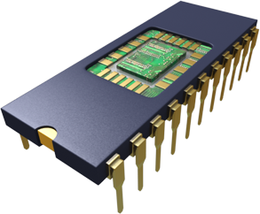
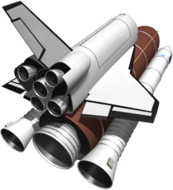
Section B
science
and Technology

Slide 14
Which travels faster?
A. Light
B. Sound

Slide 15
Which symbol stands for water?
A. H2O
B. Co2

Slide 16
Which is heavier?
A Gold
B Silver

Slide 17
Shenzhou 5
What is the name of the first manned Chinese spaceship?

Slide 18
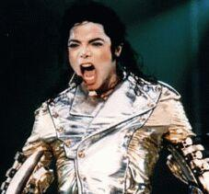

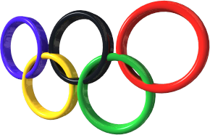


Section C
Pop music and sports

Slide 19
Where is pop singer Michael Jackson from?
A. The U.S.A
B. Canada

Slide 20


which country will host the 2008 Olympic games?
Germany
China

Slide 21


which country will host the 2006 men’s world football Cup?
A. South Africa
B. Germany
C. Brazil

Slide 22
Tiger woods
Which famous golf player’s mother is from Thailand?

Slide 23


What country does the football player Ronaldo come from?
A. England
B. Brazil
C. Japan

Slide 24
Beijing
Shanghai
Qingdao
what city of China is the NBA star, Yao Ming from?
Beijing
Shanghai
Qingdao

Slide 25
Elton John
Which British pop star sang “Candle in the wind” at Princess Diana’s funeral?
Elton John

Slide 26
What does NBA mean in full?
A. National Basketball Association
B. Nation Basketball Alliance
C. National Basketball of America

Slide 27




Section D
Language,
Culture

Slide 28
Which language has a larger population of Speakers?
A. English
B. Chinese(mandarin)
C. Spanish

Slide 29
What language is widely spoken in Ireland?
A. Irish
B. English
C. Gaelic

Slide 30

green
What colour is worn when we celebrate St. Patrick’s Day?

Slide 31
Christmas
Which Festival is celebrated in most countries on the 25th of December?

Slide 32
In one of these countries people who eat pork are few. why?
A. Italy
B. Scotland
C. Germany
D. Saudi Arabia
E. Japan

Slide 33
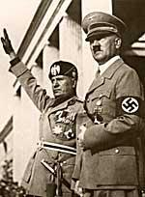
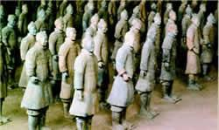
Section E
History

Slide 34
In what year did World War two begin?
A. 1945
B. 1930
C. 1939
D. 1937
E. 1940

Slide 35
Which Chinese leader carried out the famous “Long March”
A. Deng Xiao Ping
B. Mao Zedong
C. Chou en Lai
D. Chiang Kai Chek

Slide 36
Who was the leader of Germany during world war two?
A. Heinreich Himmler
B. Adolf Hitler
C. Benito Mussolini

Slide 37
Which British General was responsible for the final defeat of Napoleon at Waterloo?
A. Duke of Norfolk
B. Duke of Wellington
C. Duke of York

Slide 38
Which of these American Presidents was assassinated ?
A. John Fitzgerald Kennedy
B. Richard Nixon
C. Eisenhower
D. Ronald Reagan

Slide 39
Nelson Mandela of South Africa
Which African President spent 27 years in prison?

Slide 40
Hiroshima and Nagasaki
In what two cities of Japan did Americans drop the Atomic Bomb in 1945 ?

Slide 41
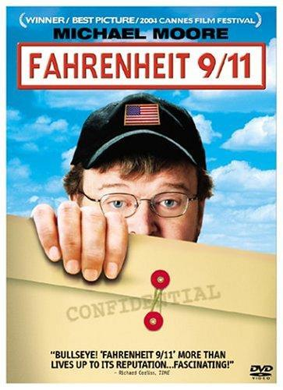
What is 9/11?
What year did 9/11 occur?
9/11 refers to the largest terrorist attack on U.S soil, September 11, 2001

