Slide 2
Checking homework : p: 90 Ex-3
Will have introduced
Will have invented
Will all be going
Won’t /will not still be using
Will have found
0-«5»
1-2- «4»
3-4- «3»

Slide 3
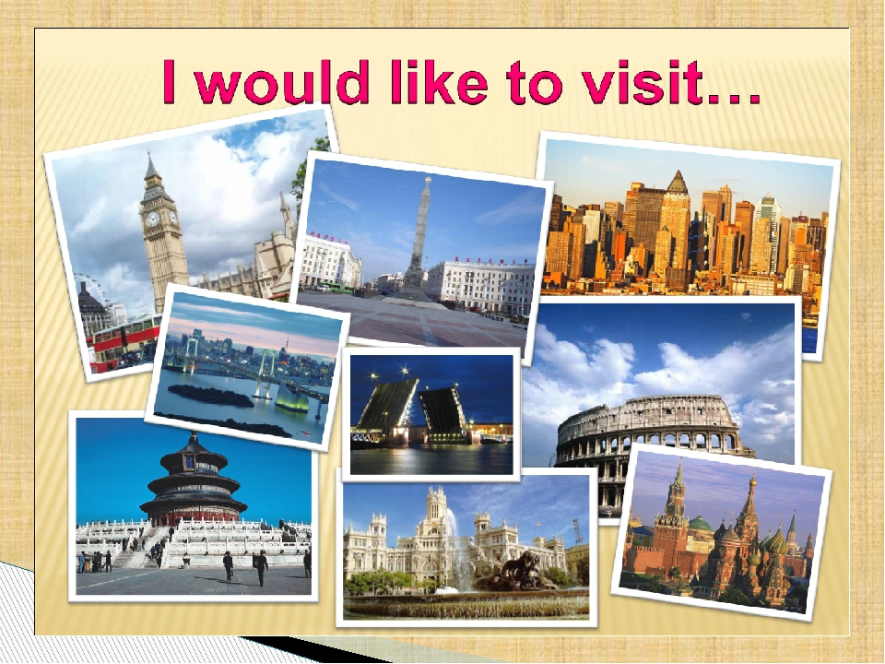

Slide 4
The 5 ^{th} of March class work

Slide 5
Learning objectives(s) that this lesson is contributing to | 8.R2 understand specific information and detail in texts on a growing range of familiar general and curricular topics, including some extended texts 8.S7 use appropriate subject-specific vocabulary and syntax to talk about a growing general topics, and some curricular 8.W2 write with minimal support about real and imaginary past events, activities and experiences on a growing range of familiar general topics and some curricular topics

Slide 8
«Банка әдісі»- I have prepared some new words for you. If you correctly take all the words you need for your topic written on the Bank, you can earn a point for your team.
/ museum, galleries, countries, culture, sightseeing, traditions, bicycle,
train, tractor, plane, ship, car, bus/.

Slide 9
Travel
Transport

Slide 10
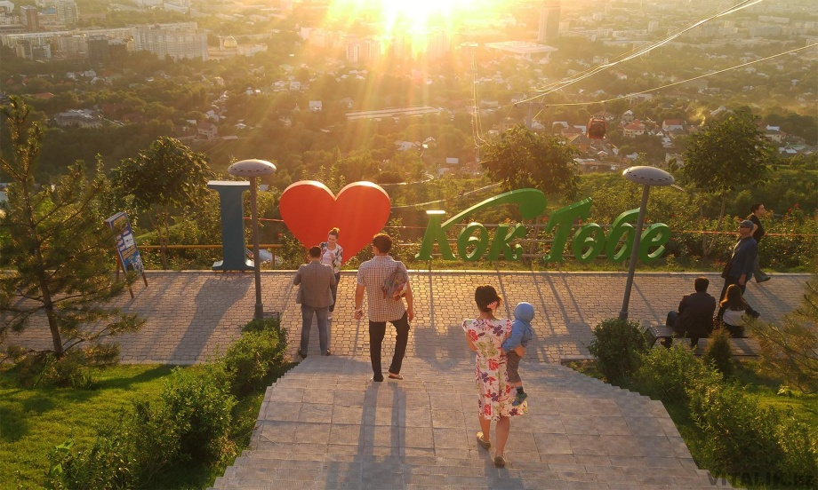
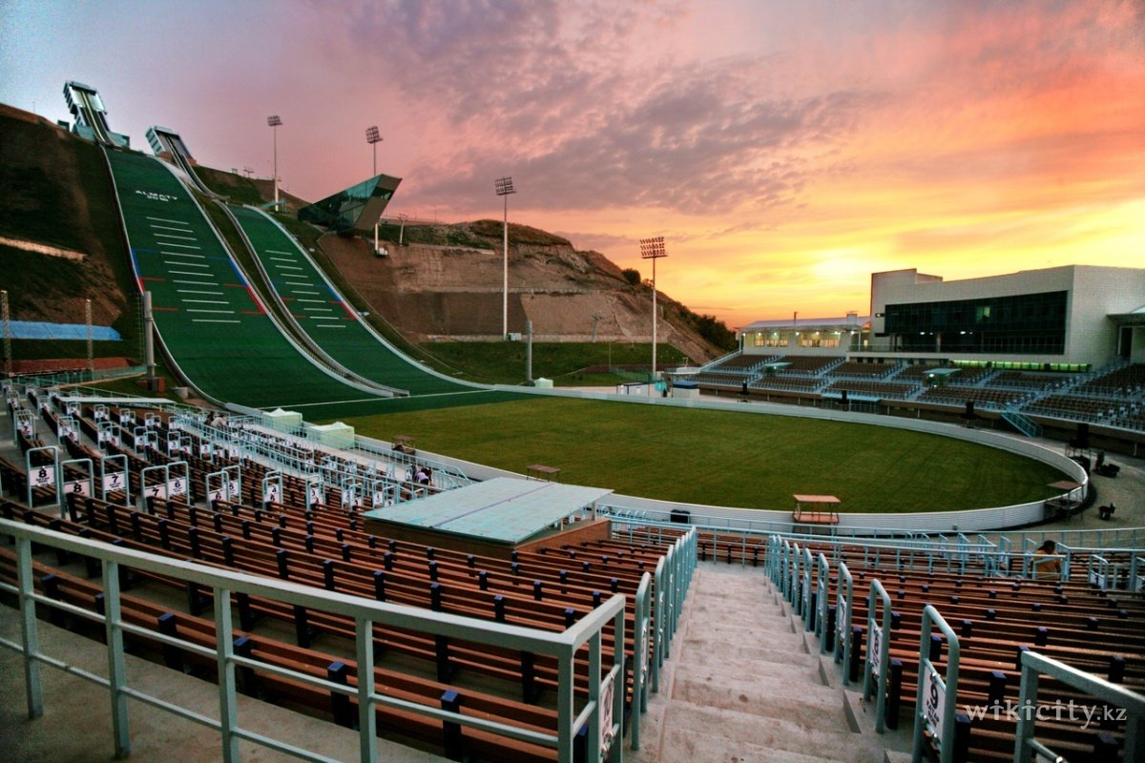
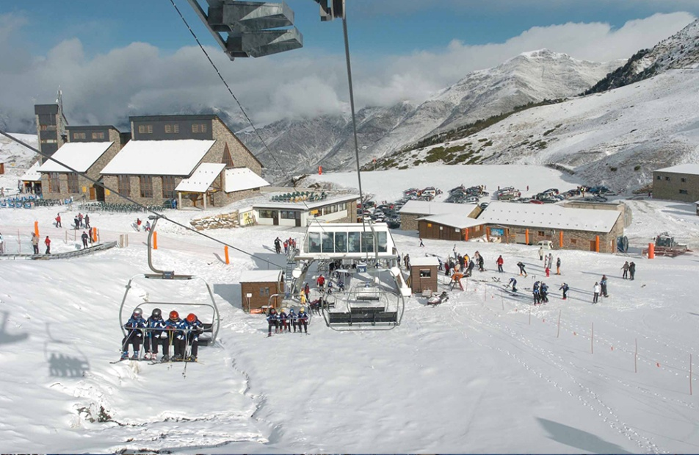
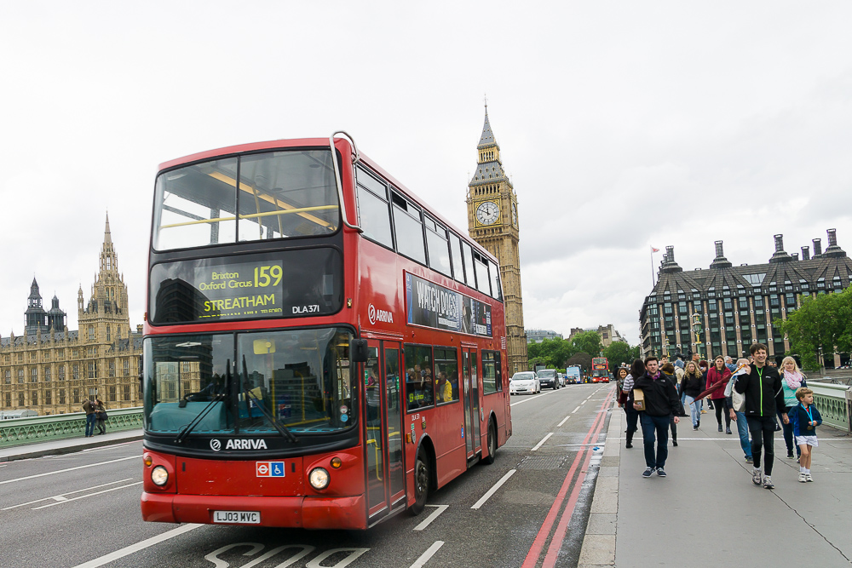
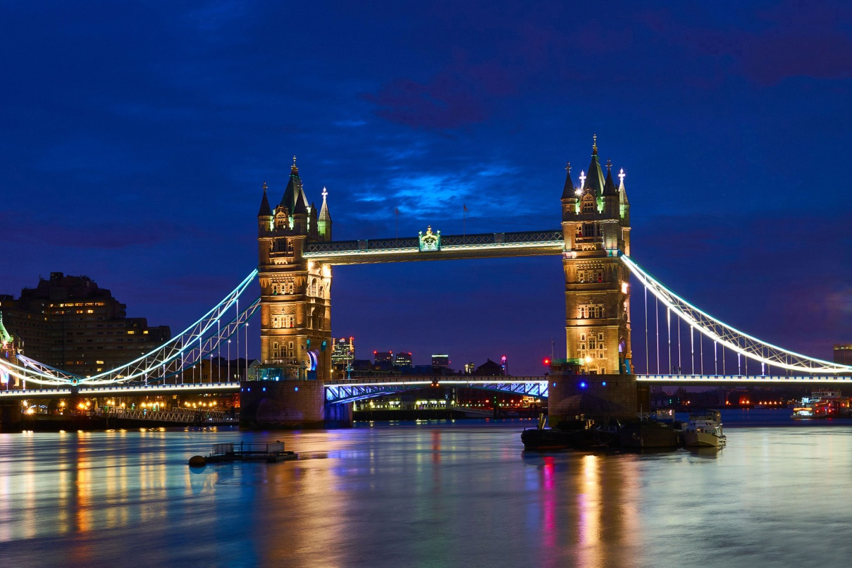
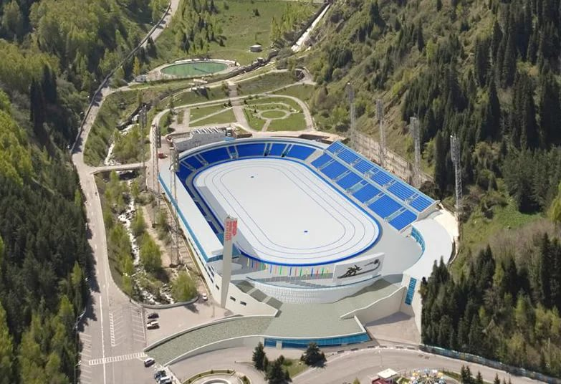
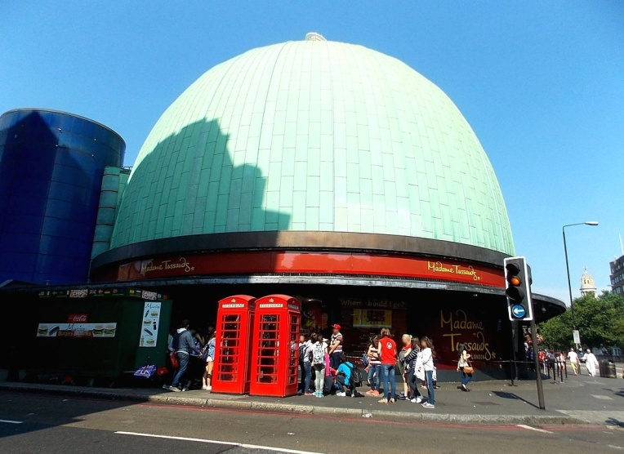
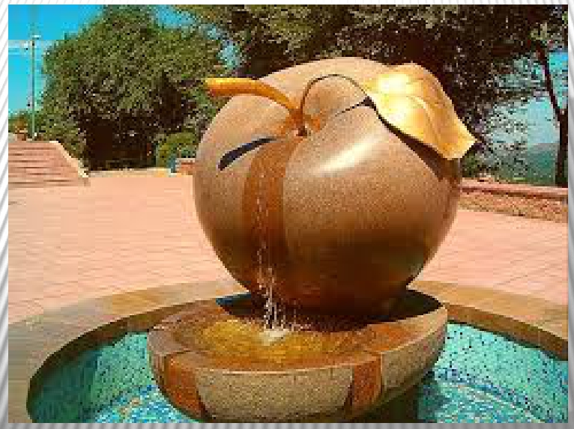
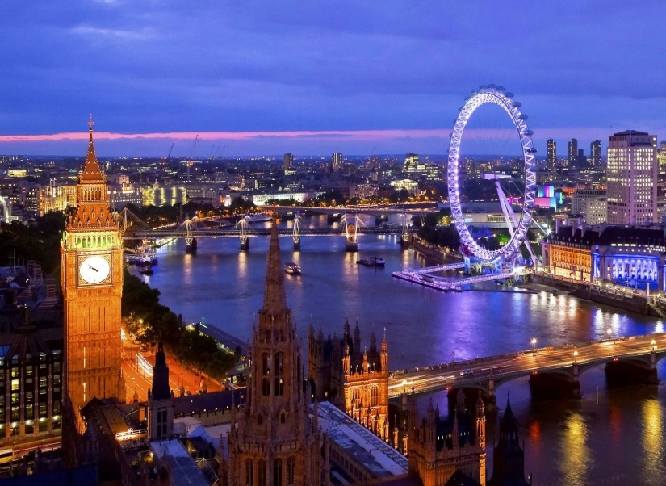
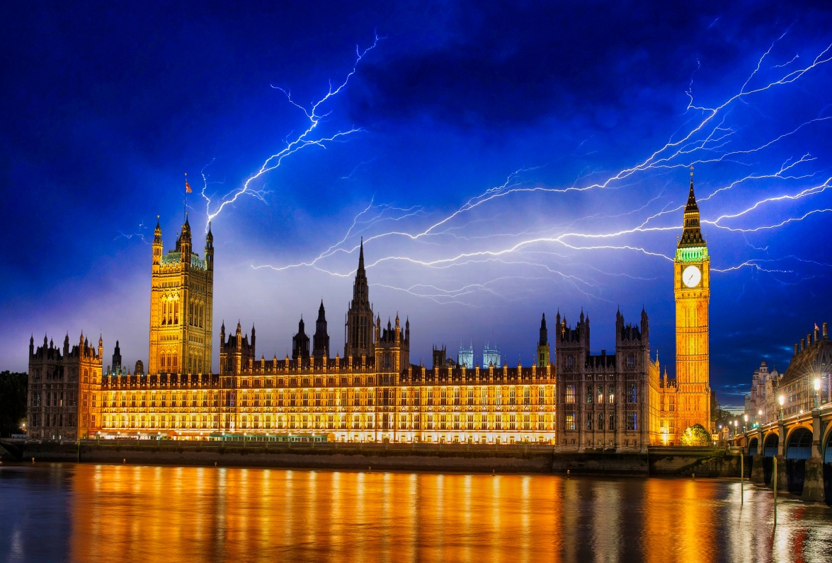
POSTER London Almaty

Slide 12
Task 1 p: 66 ex-2 WB
We’ll have finished
Rosanna will have travelled
Will you have started
They’ll have got
I’ll have spent

Slide 13
Task 2 Ex-3 p: 66 WB
I’ll be flying
They’ll be touring
She’ll be working
Will you be packing
Will we be crossing

Slide 14
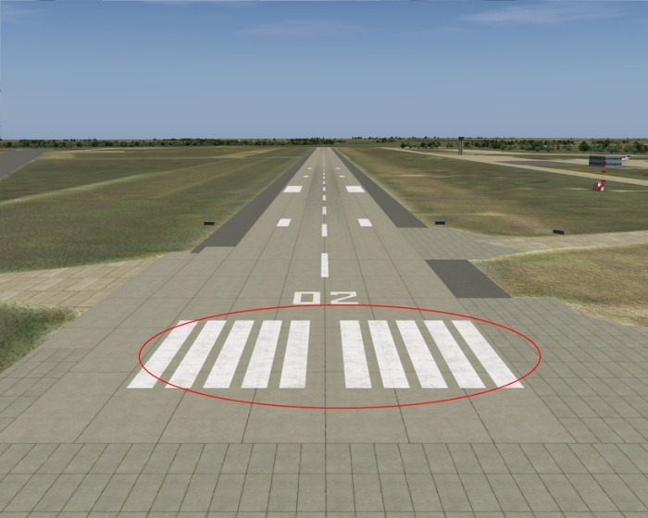
Reflection

