Slide 1
The 24th of January
Theme: Abai Kunanbaev
Learning objectives:
9.S5 interact with peers to negotiate, agree and organise priorities and plans for completing classroom tasks
9.S7 use appropriate subject-specific vocabulary and syntax to talk about a wide increased range of general and curricular topics
9.W2 write independently about factual and imaginary past events, activities and experiences on a range of familiar general and curricular topics

Slide 2
Warm up
Brainstorming

Slide 3
Journalist questions
Who? - Кім?
What? – Не?
Where? – Қайда?
When? – Қашан?

Slide 4
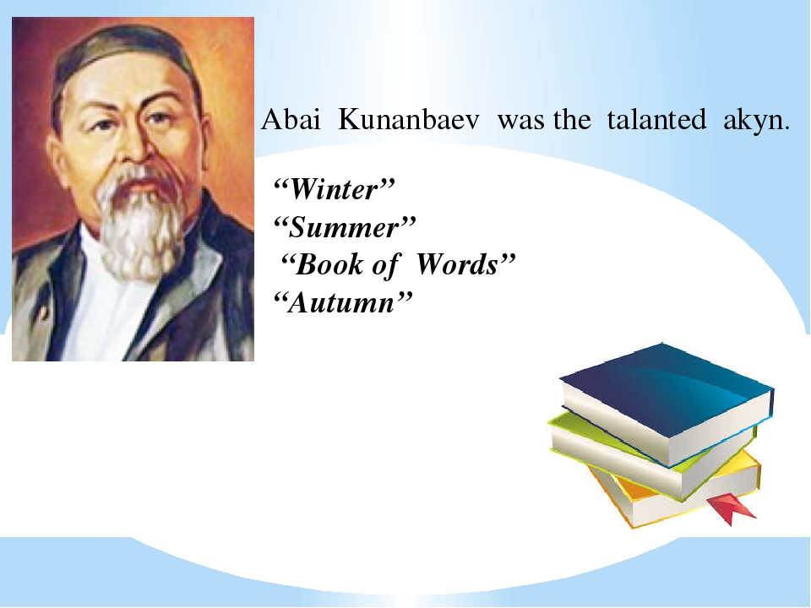

Slide 5
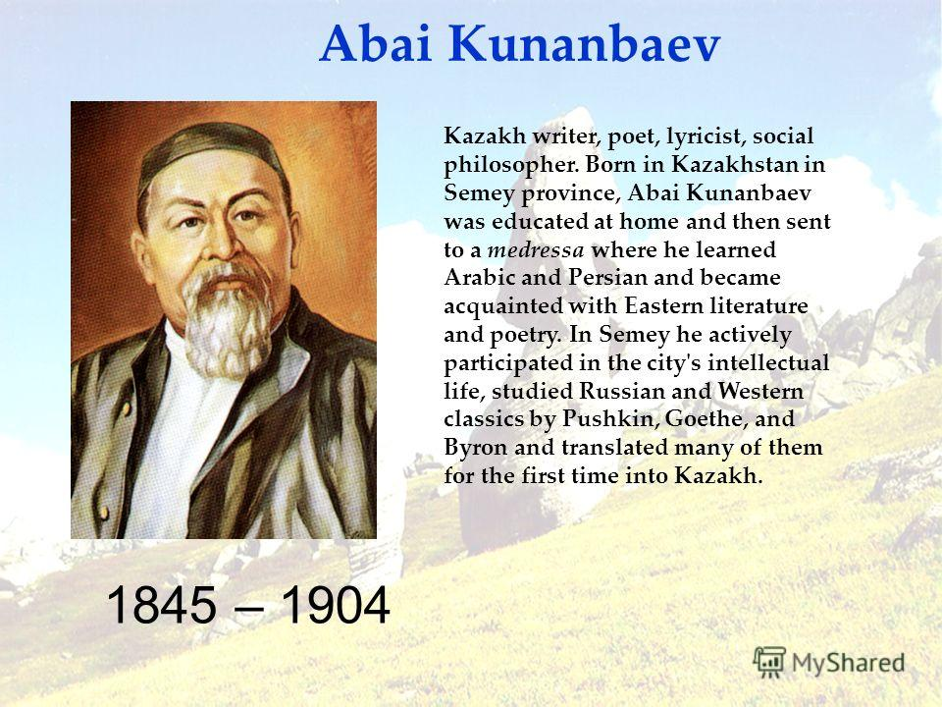

Slide 6
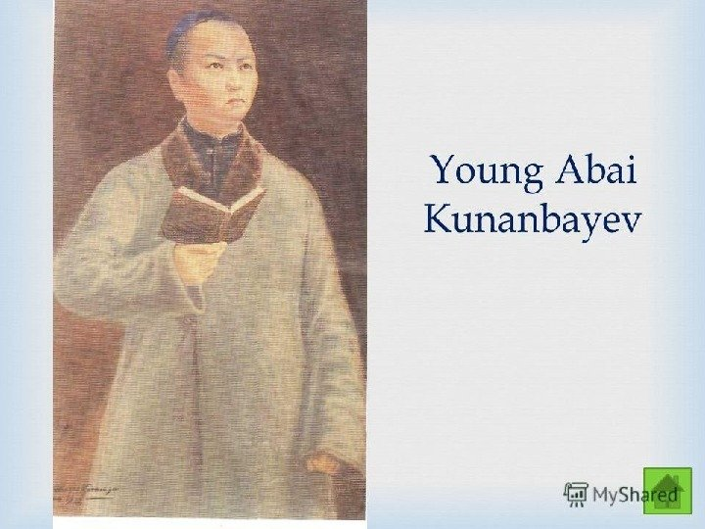

Slide 7
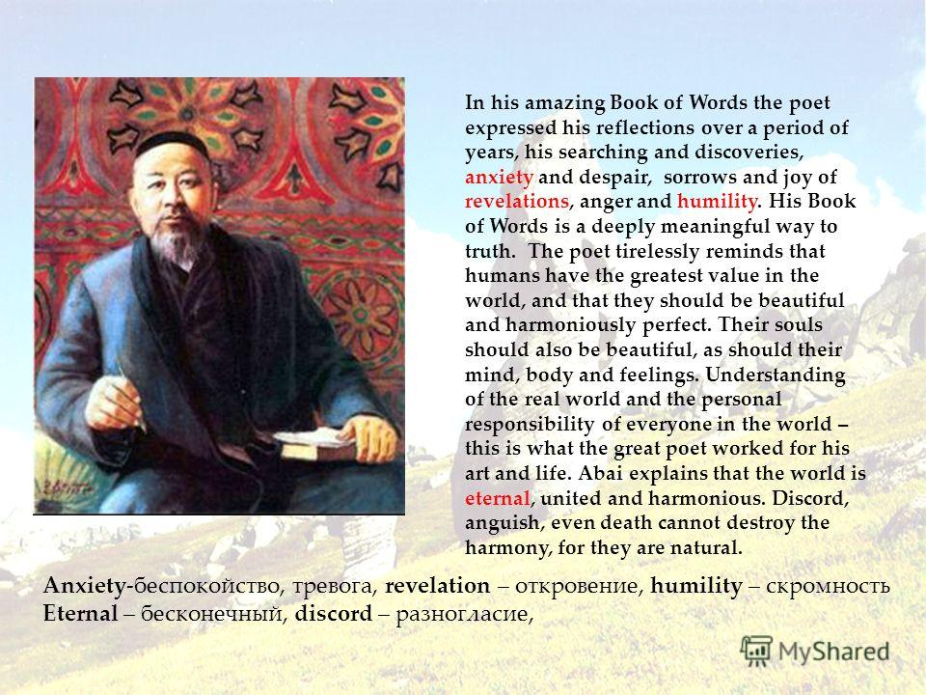

Slide 8
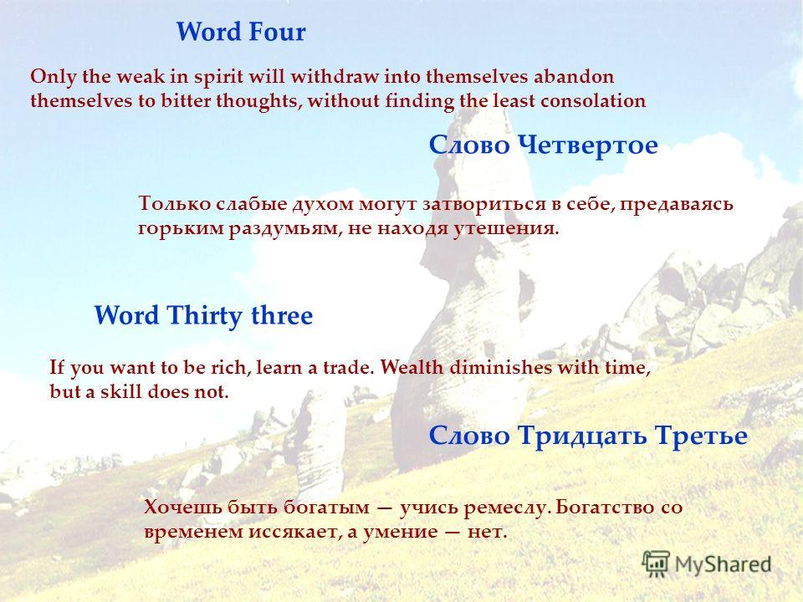

Slide 9
Feedback
“WWW”
What do you learn?
What do you like?
What don’t you like

