Slide 1
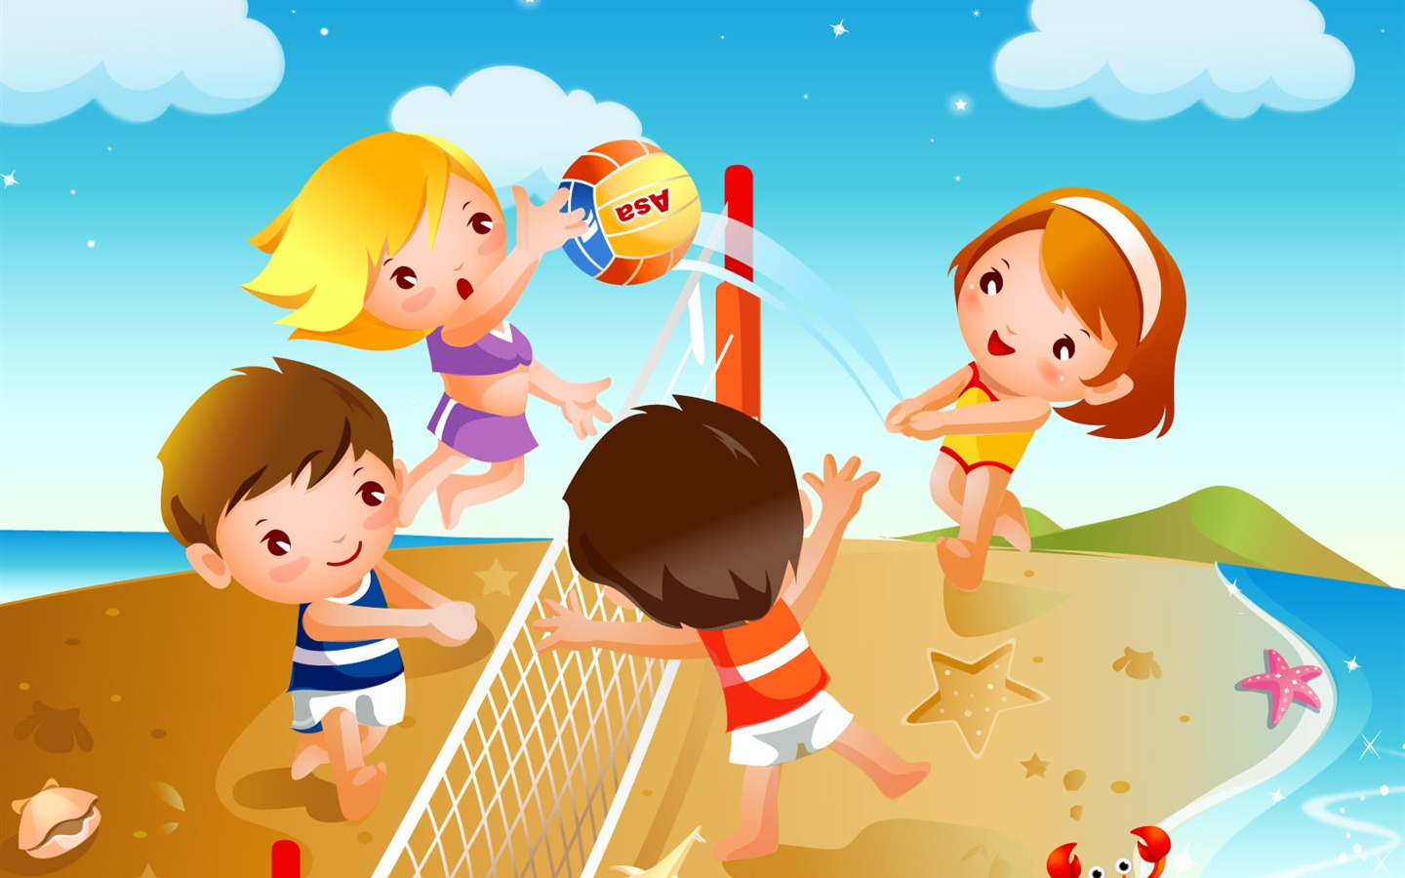
Unit 8 «Sports»
Lesson title :What teach sport us?

Slide 2
Lerning objectives
5L2, 5L8,5S1,5S6,5R6,5UE2

Slide 3
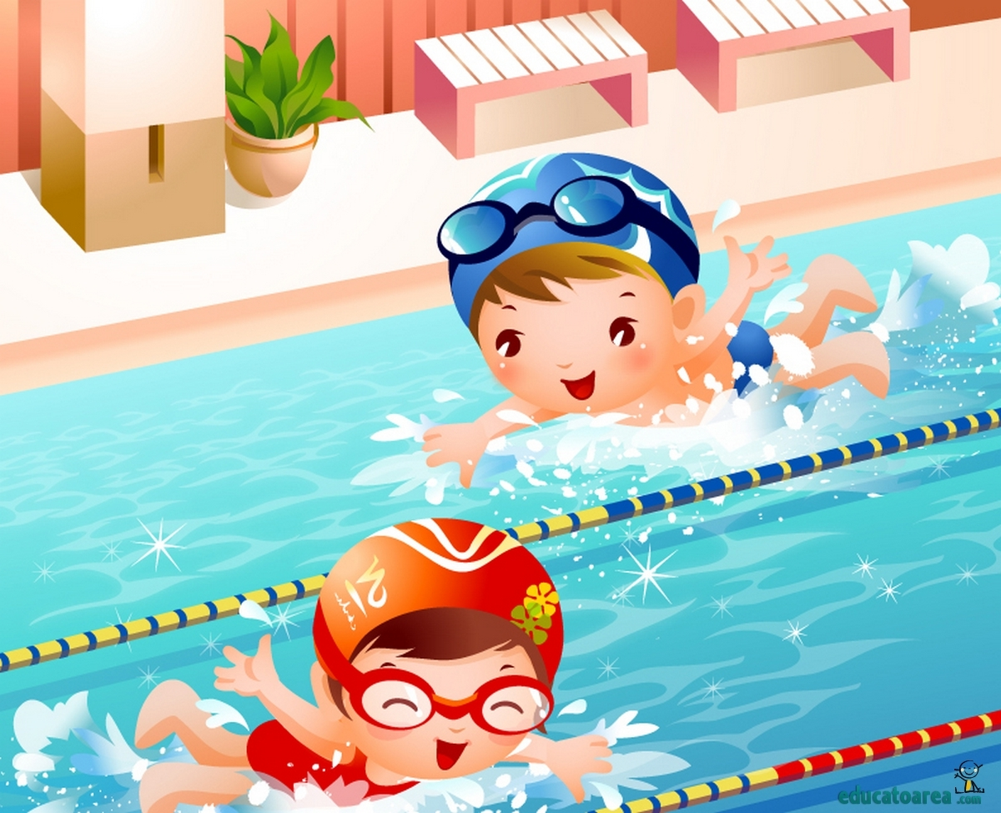
values
Most valuable thing in our life is sport

Slide 4
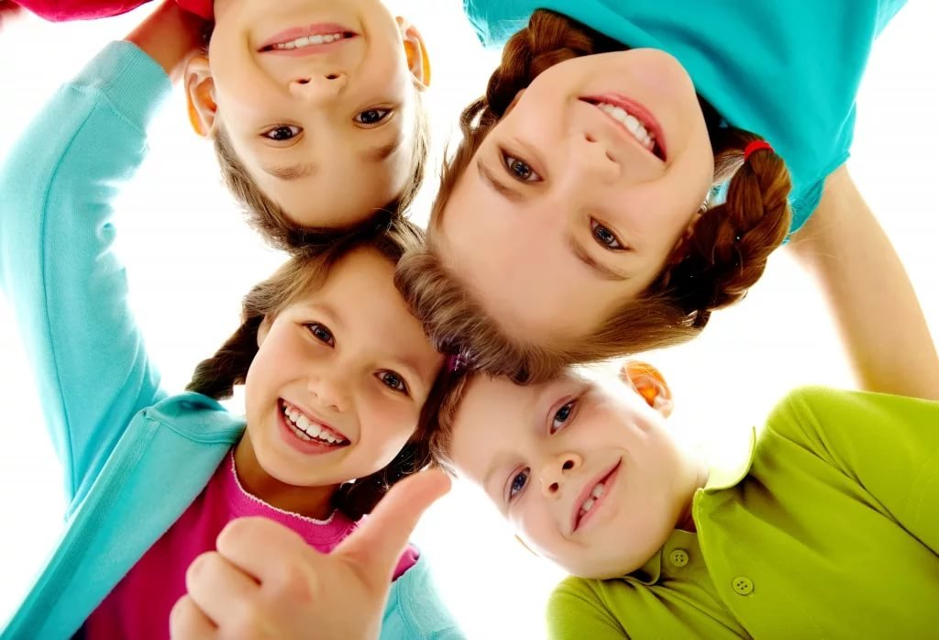
Greeting activities
Good-morning song

Slide 5
Repetition of the previous lesson Activity “snowball game” for checking up the vocabulary Students should stand around and say words related to the topic sports

Slide 6
True false activities

Slide 7
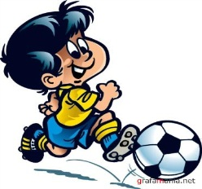
Key words
1. True
2. True
3. False
4. True
5. True
6. False

Slide 8
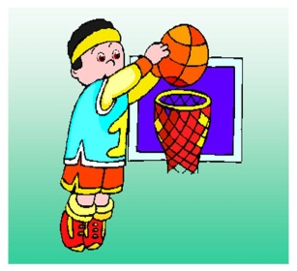
Warm-up activities

Slide 9
Listening task

Slide 10
Key words Baseball, soccer, Ok, soccer, Okay

Slide 11
Blue sofa

Slide 12
Reflection

Slide 13
Home task
SB page 137

Slide 14
Catch the Ball

