Slide 1
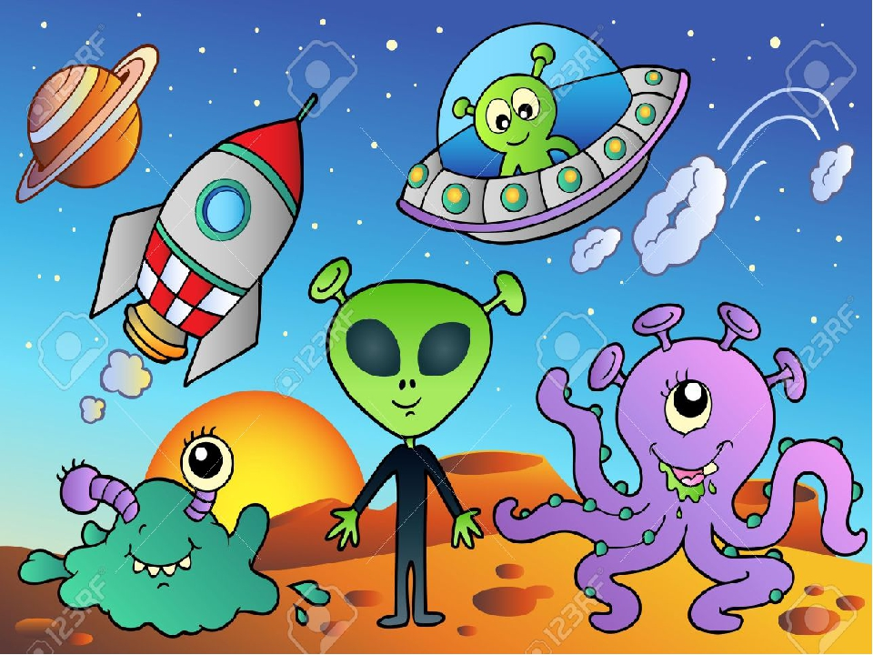
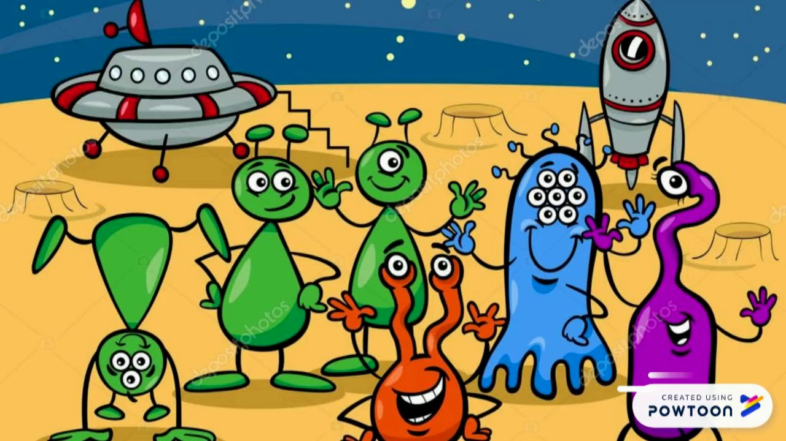
Class: 4th B
Unit7 Journey into Space
Theme of the lesson:
Aliens 2

Slide 2
Learning objectives:
4.R5 To understand the main points
of short simple texts
4.UE9 use present simple and continuous forms including short answer forms and contraction

Slide 3
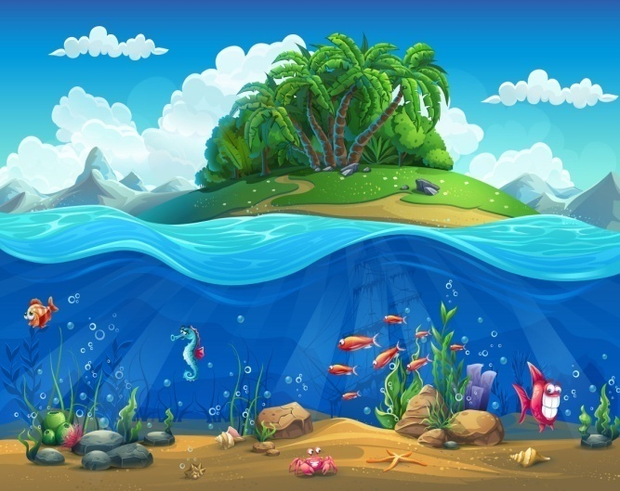
New words:
еxcited-в восторге
underwater-подводный

Slide 4
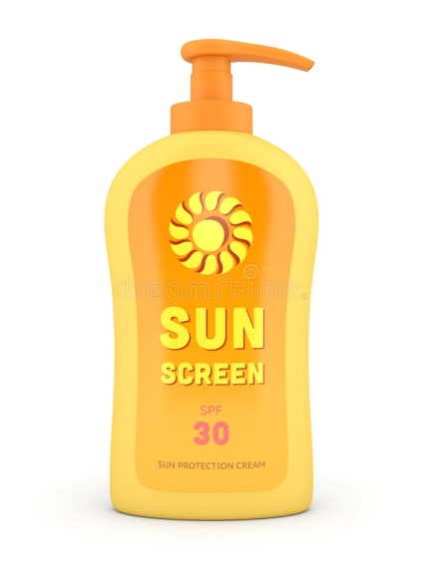
New words:
sunglasses-солнцезащитные очки
swimsuit-купальный костюм
sunscreen-cолнцезащитный крем

Slide 5
Look at the picture and answer the questions:
What can you see in the picture?
What planet are they from?
What is the weather?
What are they wearing?

Slide 6
Read the text on p.109 , ex.24:

Slide 7
Join two parts of the sentences:
1.Yonta has got …
2.Bango is excited because …
3.Floogle is wearing…
4.Dalo isn`t very happy because…
5.The alien friends are…
a) going to the beach.
b)sunglasses.
c)a swimsuit and some sunscreen.
d)he likes swimming underwater.
e)he gets very hot.

Slide 8
Descriptor:
I understand the text
I can answer the questions
I can mark true/false sentences correctly

Slide 9
Homework:
1.To learn new words
2.Watch the video https://youtu.be/P51A7wezH50?t=130

