Slide 1
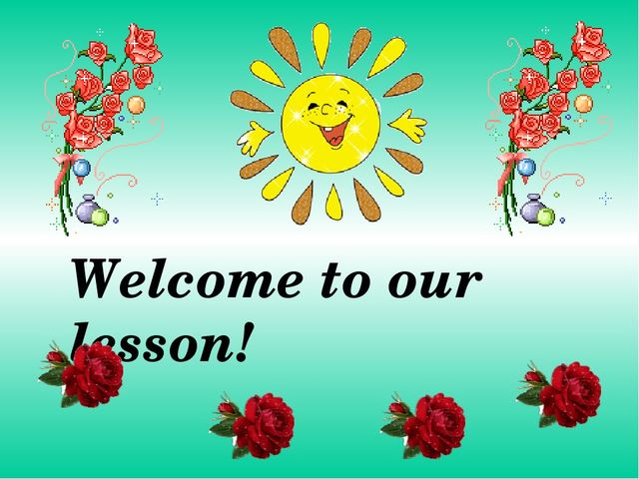

Slide 2
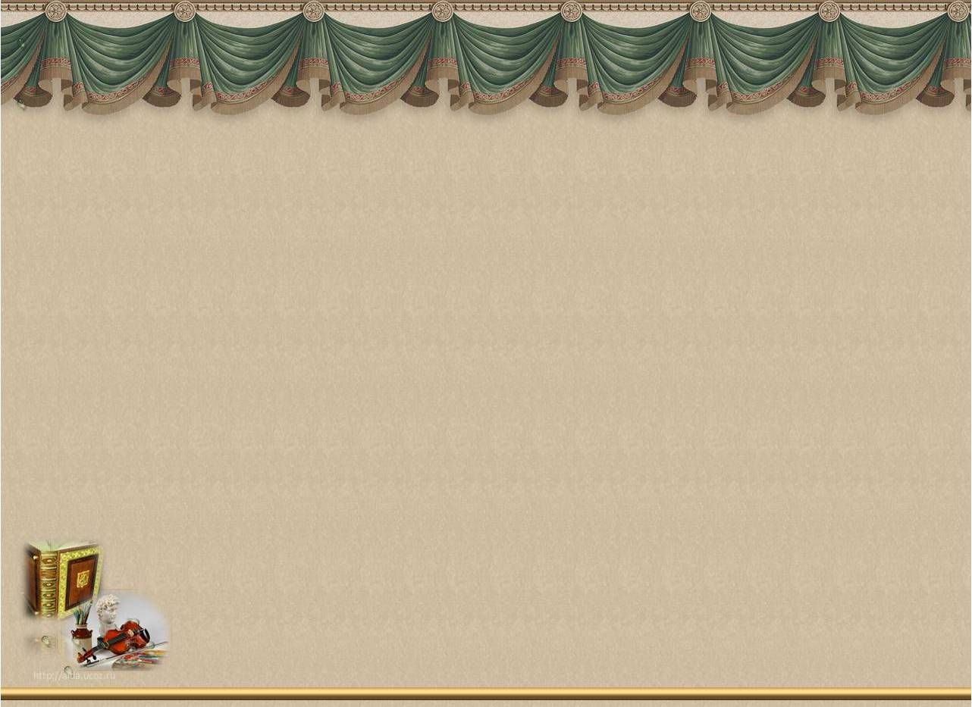
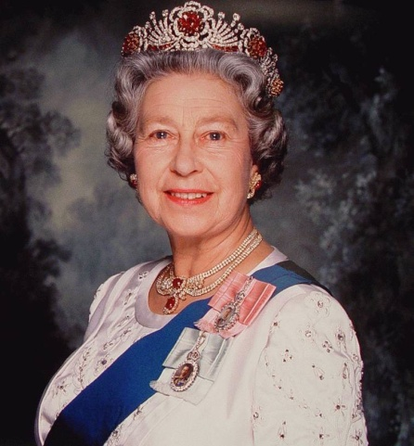
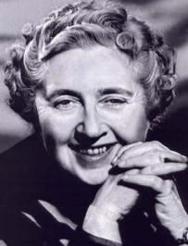
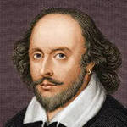
FAMOUS
PEOPLE
Elizabeth II
A. Christie
W.Shakespeare

Slide 3
Aims of the lesson
to present information about famous people of the United Kingdom.
to develop students’ skills in reading, understanding, writing, speaking
bring up to be educated, cultural and kind.

Slide 4
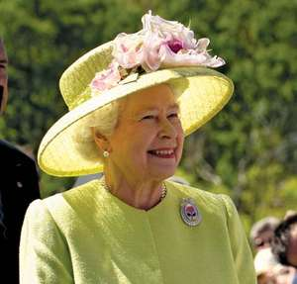
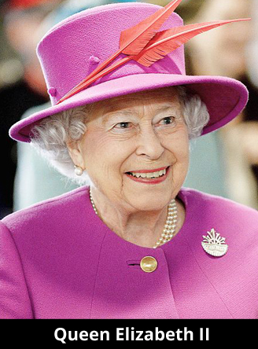
Elizabeth II
Elizabeth Mary Alexandra born in London on 21 April 1926, became Queen Elizabeth II in 1952, and is adored all around the world. She was educated at home. She can speak French.
In 1947 she married Prince Philip and they have four children, Prince Charles, Princess Anne, Prince Andrew and Prince Edward, and eight grandchildren.
She is the first ever British monarch to celebrate a Diamond wedding anniversary.

Slide 5
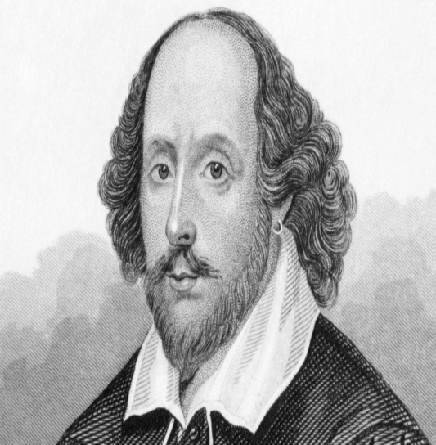
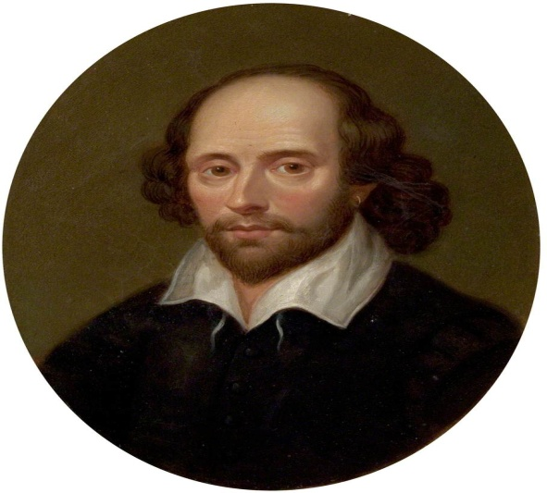
William Shakespeare
William Shakespeare was born in Stratford-upon-Avon on 23 April 1564. Shakespeare was a famous British poet and playwright.
His father was John Shakespeare, a craftsman and trader. William went to a grammar school.
In 1582 Shakespeare married Anne Hathaway. Their daughter Susanna was born in 1583 and two years later Anne gave birth to twins, Hamnet and Judith.
In 1585 Shakespeare left his hometown and moved to London. Shakespeare died in Stratford on 23 April 1616.

Slide 6
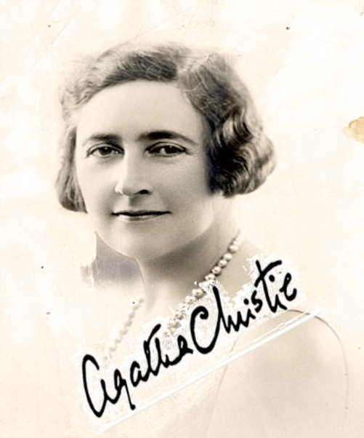
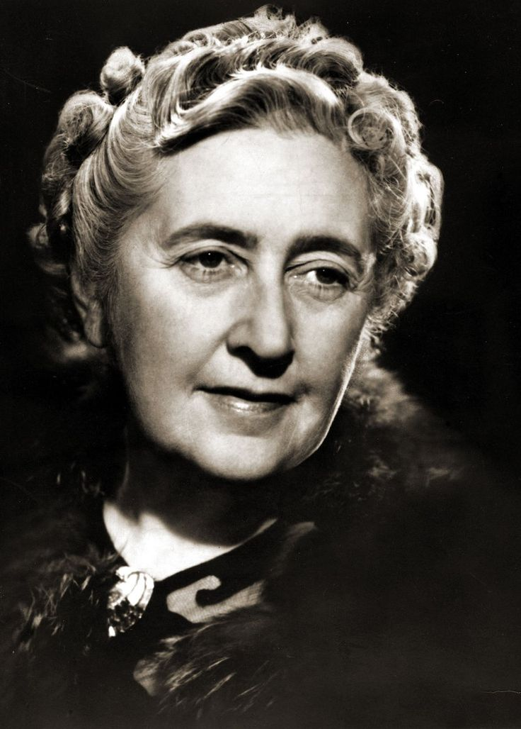
Agatha Christie
Agatha Christie was a famous English writer. She was born on 15 September 1890 in England. She was educated at home. She wrote 78 crime novels, 19 plays and 6 romantic novels. Her books have been translated into 103 foreign languages. Agatha Christie died on January 12th, 1976.

Slide 7
True or False
Elizabeth II was educated at college. ___
She was married Prince Philip in 1947. _____
Her first son is Prince Andrew _____
The Queen has got 5 children. _____
William Shakespeare was born in 23 April 1564 ___
In 1582 Shakespeare married Anne Hathaway ___
Shakespeare was a famous British singer ___
Shakespeare died in Stratford on 23 April 1616 ___
Agatha Christie was a famous English writer ___
She was educated at college___
Her books have been translated into 91 foreign languages___
Christie died on January 12th, 1976___

Slide 8
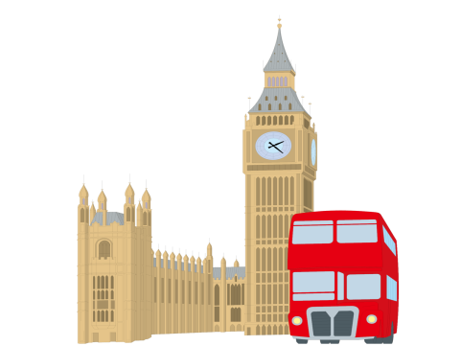
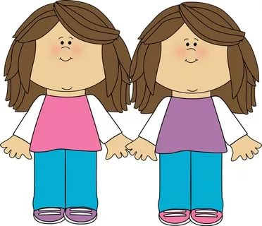
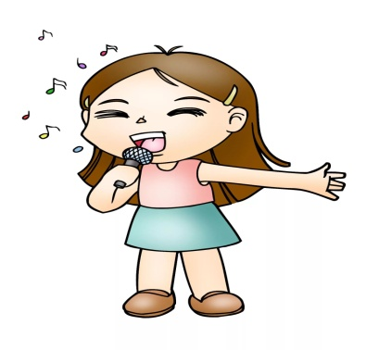
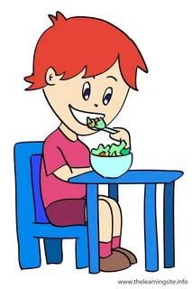
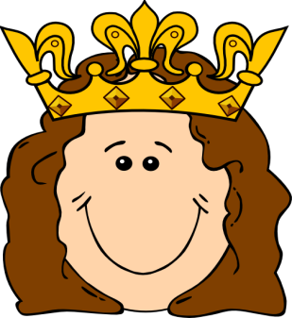
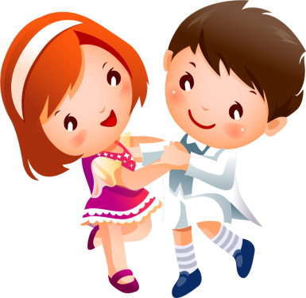
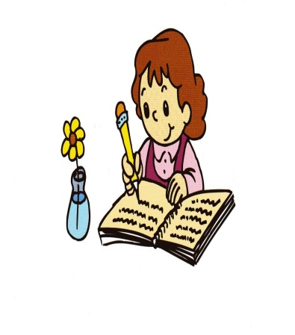
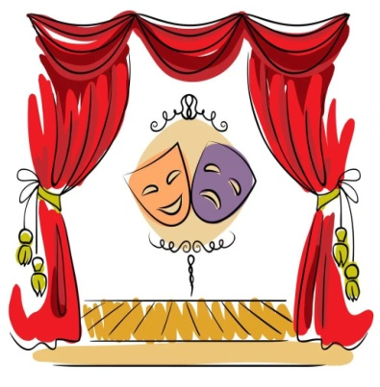
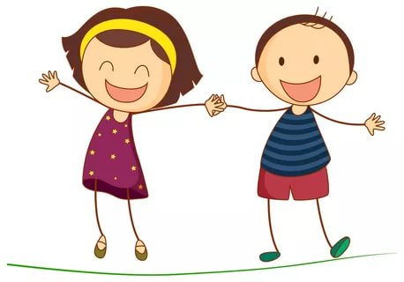
What’s the word?
twins Queen funny eat sing theatre London write dance

Slide 9
Find
the second part of the name
Marco
John
William
Agatha
Charlie
Chaplin
Shakespeare
Christie
Polo
Tolkien

Slide 10
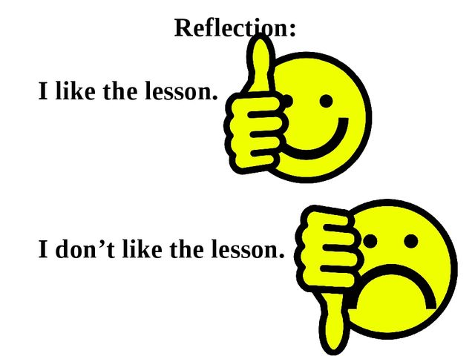

Slide 11
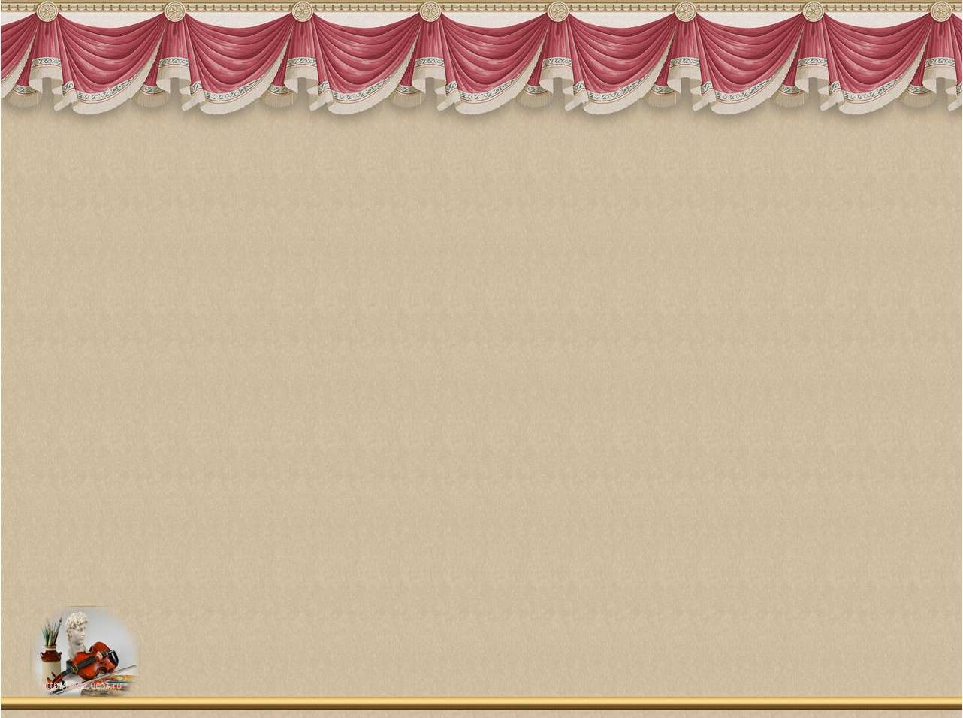

THANKS
FOR YOUR
GOOD JOB!

