Slide 1
The 21st of April
Today is Tuesday
The theme:
Hot
and
cold

Slide 2
Все учащиеся смогут понять название горячей и холодной еды и напитков
Большинство учащихся смогут задавать вопросы и отвечать на них, используя hot и cold
Задачи обучения:

Slide 4
Greeting
Hello, Hello
How are you? How are you?
Hello! Hello!
How are you? How are you!
I am find! I am great! I am wonderful!
I am find! I am great! I am wonderful!
Watch the video

Slide 5
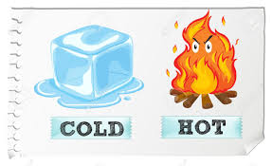

Slide 6
Cold
Ice – cream is cold

Slide 7
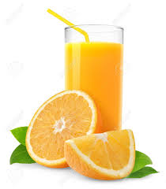
Cold
Orange juice is cold

Slide 8
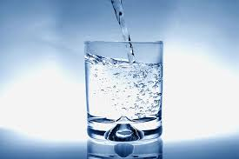
Cold
Water is cold

Slide 9
Cold
Snow is cold

Slide 10
Hot
Soup is hot

Slide 11
Hot
Tea is hot

Slide 12
Hot
Sun is hot

Slide 13
Answer the questions

Slide 14
Is ice – cream cold?
Yes. It is cold

Slide 15
Is soup cold?
No. It is hot

Slide 16
Now, listen a song “Hot and cold”
https://www.youtube.com/watch?v=PvDvLC5vT74

Slide 17
Home work: answer the questions:
Is tea cold?
Is soup hot?
Is water hot?
Is ice-cream hot?
Is sun cold?
Is orange juice cold?

Slide 18
Thank you for the attention
Good buy!
Подведение итогов
Выберите смайлик, который характеризует ваше настроение после урока

