Slide 2
Let’s sing a song!
Let’s sing a song!

Slide 3
Topic:

Slide 4
Learning objectives of the lesson:
1.S1 make basic personal statements and simple statements about objects
1.L1 recognise short instructions for basic classroom routines spoken slowly and distinctly
Recognize at least 1 word of birthday things
NaRecognize at least 1 word of birthday things
Name new words intelligibly
me new words intelligibly

Slide 5
Lesson objectives :
Recognize at least 3 word of birthday things
Name new words intelligibly
understand some factual questions about their age

Slide 6
Presentation of the new words.

Slide 7
CAKE !

Slide 8
Candles!

Slide 9
Balloons!

Slide 10
Presents!

Slide 11
Let’s have a rest!

Slide 12
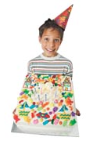
How old are you?

Slide 13
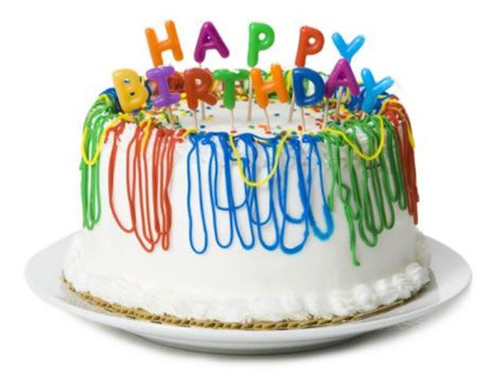
Let’s sing a song!

