Slide 1
Video editing, animation, audio and video effects.
Grade 9 ^{-th}
Kainarov N.M
MS №6 called K.Zhalayir

Slide 2
What color are you today?
I am angry | I am sick | I am indifferent | I am OK | I am great | I am dreaming | I don’t know

Slide 3
What is it?

Slide 4
Learning objectives(s) that this lesson is contributing to
Use Movie Maker (CinemaStudio). Use editing instruments. Know how do film

Slide 5
New terms
Video clips are short clips of video, usually part of a longer recording.
Toolbar (originally known as ribbon) is a graphical control element on which on-screen buttons, icons, menus, or other input or output elements are placed.
Windows Movie Maker (formerly known as Windows Live Movie Maker in Windows 7) is a discontinued video editing software by Microsoft. It is a part of Windows Essentials software suite and offers the ability to create and edit videos.

Slide 6
Use words
Visual effects, Import, Insert, Transition, Shift, Scaling, Brightness, Record

Slide 7
Watch clip
https://www.youtube.com/watch?v=gYiIo9AfHuM

Slide 8
Name instrument (tool)

Slide 9
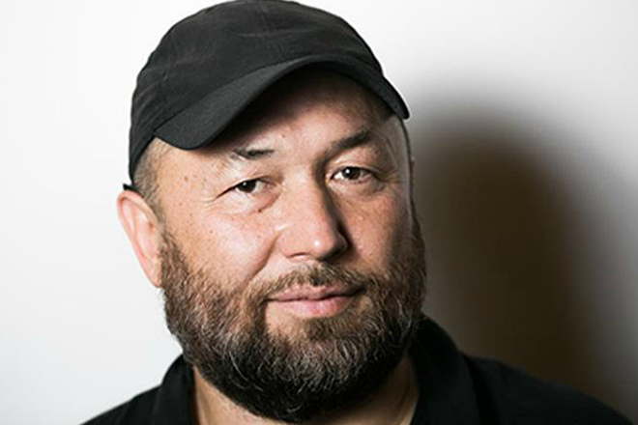
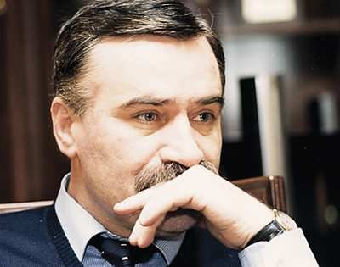
Who are you?

Slide 10
Reflection
3- new words from the lesson
2- adjectives describing the lesson
1-activity from the lesson you like best
Example: Movie Maker, Toolbar, Clip; good, new; creat

Slide 11
Home work
Essay
“I like making clip, because: …”
or
Write some sentences about making clip

