Slide 1

The theme:
Sport

Slide 2

Speaking

Slide 3
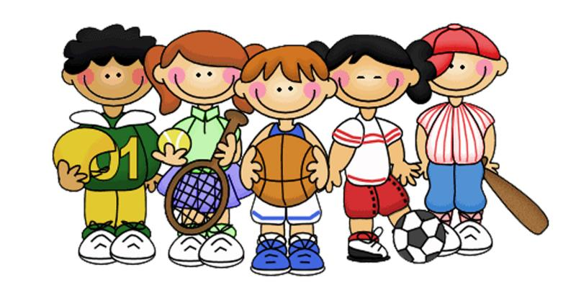
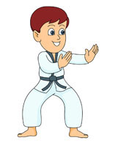
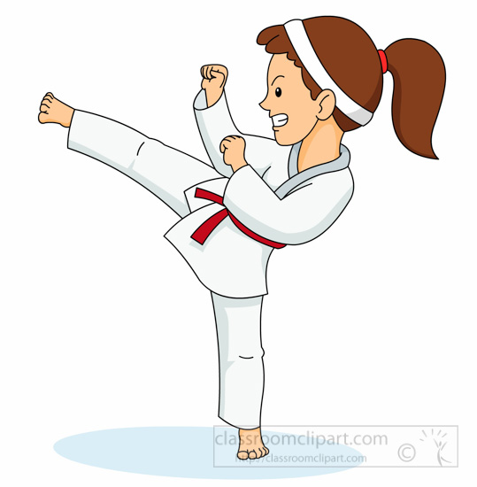

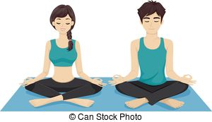

Which sport activities do we
DO/GO/PLAY?

Slide 4
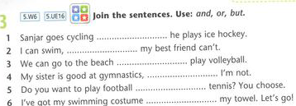
Conjunctions-cоюзы
аnd—и,және
but- но,бірақ
or-или, немесе
we use and to join similar ideas but to join opposing ideas or to link two alternatives
I like tennis and badminton.
He can ski but he cant skate.
She should decide stay or leave.

Slide 5


Slide 6
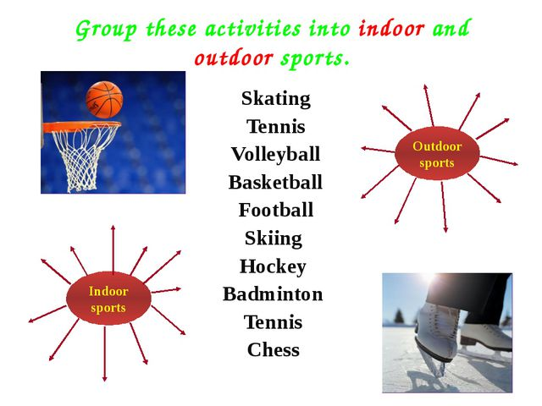

Slide 7
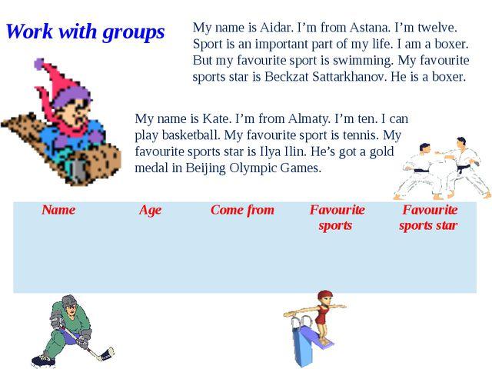

Slide 8



No mistakes-
1-2 mistakes-
3-4 mistakes-
Assessment criteria

Slide 9
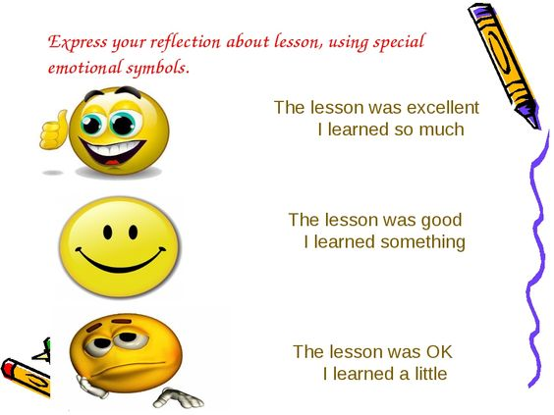
Write on stickers your feedback

Slide 10
Home work:
Write a short essay
My favourite sport

Slide 11


