Slide 1
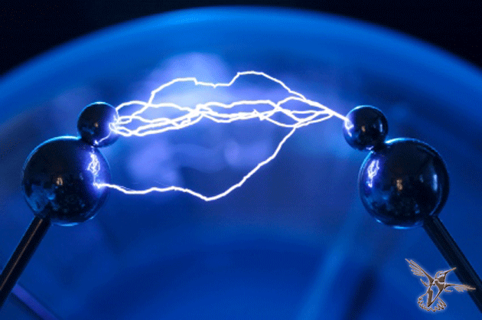
The Road to success

Slide 2
What is the difference between science and technology?
Why does someone become an inventor?
Have you ever invented anything?
Who is It?
Do you know this person?
What do you know about this person?
What did he invent?

Slide 3
+Ышвщш\в0Швь чьы-0Ю_)+ 7.\10/2691а в

Slide 4
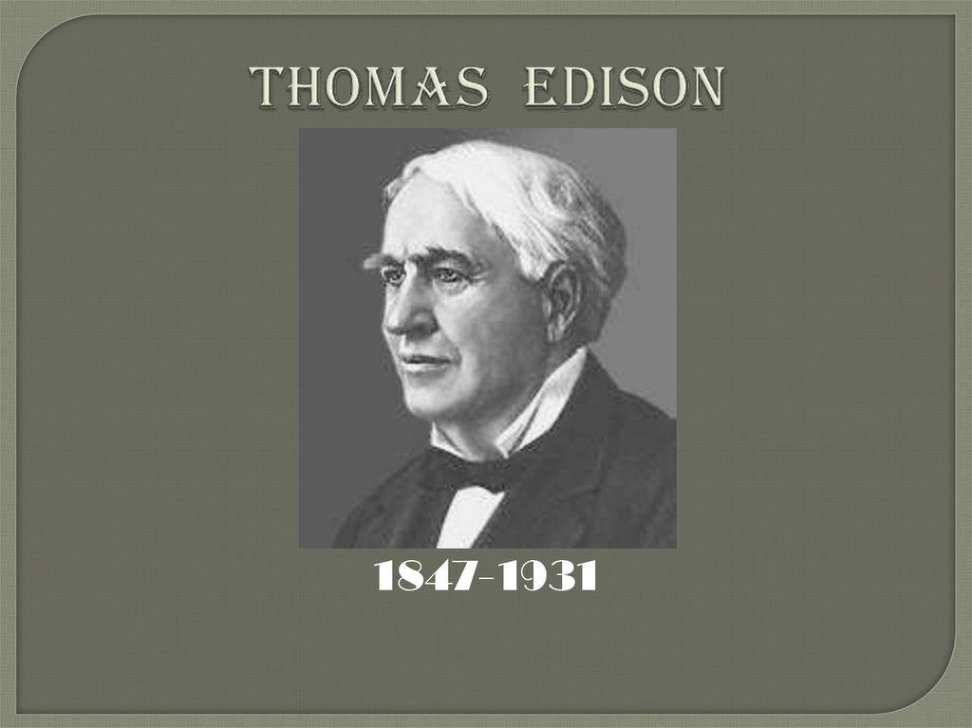
Genius is 1% inspiration and 99% perspiration

Slide 5
Assessment criteria
Can connect words with the pictures
Can answer at least 2-3 questions according to the video
Can explain his/her topic to other groups
Can interact with peers in pairs, groups

Slide 7
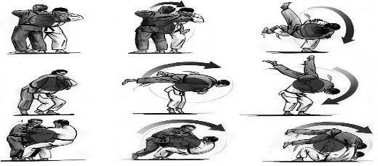
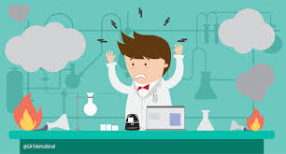
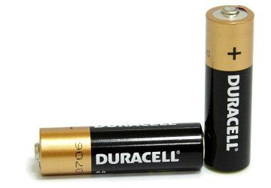
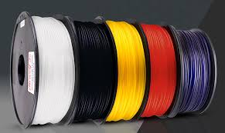
put in the right order
filament
trick
flow
burn up
nap
reach one`s goals undoubtedly
alkaline battery failure push oneself

Slide 18
Thomas Edison was successful. He reached his aims. Edison's greatest strange was that he absolutely refused to give up. He said, “Many of life’s failures are people who did not realize how close they were to success when they give up”
Edison believed in hard work and sometimes worked twenty hours a day
His 1,093 inventions have greatly changed the lives of nearly all people living across the world.
His work includes improving the incandescent electric light bulb and inventing the phonograph and the kinetoscope, or a small box for viewing moving pictures or films.
Thomas Edison competed with Nicola Tesla
Thomas Edison’s best friend was Henry Ford.

Slide 19
Make Poster:
General information
Early Life
Early inventive career
Menlo park
West orange laboratory
Later years
Thomas Edison’s Inventions
The Road to success
The keyword of the text
The phrase of the text
Find the sentence the main of the text
Conclusion
Give your assessment

