Slide 1
Threelingual intellectual game
The leaders of the
XXI
century

Slide 2
Good luck!
New words
10
20
30
40
50
Questions
10
20
30
40
50
Use grammar
10
20
30
40
50
Translate
10
20
30
40
50
Describe the picture
10
20
30
40
50

Slide 3
New words
Causeway
алқап
10
Notes:
3

Slide 4
New words
20
heritage
мұра
Notes:
4

Slide 5
New words
30
Rock balls
Тас доптар
Notes:
5

Slide 6
New words
40
Great battle
Үлкен шайқас
Notes:
6

Slide 7
New words
50
urban
қалалық
Notes:
7

Slide 8
Questions
10
- Where do you live in a village or in a city?
I live in a village
Notes:
8

Slide 9
Questions
30
How does the urban live affects to our live?
It affects bad.
Notes:
9

Slide 10
Questions
20
Why is it useful to live in a village?
Because there is a fresh air in the village.
Notes:
10

Slide 11
Questions
40
How long does it take a plastic bottle to biodegrade?
500-1000 years
Notes:
11

Slide 12
Questions
50
Where does the eco-friendly showerhead get its power from?
It gets its power from water
Notes:
12

Slide 13
Use present perfect
10
I read this book
I have read this book
Notes:
13

Slide 14
Use present perfect
20
She visited her mother
She has visited her mother
Notes:
14

Slide 15
Use past simple
30
I get up at 7 o`clock
I got up at 7 o'clock
Notes:
15

Slide 16
Use present perfect continuous
40
I have watched TV
I have watch been watching TV
Notes:
16

Slide 17
Use present perfect continuous and past simple
50
I was cleaning kitchen when my mother came home.
I have been cleaning kitchen since morning when my mother came
Notes:
17

Slide 18
Translate
10
Everybody buys and uses a variety of products
every day without giving it a lot of thought.
Әркім күнде неше түрлі заттарды оған мән бермей сатып алады.
Notes:
18

Slide 19
Translate
20
My parents are thingking about moving away from the city and going back to nature.
Менің ата-анам қаладан көшіп, табиғатқа оралу туралы ойлап жүр.
Notes:
19

Slide 20
Translate
30
It isn’t known how this balls were created.
Бұл доптардың /тастардың/ қалай пайда болғаны белгісіз
Notes:
20

Slide 21
Translate
40
Power that is prodused using the energy from the Sun, wind, water etc.
Күннің, желдің, судын қуатын пайдалана отырып өндірілетін электр қуаты
Notes:
21

Slide 22
Translate
50
Today the Causeway is a huge tourist attraction.
Осы күндері алқап туристтардың назарында. / тартады/
Notes:
22

Slide 23
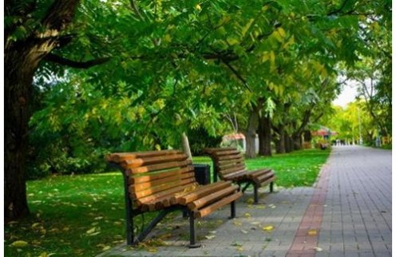
10
Notes:
23

Slide 24
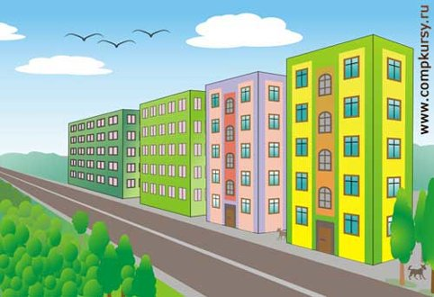
20
Notes:
24

Slide 25
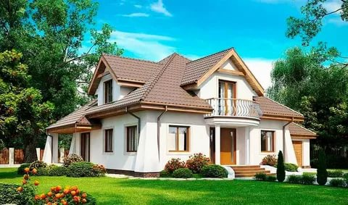
30
Notes:
25

Slide 26
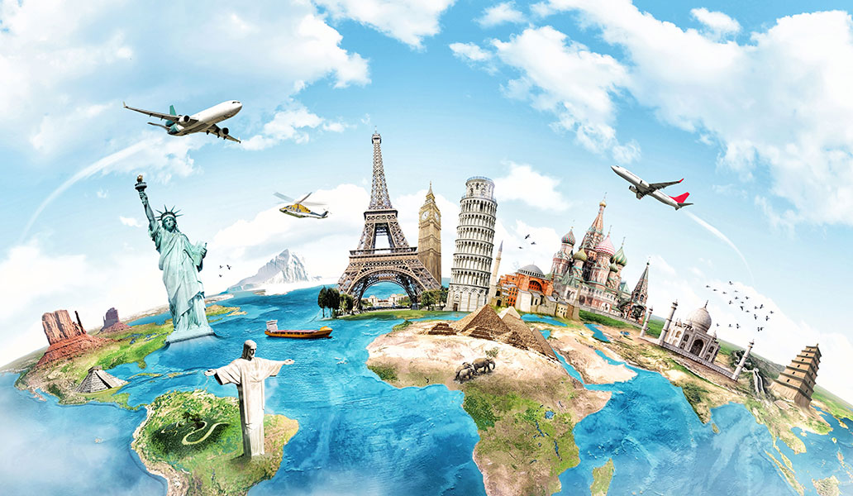
40
Notes:
26

Slide 27
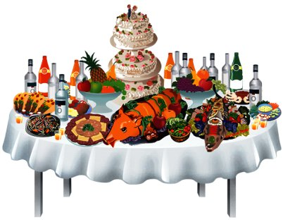
50
Notes:
27

