Slide 1
Make a circle and say your best wishes in the form adjective

Slide 2
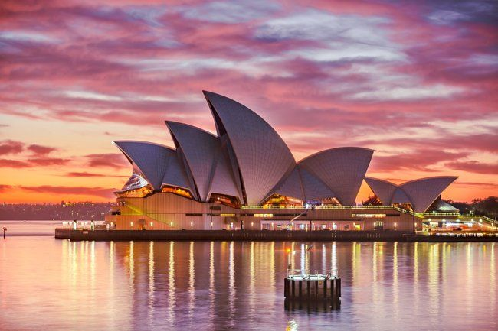
November,7 1.Mysterious photos

Slide 3
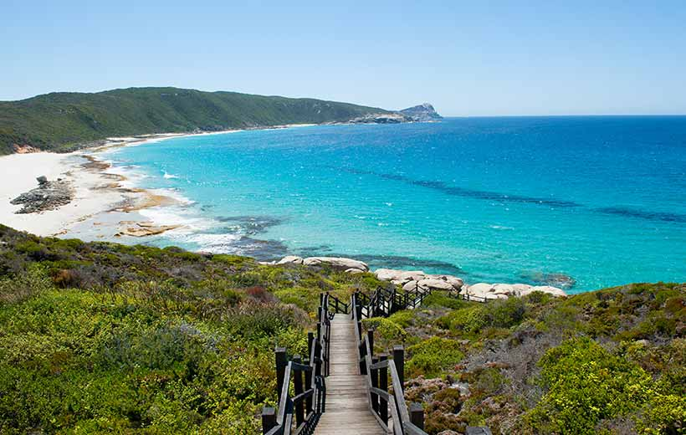
Look at the photos of student’s book page 36. 2.Make a list of images you might see in the video

Slide 4
3.The strange and beautiful land of Australia(video)

Slide 5
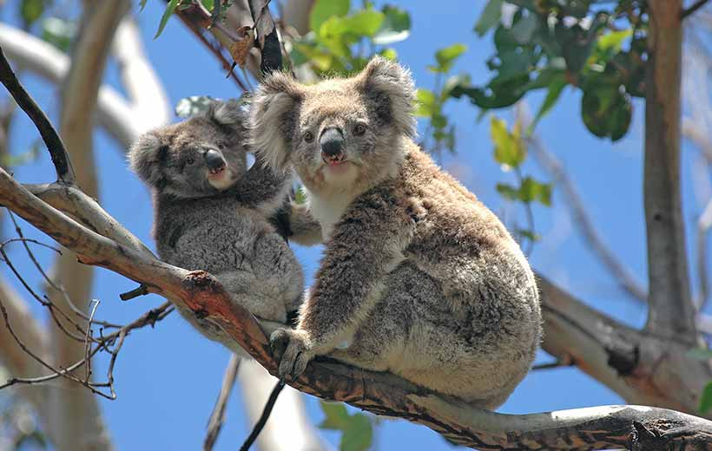
Division into KOALAS and WOMBATS

Slide 6
Name the following notes of Australia
famous places
Animals
sports

Slide 7
4. Pick up and fill in the correct word
Uluru is a giant …………….. near Sydney.
People first brought ……… to Australia in the ……….
In the national park you can see ……., ……. and wombats.
………. shearing is a popular all over the country
Cane ………….are poisonous(yлы)
Australian rules football is very similar to ………….

Slide 8
Match these adjectives with the words in the video
Confusing Unusual Famous Poisonous
Uluru
Camel racing
Toads
Australian rules football

Slide 9
The strange and beautiful land of Australia
Aiman Duisekova
&
7 A form

