Slide 1
^{12th}
^{Friday}

Slide 2
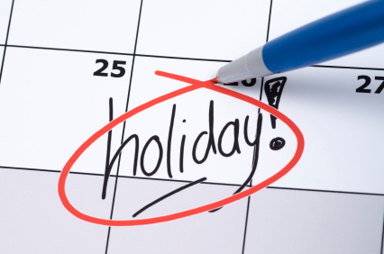
LESSON OBJECTIVES
Read the text and complete the table
Write a story in 20-40 words

Slide 3
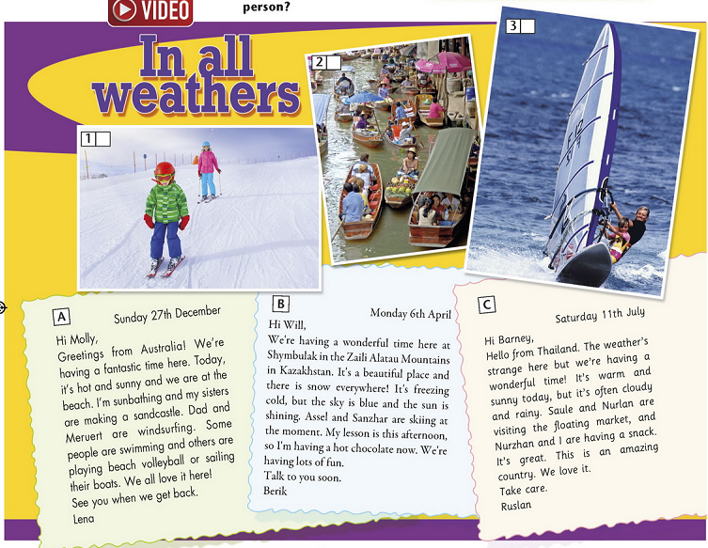

Slide 4
A floating market

Slide 5
Write about your favourite season
Criteria:
Write 20-40 words.
Use Present Simple tense
Use 3-5 new words
Use connectors and, or, but, also.

Slide 6
Reflect, Revisit Learning Goals
What new words did you learn today?
What new information did learn from the text?
What do you like/not like about the lesson? Why?
Have you achieved the learning goals today?

Slide 7
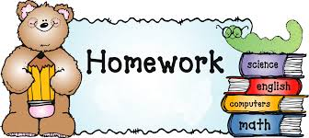
Revise words for quiz (p 66 SB)
Ex. 1-4, p 67 WB

