Slide 1
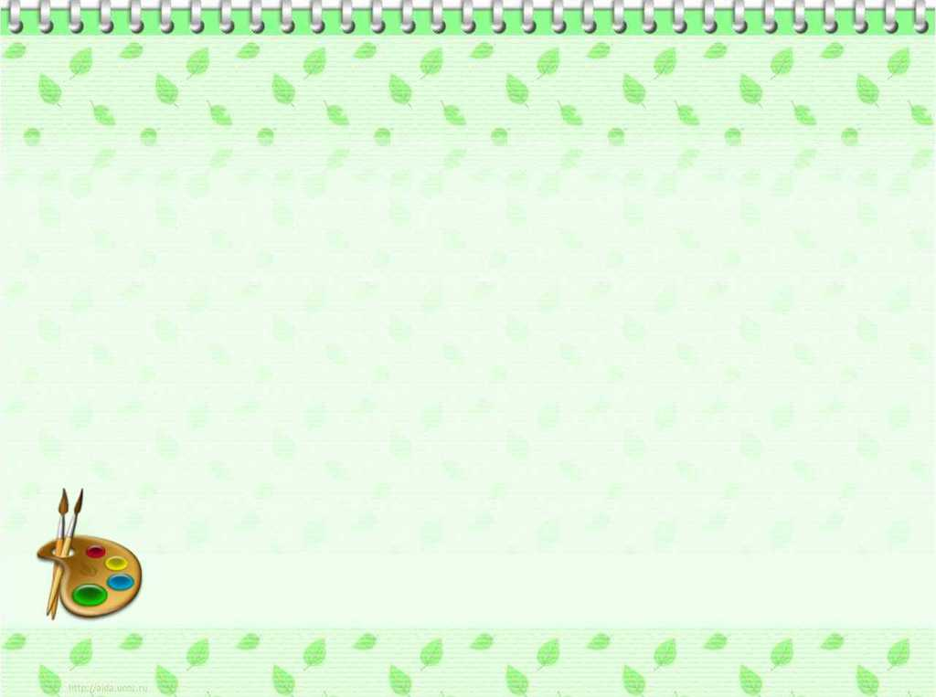
to our lesson!

Slide 2
Alatau region, School 180
Grade 7
Unit 8. Healthy habits
Reading and discussing the texts.
Creating the questions for interviewing the classmates.
Planned by Zhumabekova L.M.

Slide 3
LESSON OBJECTIVES
Learners will be able to:
understand the meaning of the words to match them with definitions;
recognize the main point of the text to give correct answer;
identify incoherence in arguments in short, simple texts;
discuss the questions to formulate the main idea ;

Slide 4
Assessment criteria
understand the main idea to give correct answer in simple text on general topic;
take part in discussing and solving problems in groups and pairs to create the questions;

Slide 5
Working with new vocabulary
1. prescription [prɪˈskrɪpʃən] | рецепт
send away [sɛnd əˈweɪ] | қайтарып жіберу
get good grades [get ˈgʊd [greɪdz] | жақсы баға алу
4 unpleasant [ʌnˈplɛznt] | жағымсыз
5. complain of [kəmˈpleɪn ˈɒv] | шағымдану
6. processed food [ˈprəusɛst ˈfuːd] | өңделген тағам

Slide 6
Answer keys:
1. prescription | a. unfriendly
send away | b. contains more than one item on the list of ingredients
get good grades | c. state that one is suffering from (a pain
4 unpleasant | d. drive away, banish
5. complain of | e. an instruction written by a doctor
6. processed food | f . get good ratings

Slide 7
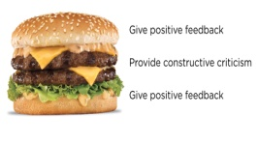
Feedback: with strategy “Sandwich”
1 complement
1 suggestion
1 complement.

Slide 8
Answer keys:
Task 2: 1.D; 2.B; 3.E; 4.C; 5.A.
Task 3: 1.F; 2.T; 3.F; 4.F; 5.T.

Slide 9
Feedback:
Teacher will evaluate learners answers with stars:
a yellow star for every correct answer;
a green star for partly correct answer;
a red star for incorrect answer

Slide 10
Task 4. Work in pairs
Creating the questions for interviewing the classmates
Differentiation by ability:
For more able students to compose an interview about healthy lifestyle

Slide 11
Feedback: Grоups evаluate each other by putting their thumbs up/dоwn and explаіn the reasons usіng sіmple lаnguаgе. Your answеr is good. I likе/I don’t likе ...

Slide 12
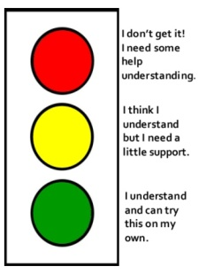
Reflection
Traffic light

