Slide 1
College of our world
“Өзін-өзі тану” АҮД гуманитарлық колледжі
Group: KBA-103
Group members: Kuderinova Ayazhan, Kaizhan Adema, Bakai Akbota, Erzhankyzy Akerke

Slide 2
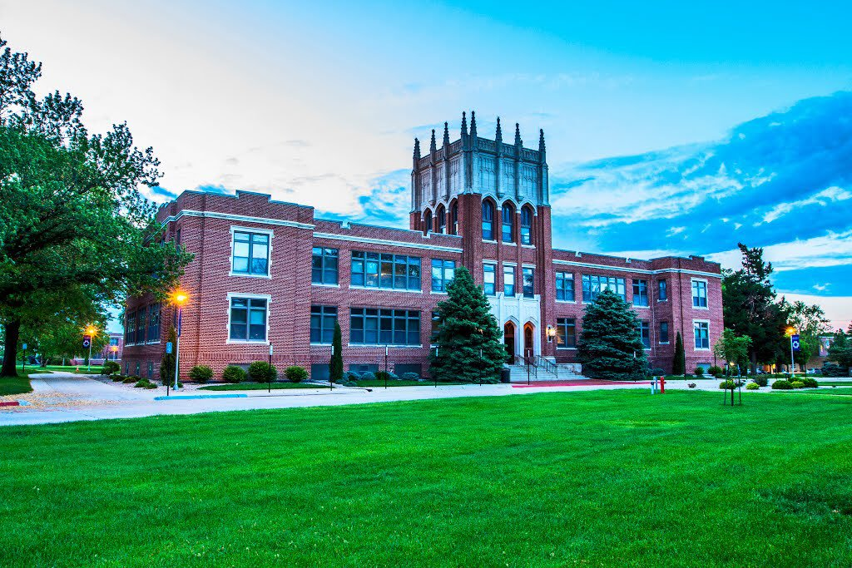
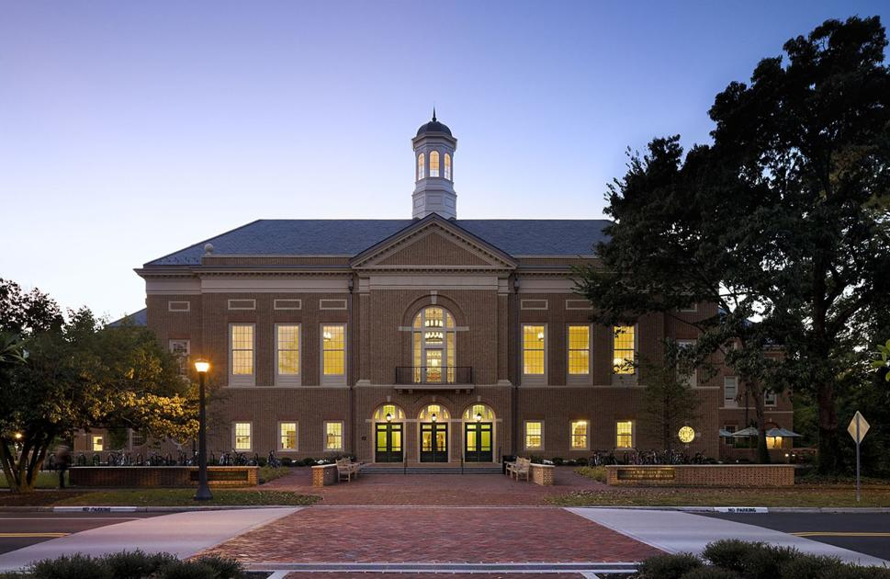
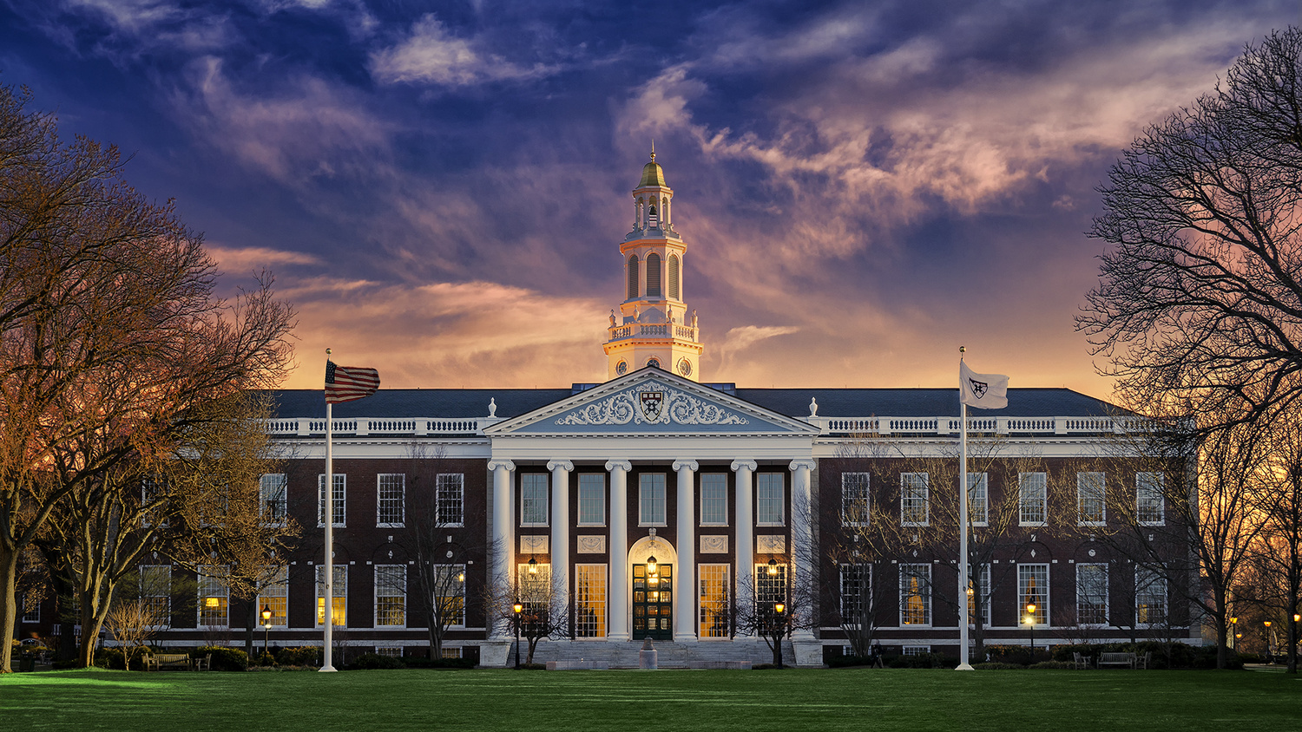

Slide 3
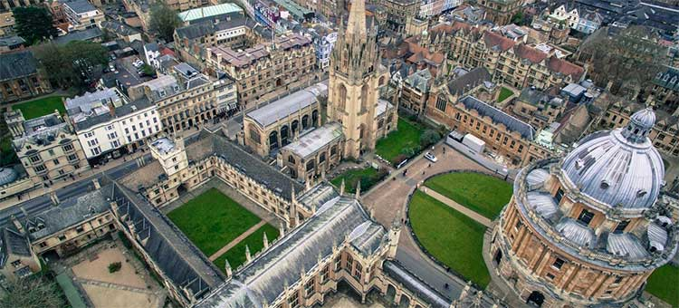
TOP 5 college of world

Slide 4
Pomona college
Pomona College is a private liberal arts college in Claremont, California. It was founded in 1887 by a group of Congregationalists who wanted to recreate a "college of the New England type" in Southern California, and in the 1920s, it became the founding member of the Claremont Colleges consortium.
Pomona is a four-year undergraduate institution, and enrolled approximately 1,700 students representing all 50 U.S. states and 63 countries as of fall 2018. The college offers 48 majors and 600 courses, though students have access to nearly 2000 additional courses at the other Claremont Colleges. The college's 140-acre (57 ha) main campus is in a residential community near the foothills of the San Gabriel Mountains.

Slide 5
Williams college
Williams College is a private liberal arts college in Williamstown, Massachusetts. It was established in 1793 with funds from the estate of Ephraim Williams, a colonist from the Provinceof Massachusetts Bay who was killed in the French and Indian War in 1755.
Williams is on a 450-acre (1.8 km²) campus in Williamstown, in the Berkshires in rural northwestern Massachusetts. The campus contains more than 100 academic, athletic, and residential buildings.There are 357 voting faculty members, with a student-to-faculty ratio of 7:1. As of 2018, the school has an enrollment of 2,020 undergraduate students and 54 graduate students.The college competes in the NCAA Division III New England Small College Athletic Conference, and competes in the conference as the Ephs. The athletic program has been highly successful, as Williams College has won 22 of the last 24 College Directors' Cups for NCAA Division III.

Slide 6
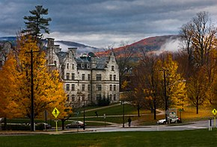
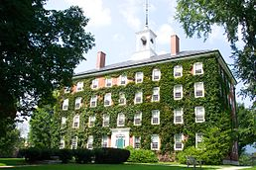
The college
Williams' Campus.

Slide 7
Amherst college
Amherst College is a private liberal arts college in Amherst, Massachusetts. Founded in 1821 as an attempt to relocate Williams College by its then-president Zephaniah Swift Mooe, Amherst is the third oldest institution of higher education in Massachusetts. The institution was named after the town, which in turn had been named after Jeffery, Lord Amherst, Commander-in-Chief of British forces of North America during the French and Indian War. Originally established as a men's college, Amherst became coeducational in 1975.
Amherst has historically had close relationships and rivalries with Williams College and Wesleyan University, which form the Little Three colleges. The college is a member of the Five College Consortium, which allows its students to attend classes at four other Pioneer Valley institutions: Mount Holyoke College, Smith College, Hampshire College, and the University of Massachusetts Amherst.

Slide 8
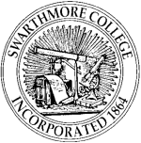
Swarthmore college
Swarthmore College is a private liberal arts college in Swarthmore, Pennsylvania. Founded in 1864, with its first classes being held in 1869, Swarthmore was one of the earliest coeducational colleges in the United States. It was established to be a college "...under the care of Friends, at which an education may be obtained equal to that of the best institutions of learning in our country.“ By 1906, Swarthmore had dropped its religious affiliation and became officially non-sectarian.

Slide 9
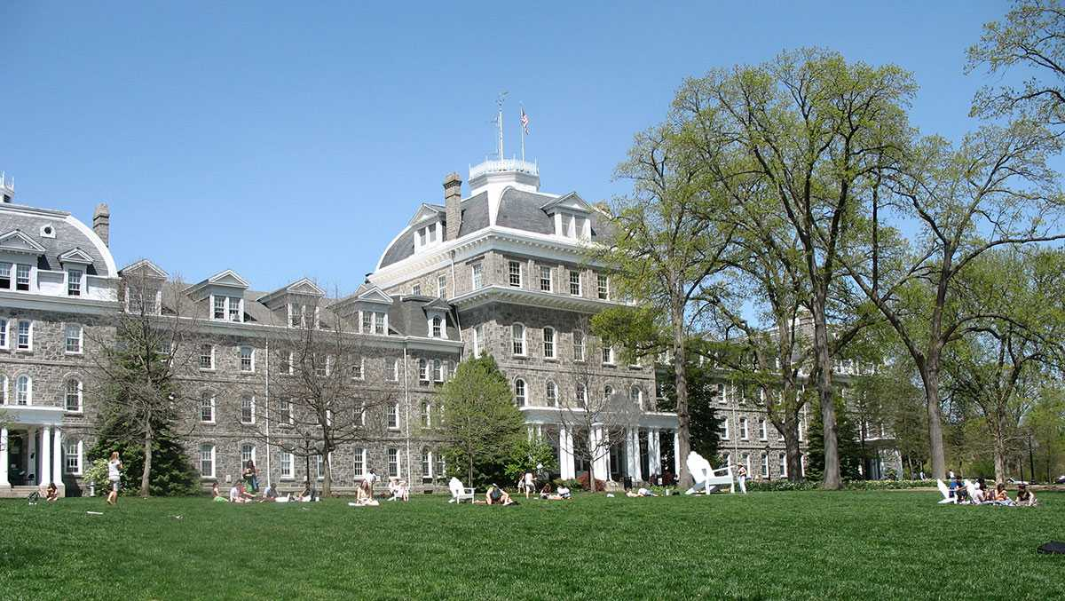

Slide 10
Dartmouth college
Dartmouth College is a private Ivy League research university in Hanover, New Hampshire, United States. Established in 1769 by Eleazar Wheelock, it is the ninth-oldest institution of higher education in the United States and one of the nine colonial colleges chartered before the American Revolution. Although founded as a school to educate Native Americans in Christian theology and the English way of life, Dartmouth primarily trained Congregationalist ministers throughout its early history before it gradually secularized, emerging at the turn of the 20th century from relative obscurity into national prominence.

Slide 11
