Slide 1
School №50 named after A. Baitursynov
THE TWENTY SEVENTH OF FEBRUARY
HOME AND GARDEN
Grade: 5'B’
Sugiraliyeva Dinara Erkinovna

Slide 2
BEDROOM
KITCHEN
LIVING ROOM

Slide 3
GOOD AFTERNOON!!!
Warm up: Garden song
https://www.youtube.com/watch?v=RCClYcU97PA

Slide 4
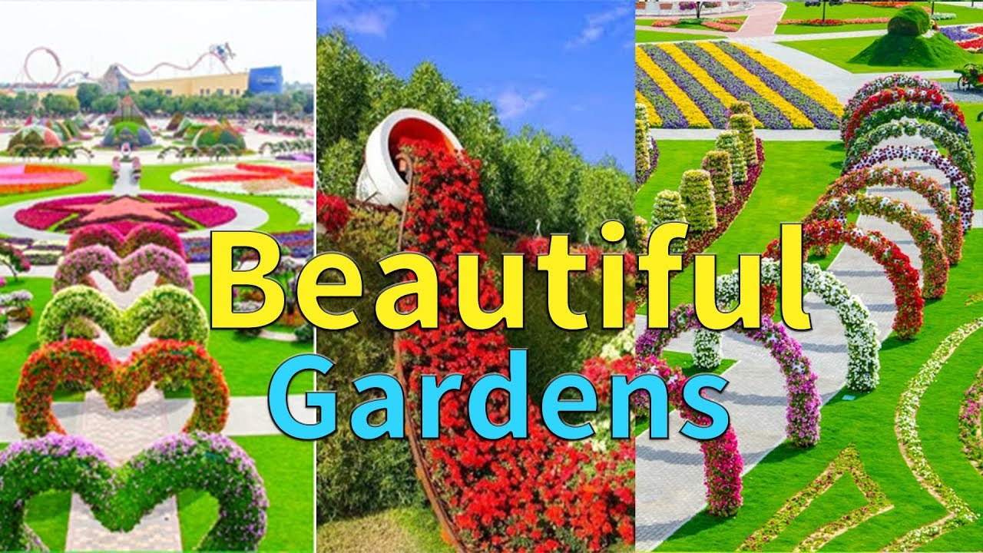
“Beautiful gardens of the world”
Group 1 has to name only nouns
Group 2 has to name only adjectives
Group 3 has to name only verbs

Slide 5
WHICH WORD IS ODD???
TV – BATHROOM – KITCHEN – STAR – TABLE
CHAIR – CAT – GARDEN – DINING ROOM – WARDROBE
CARPET – ARMCHAIR – BALL – DISHWASHER – WINDOW
BED – RIVER – PILLOW – CUPBOARD – MICROWAVE OVEN
FRIDGE – SOFA – BEDROOM – TEACHER - LAMP

Slide 6
MAGIC BOX

Slide 7
LISTENING
https://www.youtube.com/watch?v=gDlRiD739Uc

Slide 8
SPEAKING
1.Flower [flauә] n - the coloured part of a plant from which the seed or fruit develops
Example: a beautiful flower
2. Garden [ga:dn] n – a piece of land next to or around your house where you can grow flowers, fruits, vegetables, etc, usually with a lawn.
Example: Children playing in the garden.
3. House [haus] n – a building for people to live in usually for one family.
Example: He went into the house.
4. Neighbour [neibәr] n – a person who lives next to you or near you.
Example: We’ve had a lot of support from all our friends and neighbours.
5. Colour [kлlәr] n – the appearance that things have that results from the way in which they reflect light.
Example: Red, orange and green are colours.

Slide 9
bedroom
Read the text and draw the picture
kitchen
Make up dialogue
living room
Describe the picture of the garden

Slide 10
ASSESSMENT
Group Assessment Sheet
Criteria of an estimation (0-5) | Name of the students in the group
“Beautiful gardens of the world”
“Magic box”
Listening
Group work
Total points
15-20= «5»
10-15= «4»
5-10= «3»

Slide 11
REFLECTION
Balcony - I have known much information.
Window - I have understood much information.
Door - Today some questions were not clear for me.

Slide 12
to make up sentences with
at, in, on, behind, between, in front of, near, next to, opposite, above, up, down;
to describe and design rooms and gardens;
to speak about the garden and home;
Today we learn

Slide 13
HOMEWORK
draw a picture of your magic garden.

