Slide 1
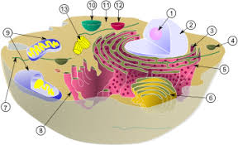
Cell division types
Performed: Akhmedyanova Bakhytzhan Oralovna

Slide 2
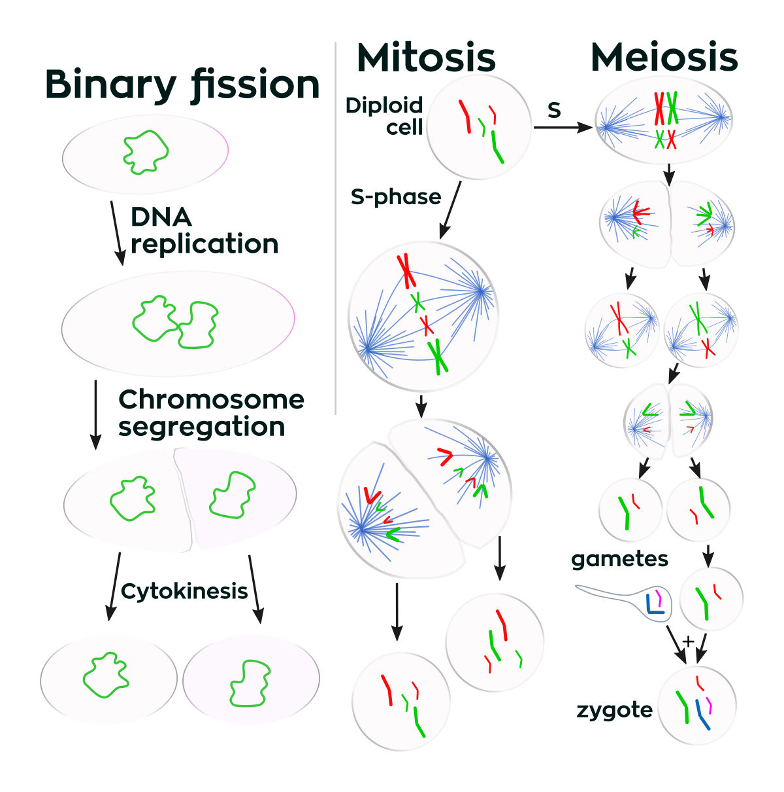
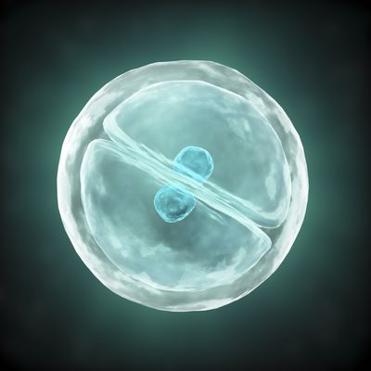
Cell division types
(UK- /sel dɪˈvɪʒ.ən/)
(UK- /taɪp/)

Slide 3
Aim:
- explain the importance of mitosis and meiosis for growth and development of plants and animals

Slide 4
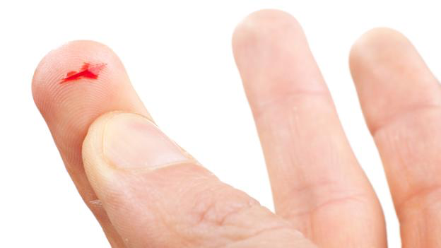
Imagine you cut your skin. After some time this wound is healed. What happens during this healing process?

Slide 5
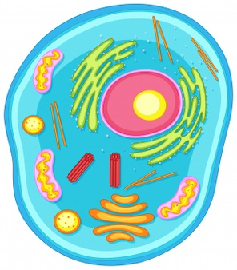

Slide 6
Egg cell
Sperm cell
Haploid
Diploid
Injury
Cancer cell
Genetic information
Division
Reproduction
Heal
Chromosome
Regeneration
Pronunciation 3 TIMES

Slide 7
Egg cell
Sperm cell
Haploid
Diploid
Injury
Cancer cell
Genetic information
Division
Reproduction
Heal
Chromosome
Regeneration
Translation

Slide 8
Match words
1-Dividing groups
2-Match words with pictures

Slide 9
Key terms
Mitosis - division of cell into two identical cells, each containing the same number of chromosome.
Meiosis - division of cell, resulting in four cells, each containing half number of chromosome.

Slide 10
Skin cells divide by mitosis and close the wound.

Slide 11
Pre video questions
Why organisms need mitosis?
2) Why organisms need meiosis?

Slide 12
Video
http://tiny.cc/celldivisionlong

Slide 13
Post video questions
How many cells formed from mitosis?
2) How many cells formed from meiosis?
3) What is the cell cycle?

Slide 14
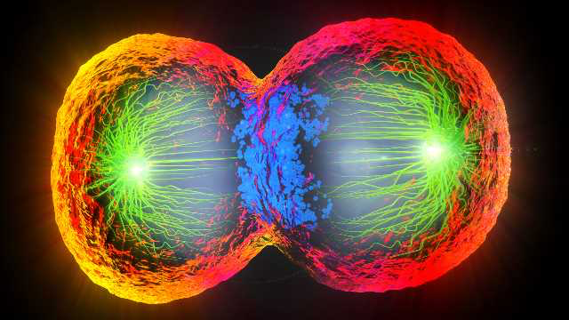
Cell division is the process of formation of new cells. Before cell division a cell grows, prepares needed materials and stores energy.
Chromosomes are structures inside the nucleus, which contain genetic information. Body cells have two times more chromosomes than reproductive cells.

Slide 15
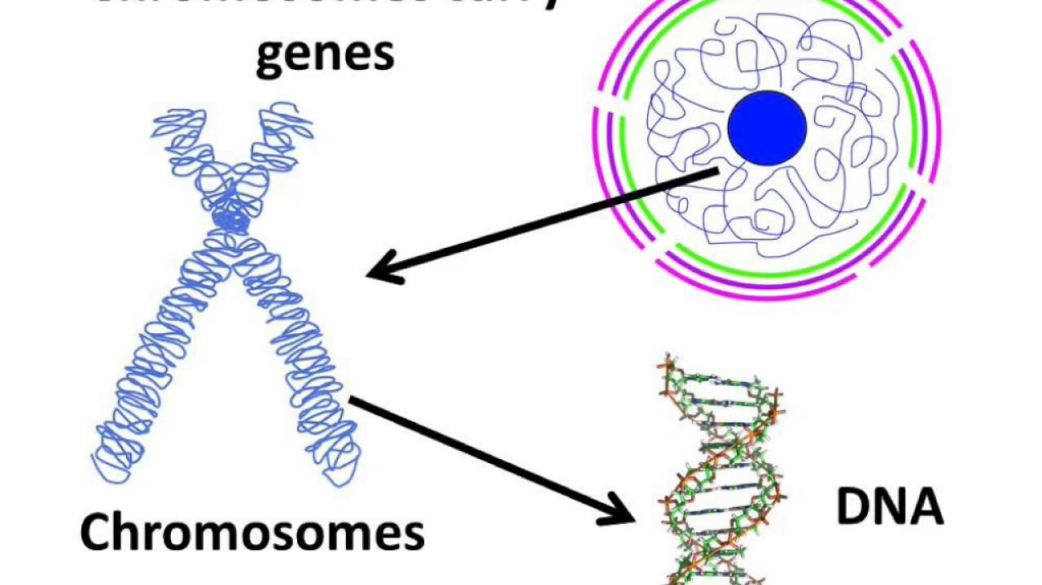

Slide 16
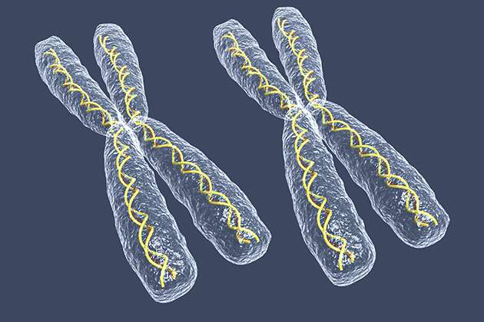
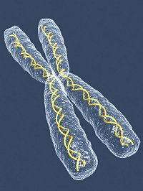
Reproductive cells have n number or haploid chromosomes. Body cells have 2n number or diploid chromosomes. In human skin cell there are 46 (2n) chromosomes, sperm cell 23 (n); in dog liver cell there are 78 (2n) chromosomes, egg cell 39 (n).
There are two types of cell division: mitosis and meiosis.
Diploid
Haploid

Slide 17
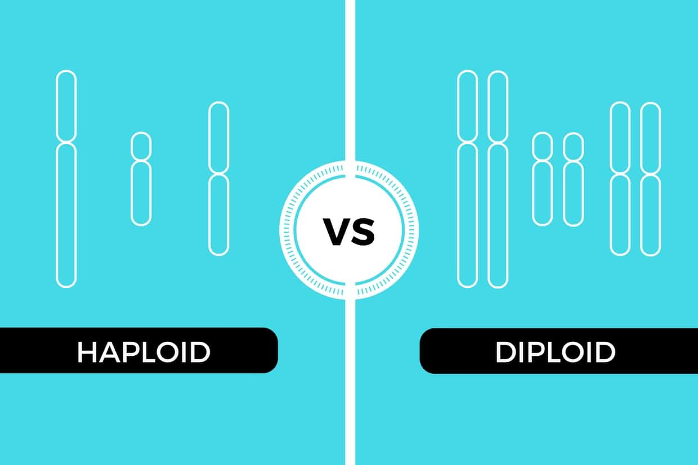

Slide 18
Mitosis is a process when one diploid cell (2n) divides and forms two identical diploid cells (2n). Newly formed cells are known as daughter cells.
Mitosis occurs in body cells. By mitosis organisms grow, repair body parts and reproduce asexually.

Slide 19
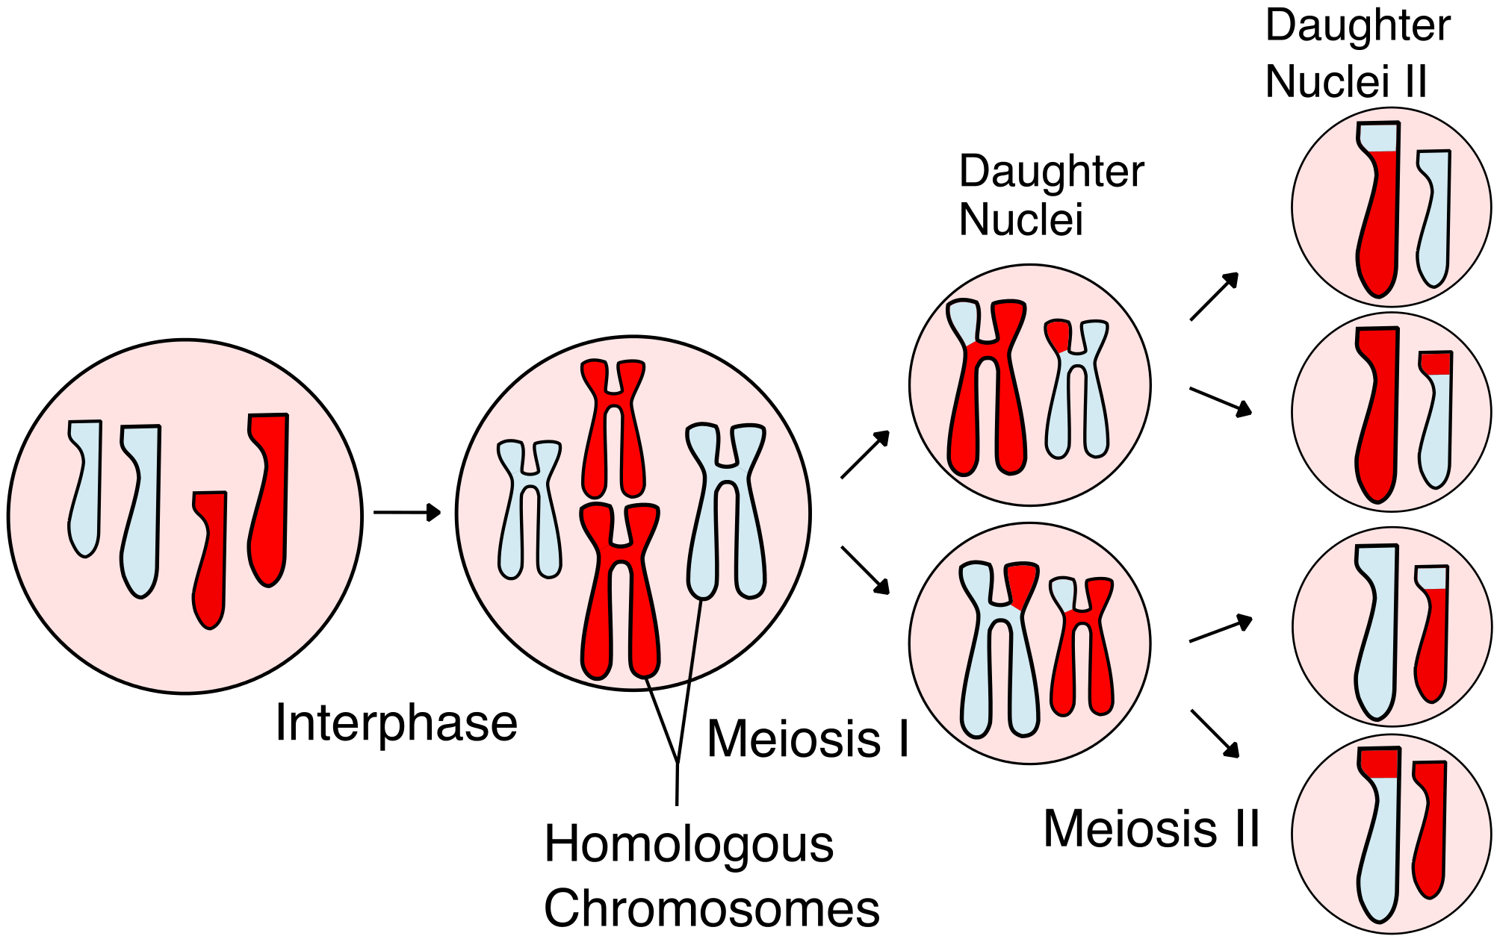
Meiosis occurs only in reproductive cells. During meiosis diploid cell divides two times and forms four haploid cells. Two divisions are meiosis I and meiosis II. By meiosis sperm and egg cells are produced.

Slide 20
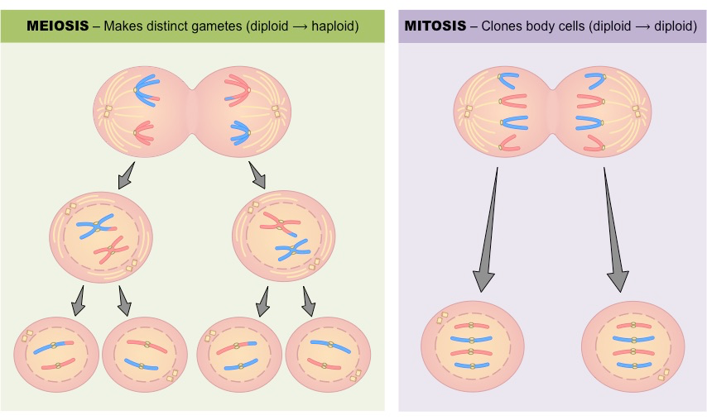

Slide 21
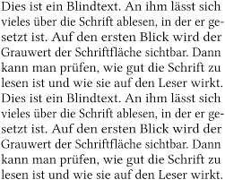
Text-based activity
Dividing into groups

Slide 22
Extra Videos
http://tiny.cc/mitosismake
http://tiny.cc/mitosissong

Slide 23
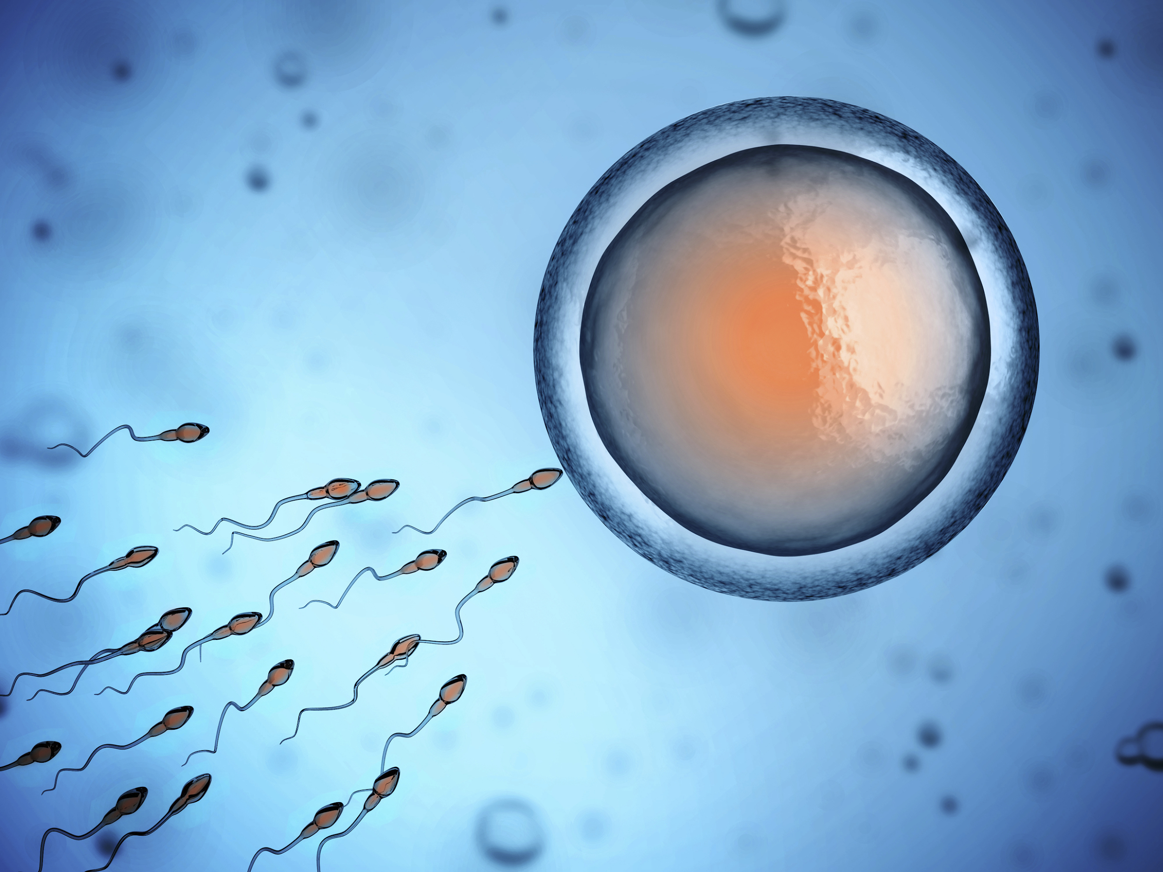
Sperm and egg cells are produced by meiosis

Slide 24
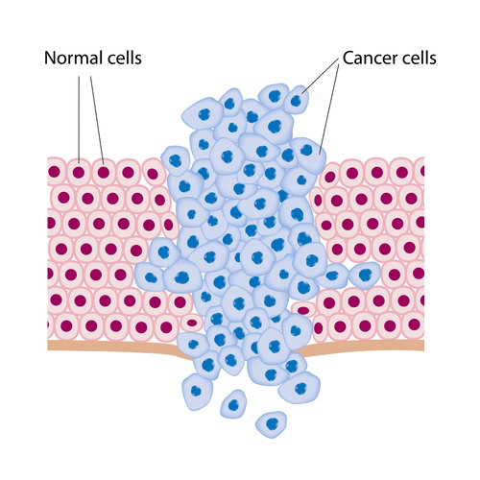
Interesting facts
Body cells grow, divide and die orderly. This process is regulated and controlled by the DNA. Cell division helps an organism to grow and regenerate injuries. When cells start to divide out of control, they may become cancerous. Cancer cells do not die. They divide constantly and consume a lot of energy.

Slide 25
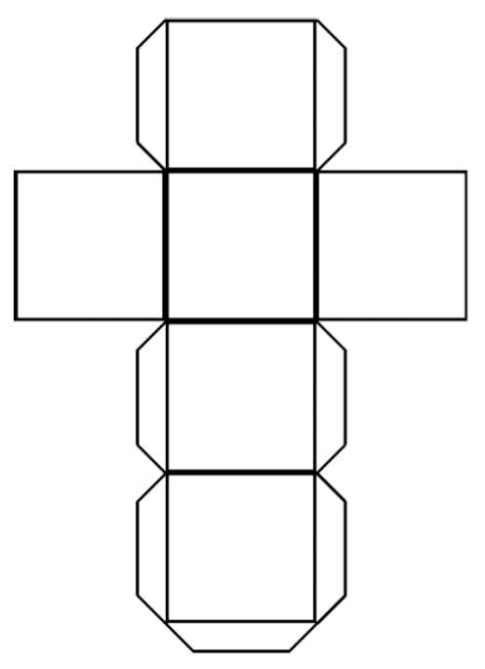
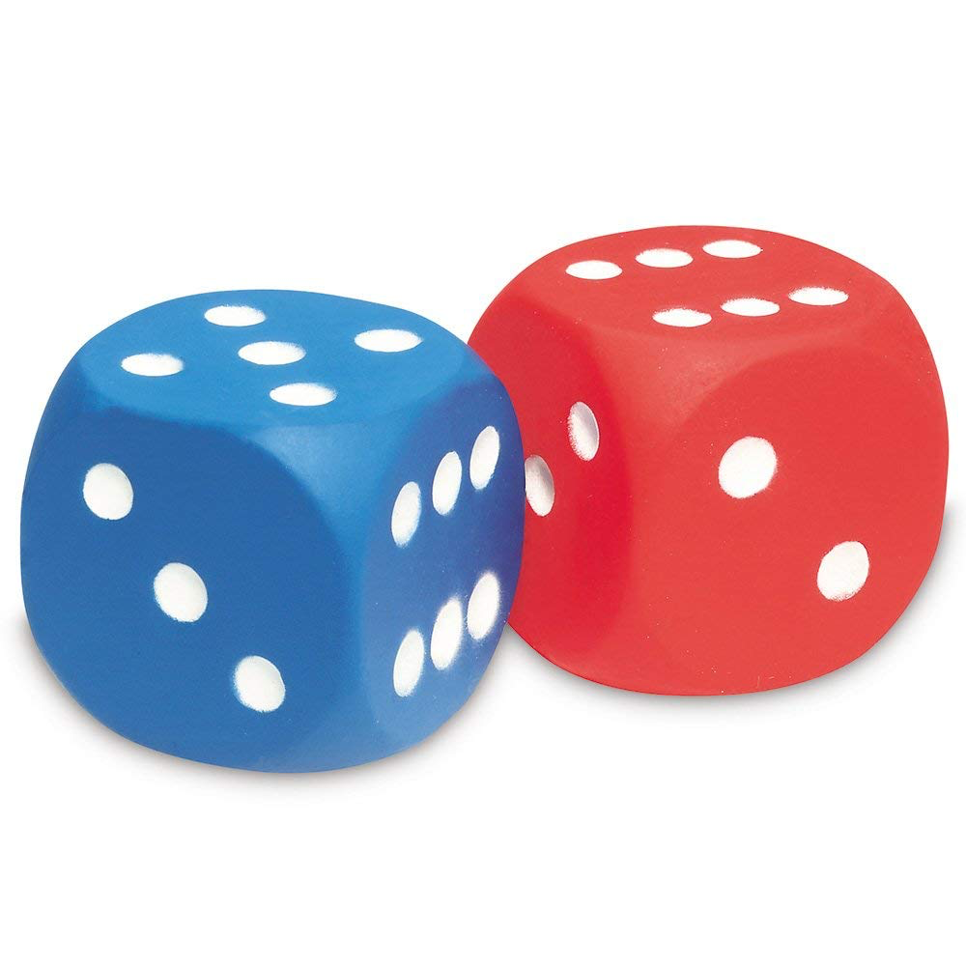
Activity - Let’s play dices
Use a paper to make cubes shown below. Write words on the paper and fold it.
Now throw dices and do the action on cube-1 to explain word on cube-2 that falls to you.

Slide 26
Literacy
1. What occurs if reproductive cells are formed by mitosis? Explain.
2. Why is regeneration not done by meiosis?
3. Cells formed by mitosis are known as daughter cells. Explain why?

Slide 27
Math in Biology
If a cell fully divides in 30 minutes, how many cells will be produced from one cell in 12 hours?

Slide 28
Answer is...
….not 24
answer is -
24
2

Slide 29
Crazy Question!!!
Жасуша ішінде бірінші не пайда болды? ДНҚ немесе ДНҚ синтездейтін Ақуыз ба?
Что появилось в клетке первым ДНК или Белок синтезирующий ДНК?

Slide 30
Home work
Research scientific materials and write a 150-200 words essay on topic: “What would be if there wasn’t any mitosis in life?”

Slide 31
Crazy Question Anwer!!!
Жасуша ішінде бірінші не пайда болды? ДНҚ немесе ДНҚ синтездейтін Ақуыз ба?
They must synthesized in the same time, because they create each other.
Что появилось в клетке первым ДНК или Белок синтезирующий ДНК?

