Slide 1
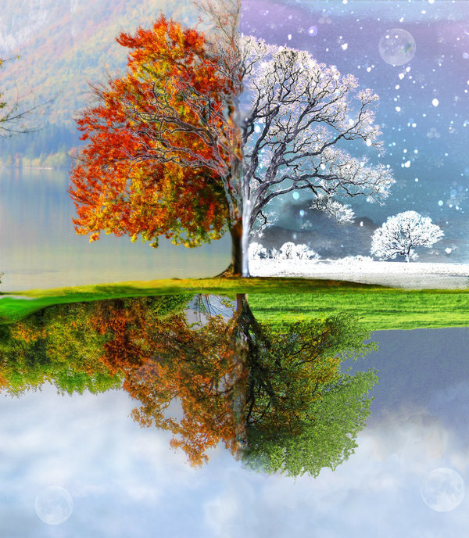
The theme of the lesson: Changing seasons
School: № 4
Form: 2
Teacher: Bisengalieva Ainur

Slide 2
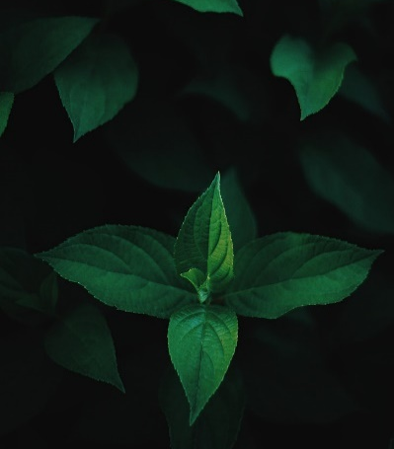
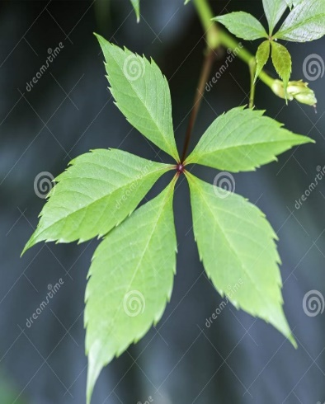
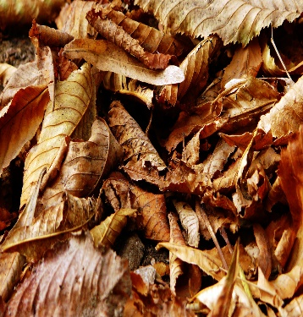
REMEMBER!
Warm-up
yellow leaves,
dark green leaves,
light green leaves
brown
leaves

Slide 3
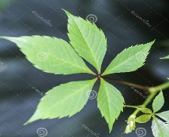
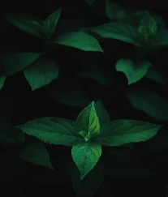
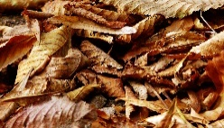
Complete the sentences:
Spring has _________on the trees
Summer has _________on the trees.
Autumn has _________on the trees.
Winter has _________or no leaves on the trees.

Slide 4
Read a short poem about seasons
SEASONS – мезгілдер
Spring is green.
Summer is bright.
Autumn is yellow.
Winter is white.
Autumn
Winter
Summer
Spring

Slide 5
Answer the questions:
1. How many months are there in winter?
2. What colour are the snowflakes?
3. How many months are there in spring?
4. What colour are the trees in spring?
5. How many months are there in summer?
6. What colour are the flowers in summer?
7. How many months are there in autumn?
8. What colour are the leaves in autumn?
month – ай
colour – түс

Slide 6
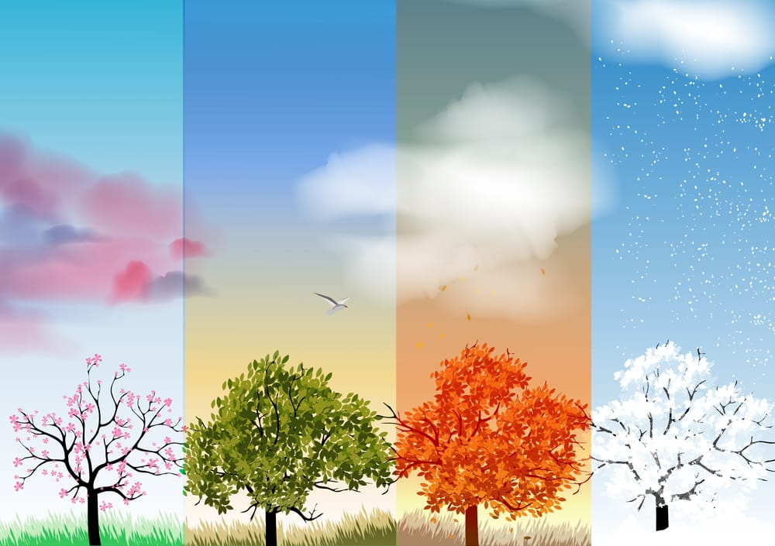
HOMEWORK:
Read the poem and learn
by heart words;

