Slide 1
Almaty region
Ili district
№ 24 lyceum
English teacher: Auelkhan G.S
Grade: 4

Slide 2
Module 8. Machines
Slow machines
Баяу машиналар

Slide 3
Lesson objective:
learn to speak English the names of "slow" machines;
repeat the grammar theme Past Simple Tense;
learn to distinguish between "slow machines" from "fast".

Slide 4
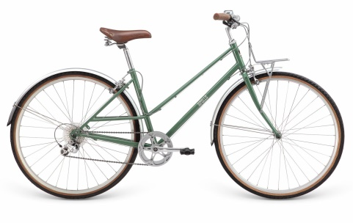
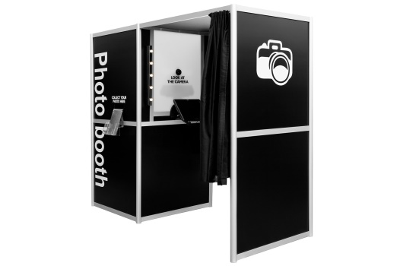
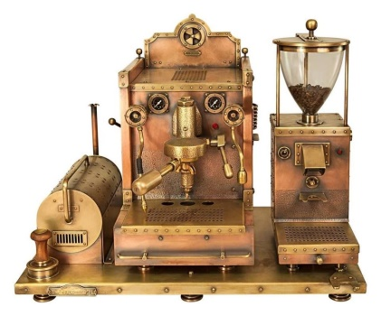
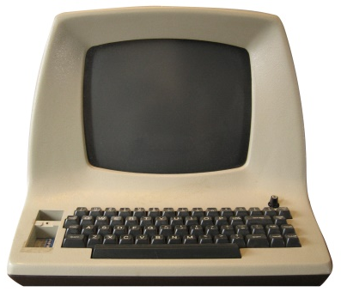
What is a slow machine?
A slow machine is an old technique / equipment which our grandparents / parents used.
photo booth
bicycle
coffee machine
computer

Slide 5
Task for pupils.
Repeat the words you learned during the lesson. Tell your teacher what slow and fast machines you know.
I learnt slow machines. They are _____, ______, ______.
I learnt fast machines. They are _____, ______, ______.

Slide 6
coffee machine
photo booth
bicycle
computer

Slide 7
Complete the task orally. Fill the gaps with the words from previous task.
computer photo booth coffee machine bicycle
1. I would use a ________ to take a photo.
2. I would use a ________ to make a drink.
3. I would use a ________ to go to school.
4. I would use a ________ to do my homework.

Slide 8
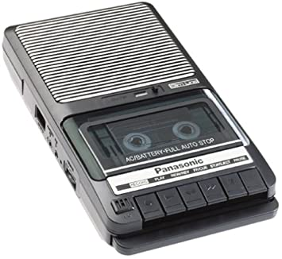
New words:
Cassette player – кассета ойнатқышы
Typewriter – баспа машинкасы
Washing machine – кір жуғыш машина

Slide 9
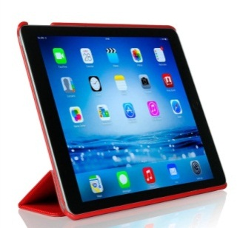
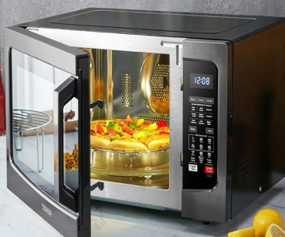
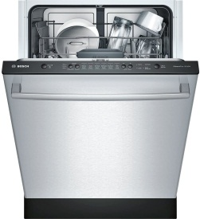
Make a list of 5 machines you use every day!
Are they fast or slow?
Slow machine | Fast machine
tablet
microwave
bicycle
scissors
dishwasher

Slide 10
Past Simple
Verb
regular
irregular
press + ed
pushed
pressed
listened
used
put - put
go – went
do - did

Slide 11
Read and complete. Use: Past Simple
People 1) put (put) some paper in me. They 2)______(press) the buttons on me to write. They 3)_____(push) the lever to write on the next line.
2. People put some hot water in me. Then they put the clothes in. They 4) ________ (use) the handles to move the clothes around quickly.
3. People put a cassette in me. They 5) _______ (press) the play button. They 6) _________ (listen) to music on me.

Slide 12
Check your answer
People 1) put (put) some paper in me. They 2)pressed the buttons on me to write. They 3)pushed the lever to write on the next line.
2. People put some hot water in me. Then they put the clothes in. They 4)used the handles to move the clothes around quickly.
3. People put a cassette in me. They 5) pressed the play button. They 6) listened to music on me.

Slide 13
Reflection
Now I …
1) I know new words on the subject of “Slow machines”
2) repeated the grammar theme Past Simple Tense
3) I can distinguish “slow machines” from “fast machines”

Slide 14
Home task:
to learn new words,
Exercise 2, at page 80 (Activity book)

Slide 15
Good luck pupils
See you soon
Good bye

