Slide 1





Slide 2
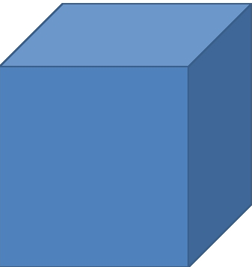
Сheck up hometask
Answer the question

Slide 3
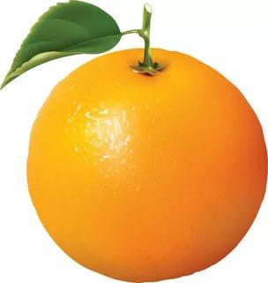
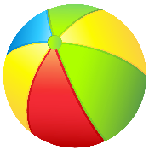
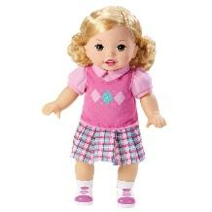
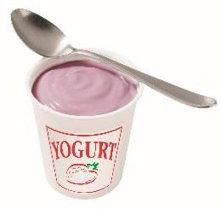
Brainstorming
B O D Y

Slide 4
Unit 5.Step 3. Our body

Slide 5
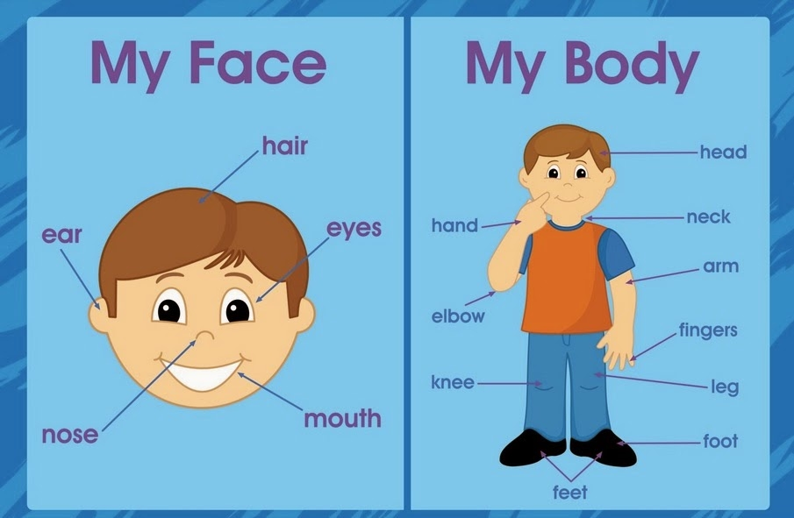
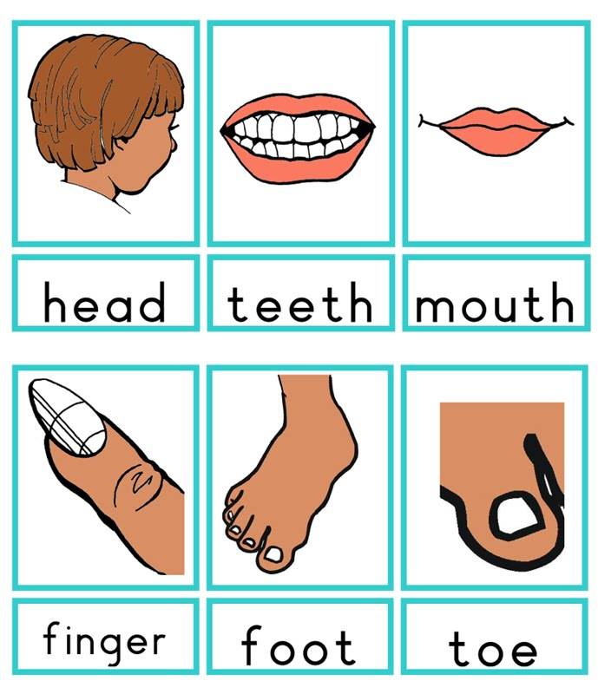
Let`s watch a video about
parts of the body

Slide 6
New words:
Head – бас
Hair – шаш
Eyes – көздер
Ears – құлақтар
Nose – мұрын
Teeth - тіс
Mouth –ауыз
Fingers - саусақтар
Neck – мойын
Hand – қолдар
Leg – аяқтар
Knee – тізе

Slide 7


Work in groups
Make a poster
I - group.
Match the words with the pictures. Write the parts of the body
II – group.
Colour and say

Slide 8
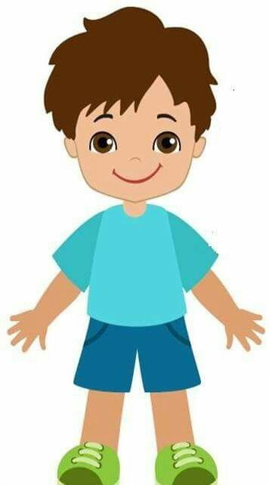

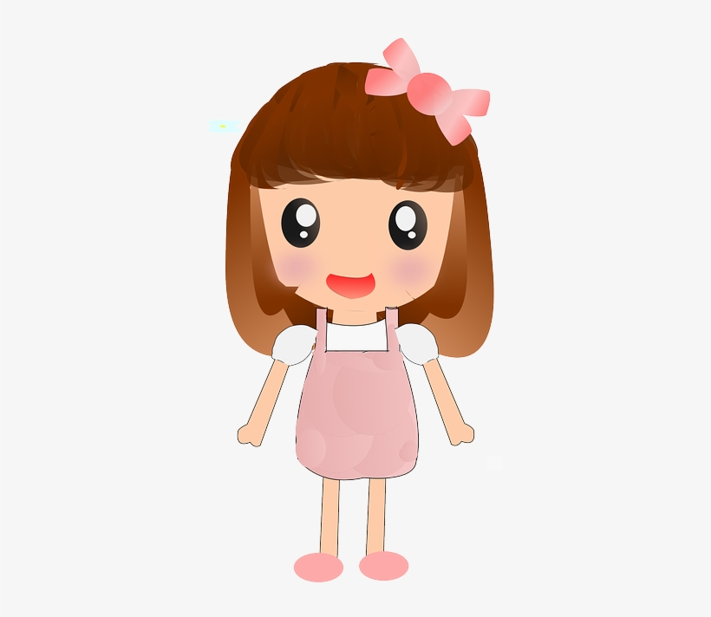
I-group. Match the words with the pictures
Write the parts of the body

Slide 10
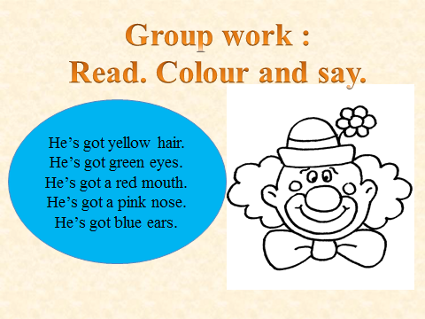
II – group. Colour and say

Slide 11
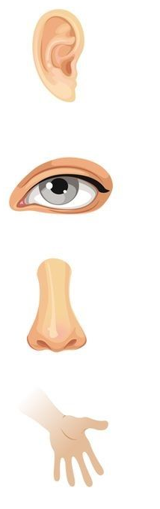
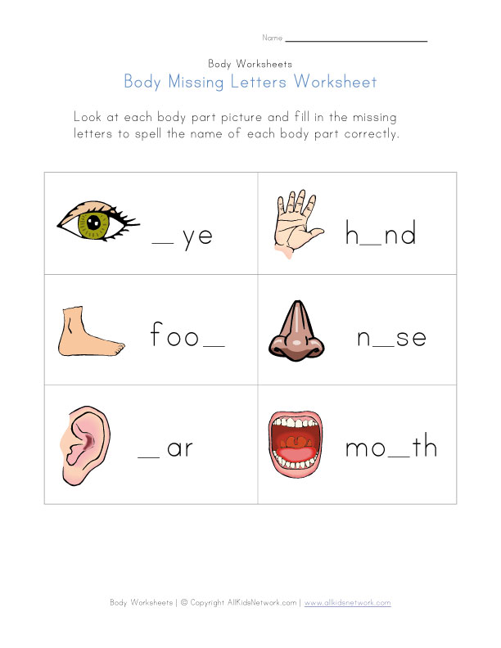
Individual works
I – group. Learners must write initial letters.
Fill in missing words
1.foo_
2. _ar
3._ye
4._ose
5._outh
6. _and

Slide 12
e
a
t
o
e
u

Slide 13

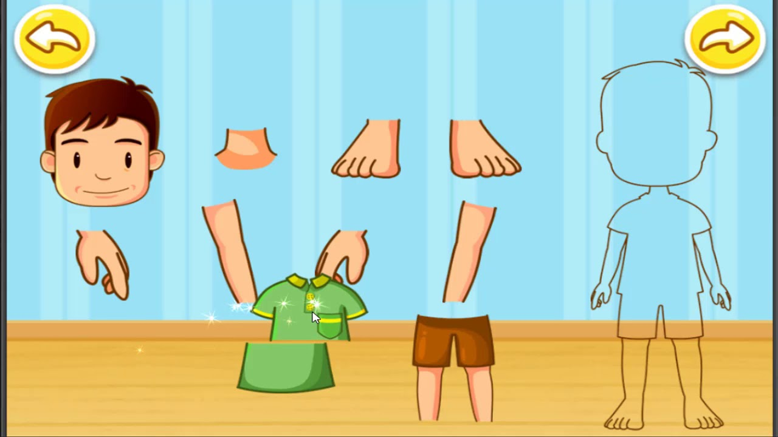
II – group. Translate
Translate the words into English
1.Үлкен құлақ
2. Қара шаш
3. Кішкене қол
4. Екі аяқ
5.Үлкен ауыз
6. Қызыл көз

Slide 14
1.Big ear
2. Black hair
3. Small hand
4. Two foot
5.Big mouth
6. Red eye
1.Үлкен құлақ
2. Қара шаш
3. Кішкене қол
4. Екі аяқ
5.Үлкен ауыз
6. Қызыл көз

Slide 15
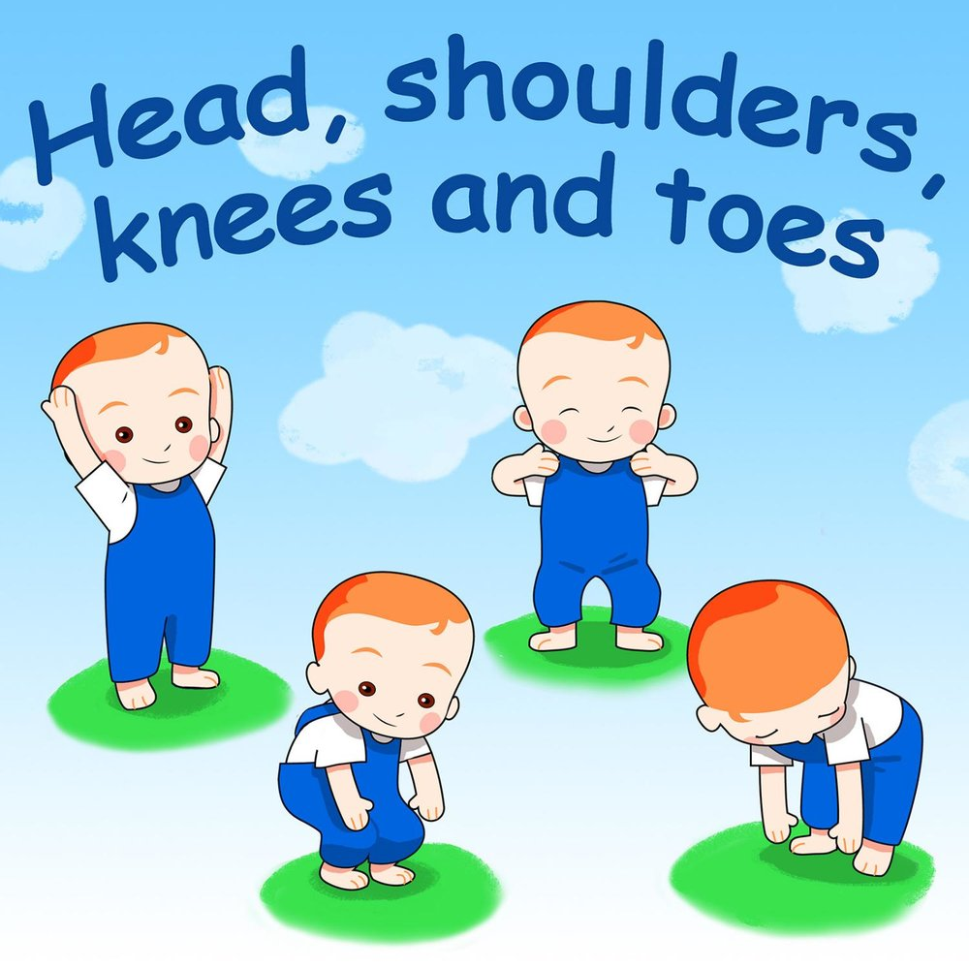
Relaxation
Listen and do
Exercise song

Slide 16
Put the words in two columns:
Head | Body
Words: hair, foot, nose, finger, leg, face, teeth, arm, hand, toe, neck, ear, eye, mouth

Slide 17
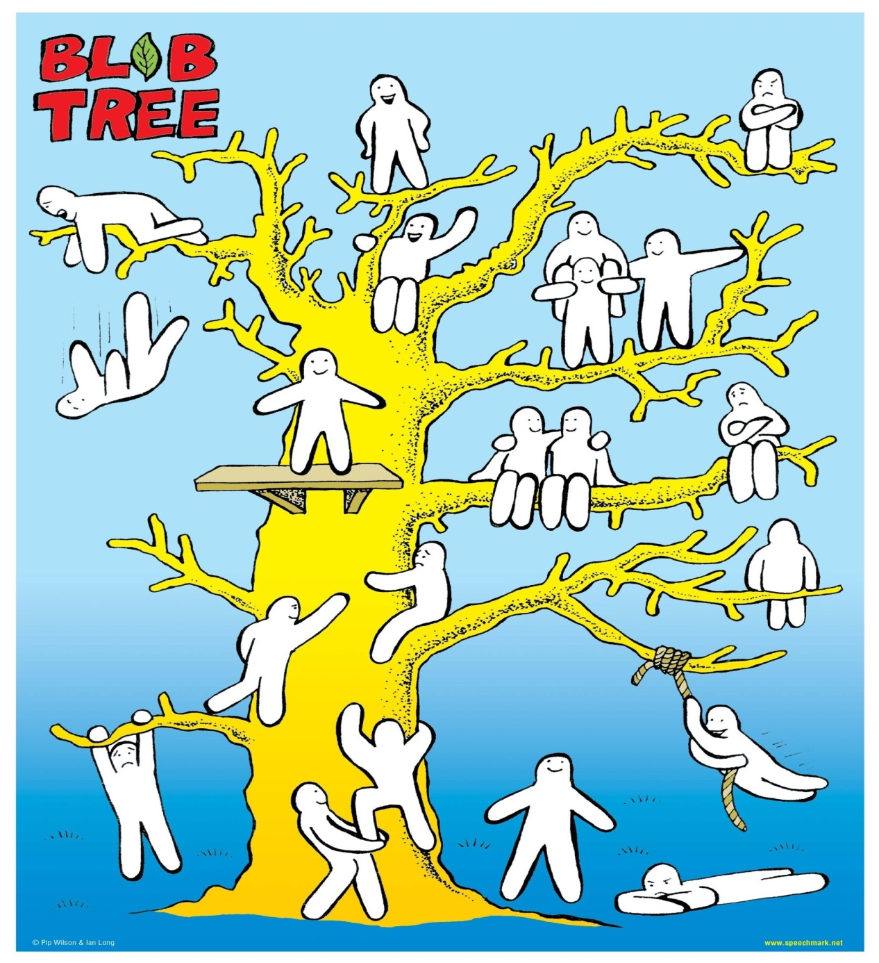
Feedback

Slide 18
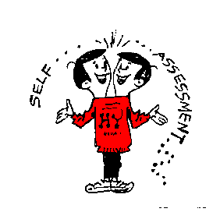


Slide 19
Home task
To learn new words

Slide 20


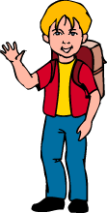

Good-bye!
Thank you for your attention!

