Slide 1
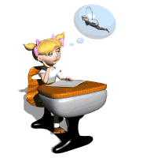
The physical structure of the human brain

Slide 2
Human Brain - Parts & Functions - Cerebrum & Cerebellum - Biology - LetsTute.mp4

Slide 3
The physical structure of the human brain
The lesson objectives
1)To introduce with the physical structure of the human brain
2)To learn new vocabulary
3)To increase knowledge about human brain

Slide 4
Playing the game
“CROCODILE”

Slide 5
New words of the lesson:
Skull Be related to | Бас сүйегі Қатысты болу
Hemisphere Require | Жартышар Қажет ету
Play a part Hunger | Рөл атқару Ашаршылық
Deal with determine | (бірдеңені) орындау анықтау
Nerve fibre complex | Жүйке талшықтары Күрделі

Slide 6
1) Reading the text “One brain or two” (Ex.1 p.70)
2) Read the sentences (1-8) and decide if they are T(true), F(false) or DS(doesn’t say).
1. The human brain controls how the body works.
2. A laptop’s CPU is smaller than the human brain.
3. The two sides of the human brain are not connected.
4. The right hemisphere controls the left side of the body.
5. The left hemisphere is dominant in both scientists and sculptors.
6. Both sides of the brain play a role in our use of language.
7. The human brain creates new brain cells all the time.
8. We might never fully understand the human brain.

Slide 7
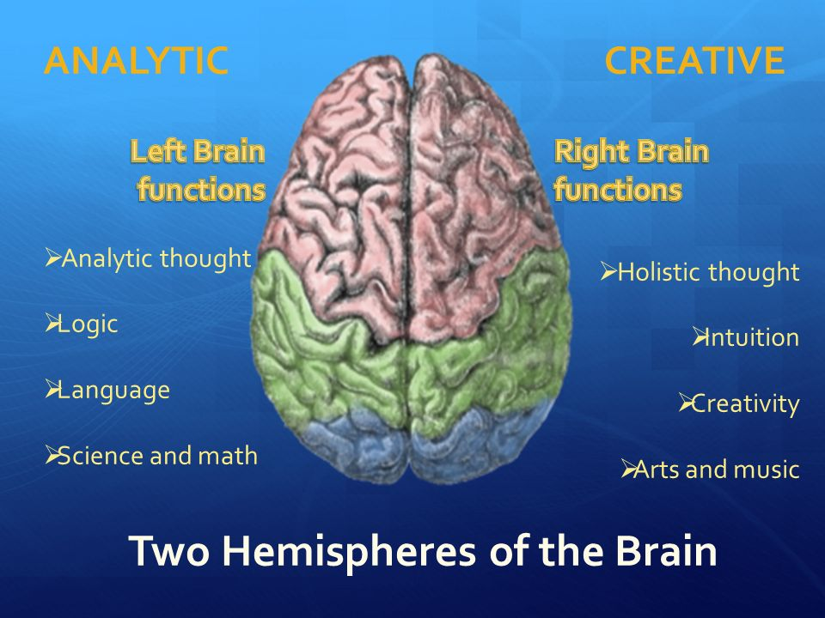

Slide 8
Answer the questions
1 | Capabilities of the brain
2 | Two halves of the brain
3 | The function of the right and left hemispheres

Slide 9
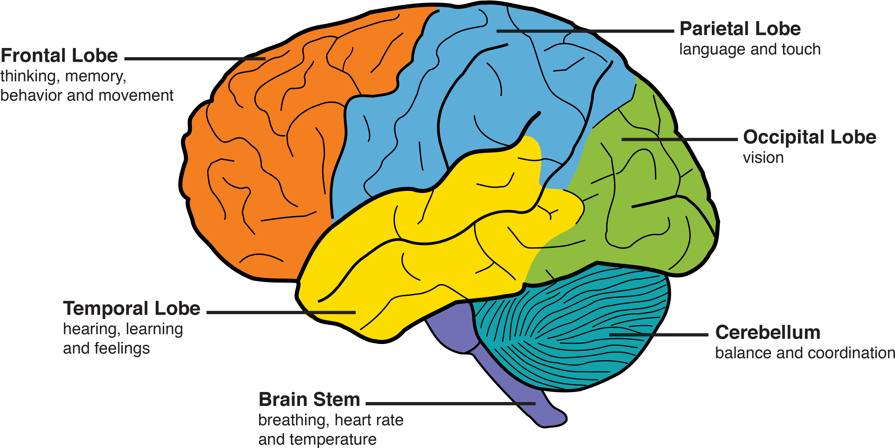

Slide 10
Singing the song
“Human brain”

Slide 11
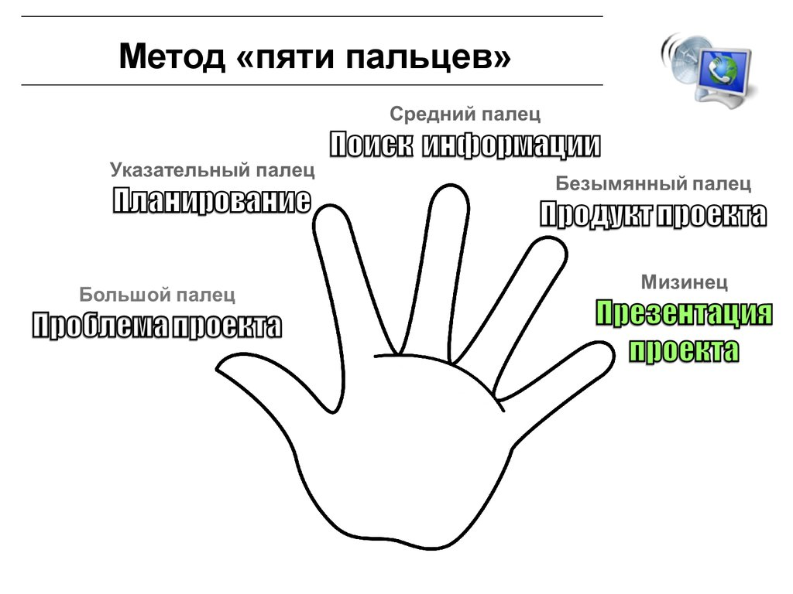
Reflection “5 fingers”
1 finger – difficulties during the lesson
2 finger – what do you like during the lesson
3 finger – your mood
4 finger – what do you do today?
5 finger – what do you learn today

Slide 12


