Slide 1

Unit: Our neighbourhood
Theme of the lesson:
“A description of a town”
Grade 6

Slide 2
Learning objectives
6.R5 deduce meaning from context in short texts on a limited range of familiar general and curricular topics | Identify the meaning of the text
6.S7 use appropriate subject-specific vocabulary and syntax to talk about a limited range of general topics | Use topic-related vocabulary correctly

Slide 3
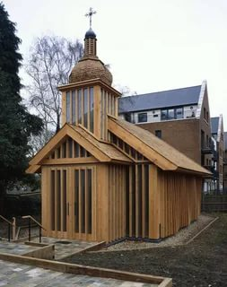
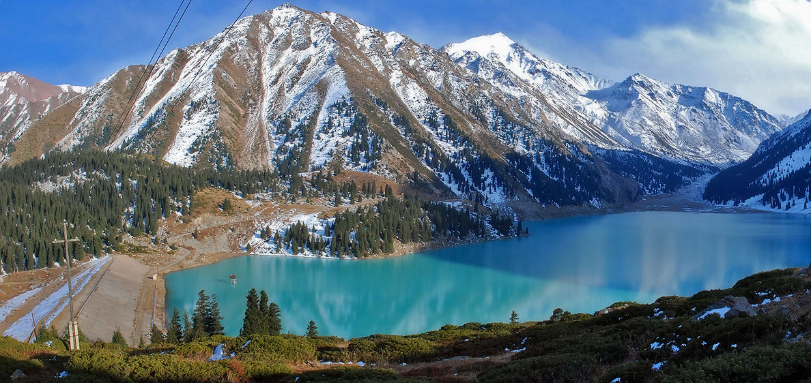
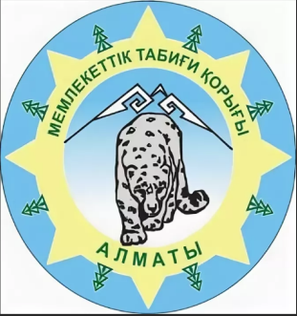
Vocabulary to the text
wooden church
Almaty Nature Reserve
beautiful view – керемет көрініс
сountryside – қала маңы, ауылдық жер

Slide 4
Read the text “My home town: Talgar”
Talgar is in Almaty region in the south of Kazakhstan. It’s not a big town. It’s got a population about 50 000.
I like Talgar because it’s a friendly place and it is a very pretty area. There are some really old buildings like the old wooden churches. It hasn’t got many shops and cafes, but it is in beautiful countryside. Talgar mountain is nearby and it’s in the Almaty Nature Reserve. My favourite place is by the river outside town. The mountains around the town are important for tourists too. There are lots of walks you can go on with wonderful views.
Talgar is about 25km from Almaty. You can take bus or the train there. It takes about an hour.
Descriptor: read the text.

Slide 5
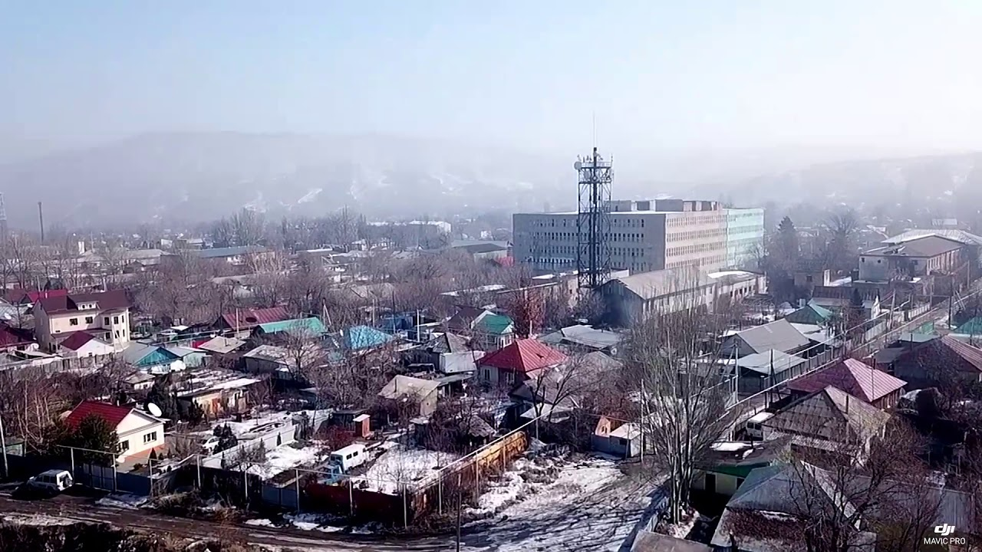
The town: Talgar
Paragraph 1. Location
Talgar is in Almaty region in the south of Kazakhstan.
Paragraph 2. Good things
I like Talgar because it’s a friendly place …
Paragraph 3. Transport and other places
Talgar is about 25km from Almaty…

Slide 6
Find True/ False sentences
Talgar is in the north of Kazakhstan. _______
2. There are about 40 000 people in Talgar. _____
3. There are old wooden churches. ________
4. Talgar mountain is in the Almaty Nature Reverse. ___
5. Talgar town is far from Almaty. _______
6. You can go by bus or train to Almaty. ________
Descriptor: write true/false sentences.

Slide 7
Complete the sentences
Talgar is in the south of ____________.
2. It’s got a population about _____________.
3. It’s a ___________ place.
4. My favourite place is _______________.
5. It’s _______ kilometres from _________.
Descriptor: complete the sentences

Slide 8
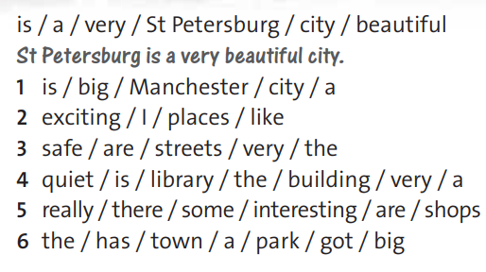
Making sentences
Descriptor: order the words to make sentences

Slide 9
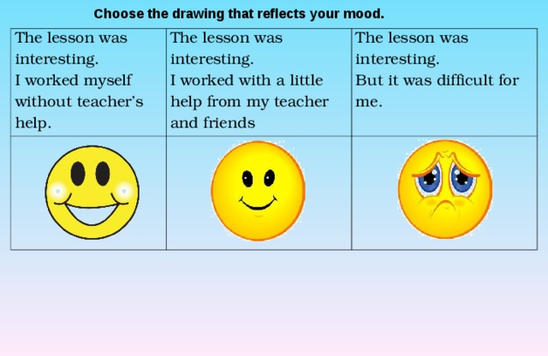
Reflection

Slide 10

Home task
Write about your town/ city using the following plan
Paragraph 1. Location
… is a town/ city in …
Paragraph 2. Good things
… is a greaat place. I like it because …
Paragraph 3. Transport and other places
… is about kilometres from …

