Slide 1
Teacher:Kenzhalieva Laila
Unit7 The natural Environment
Theme of the lesson:What can animals do?
The aim of lesson : use can to talk about ability and to make requests and offers; use can / can’t to talk about permission
use structure I can+verb with support
recognise short basic instructions

Slide 2
I can -Мен жасай аламын
I can not / can`t-Мен жасай алмаймын

Slide 3
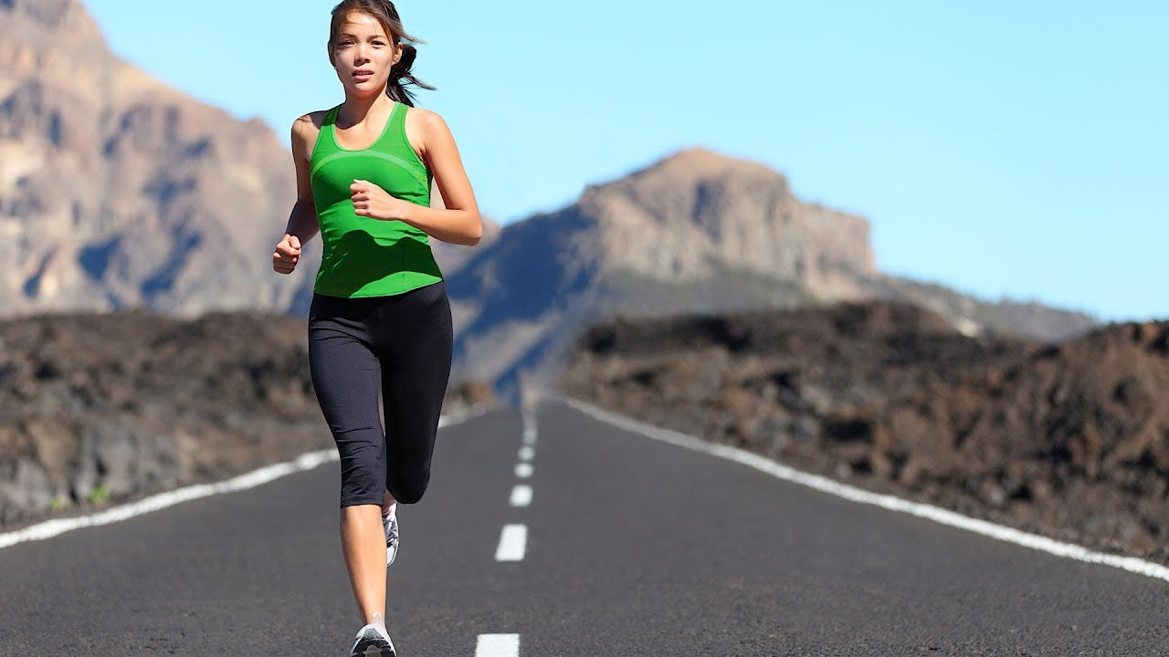
I can run

Slide 4
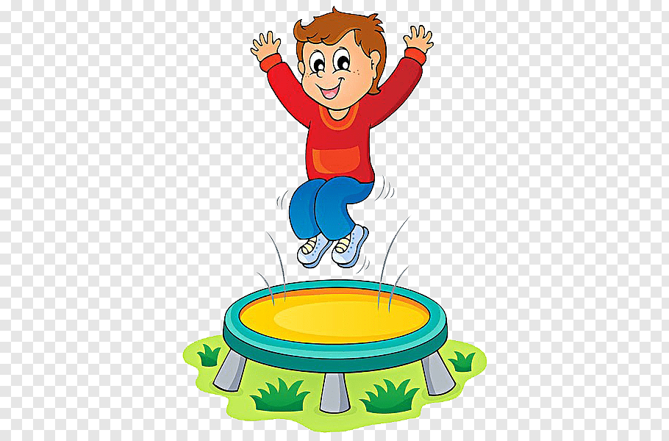
I can jump

Slide 5
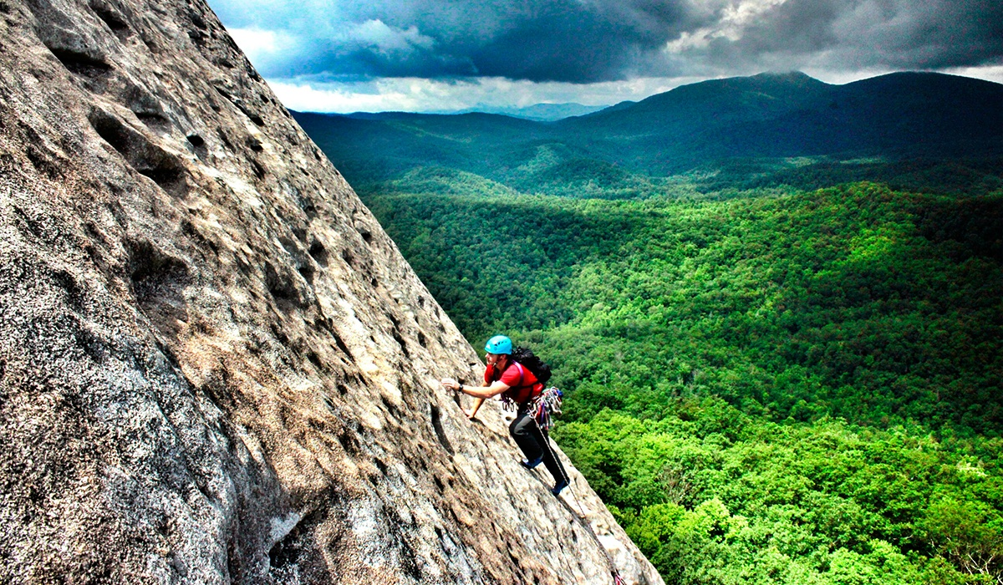
I can climb

Slide 6
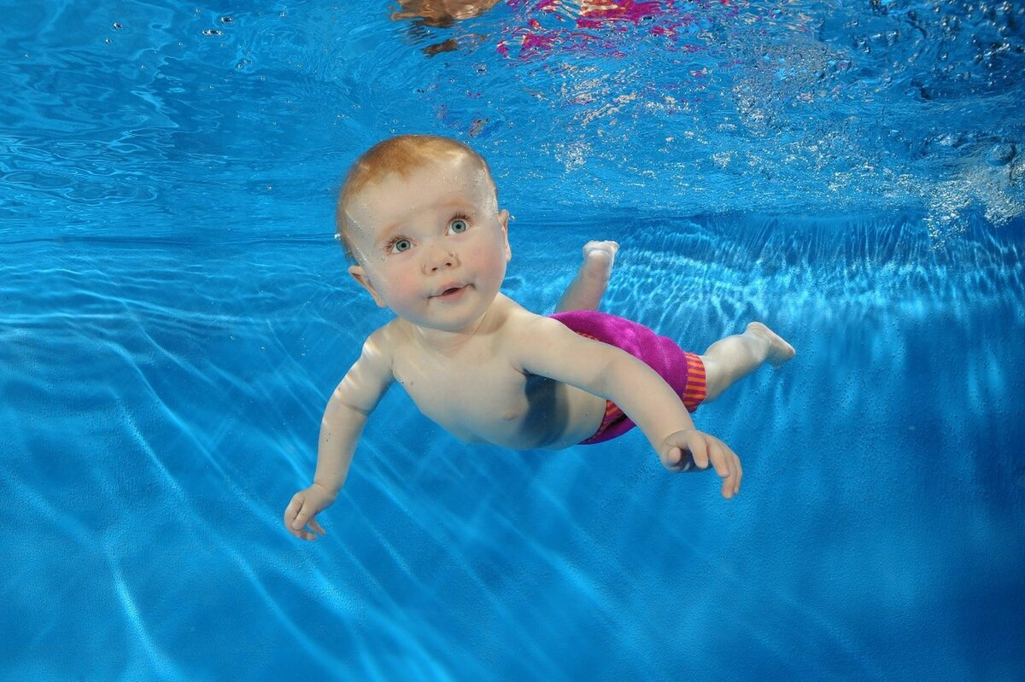
I can swim

Slide 7
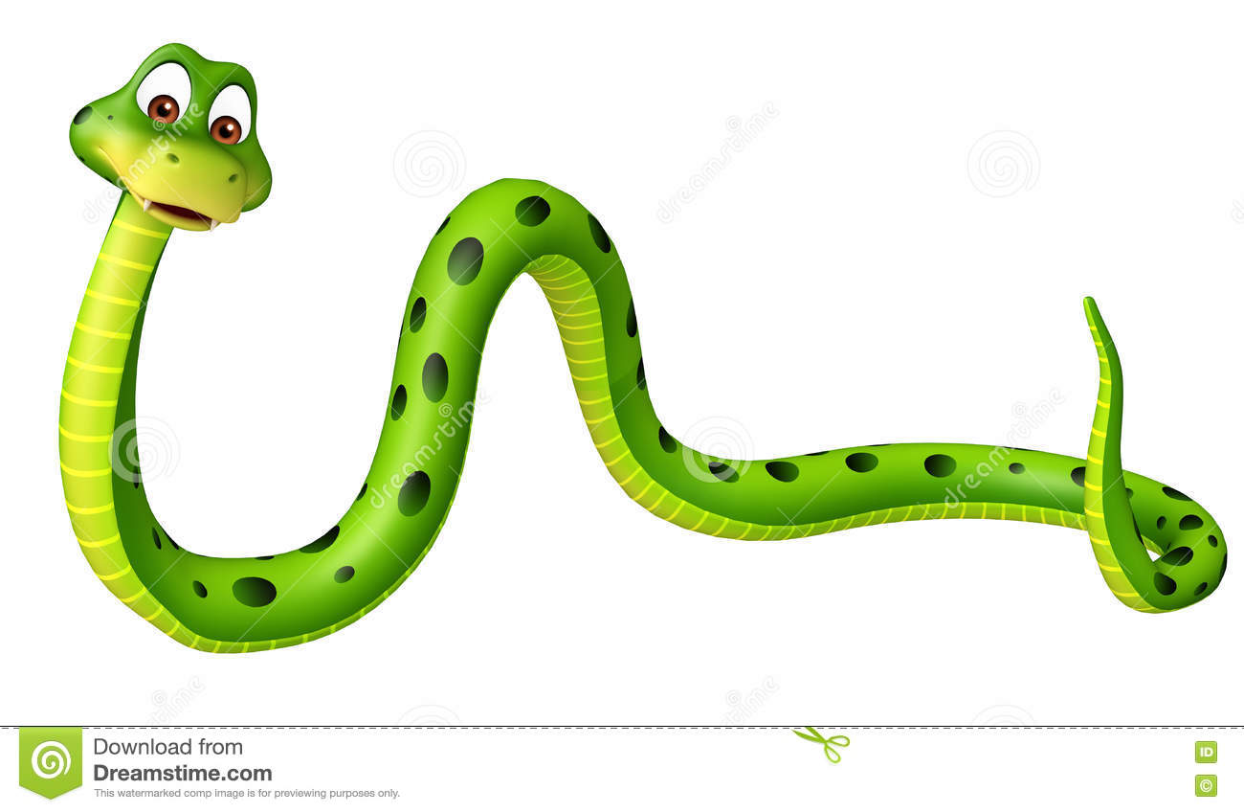
It can crawl

Slide 8

A bird can fly

Slide 9
What can animals do?
A dog can run, jump,swim
A cat can climb, run, jump
A monkey can`t fly
A horse can run , jump
A parrot can fly and speak
A rabbit can run
A snake can crawl
A fish can`t fly and run

Slide 10
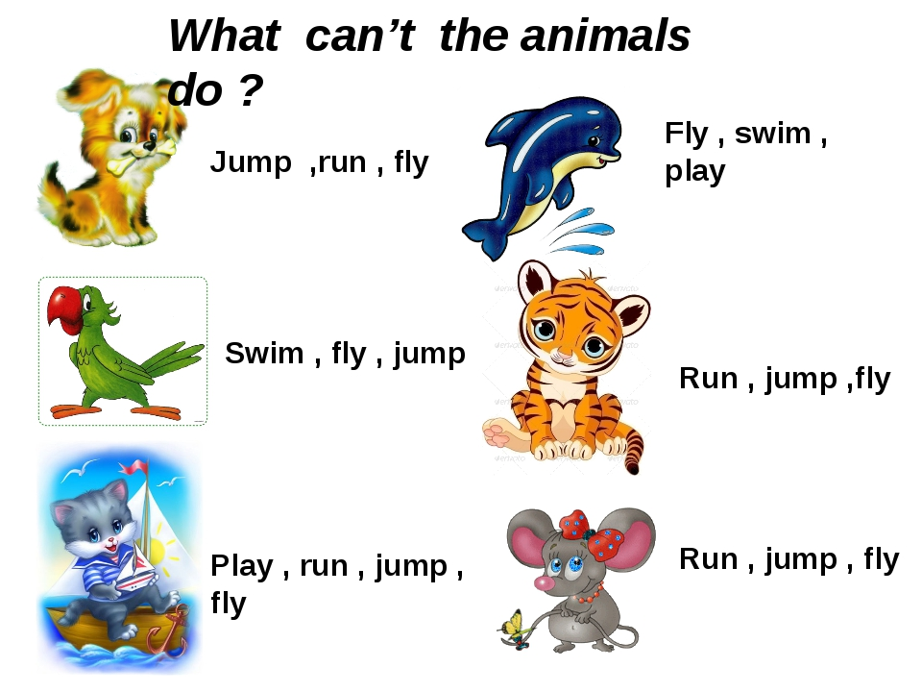

Slide 11
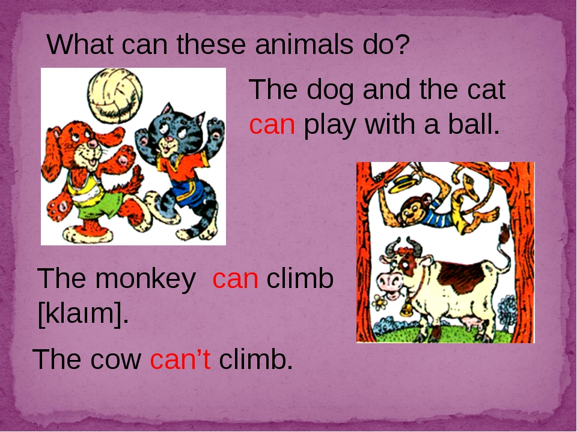

Slide 12
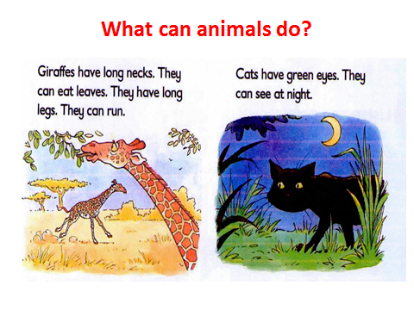

Slide 13
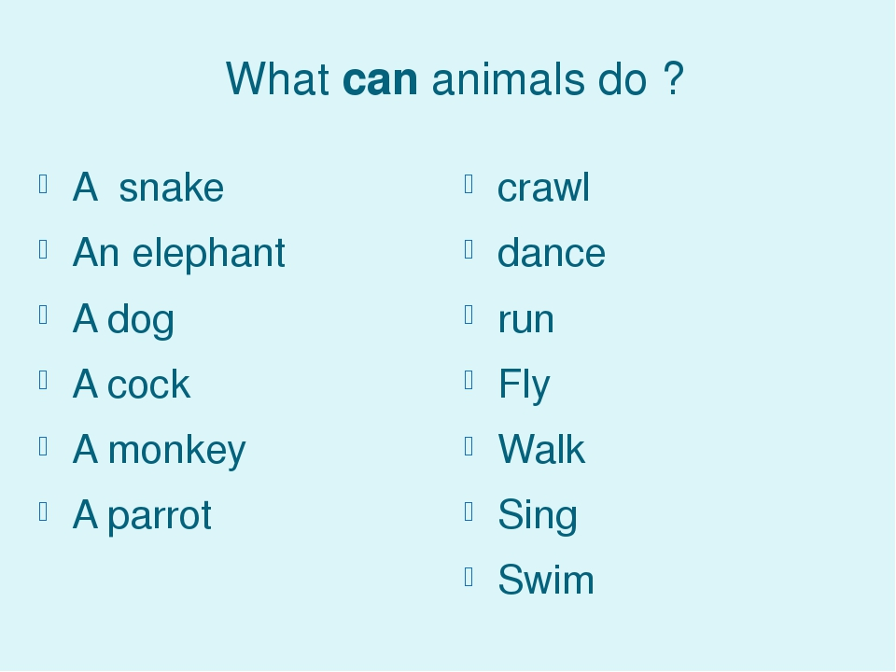

Slide 14
