Slide 1
Welcome to my Kazakhstan
Aim: To talk about Kazakhstan culture in English.
Lesson objectives
All learners will be able to:
1.L1 recognize short instructions for basic classroom routines spoken slowly and distinctly with support
1.S3 pronounce basic words and expressions intelligibly with support
1. UE1 use there is / there are to make short statements and ask questions with support

Slide 2
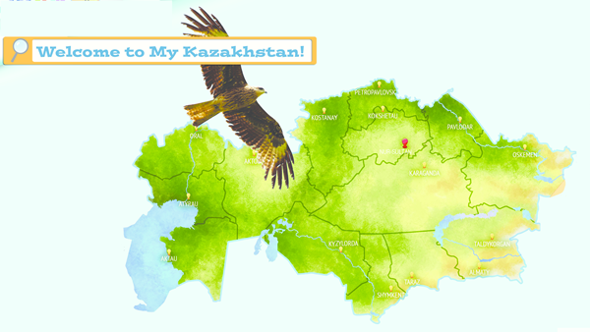
Unit 7. All about my world
p.88-89
1.Listen, point and read.
This is my country, Kazakhstan.
Kazakhstan is a very big country! The president of Kazakhstan is Nursultan Nazarbaev.

Slide 3
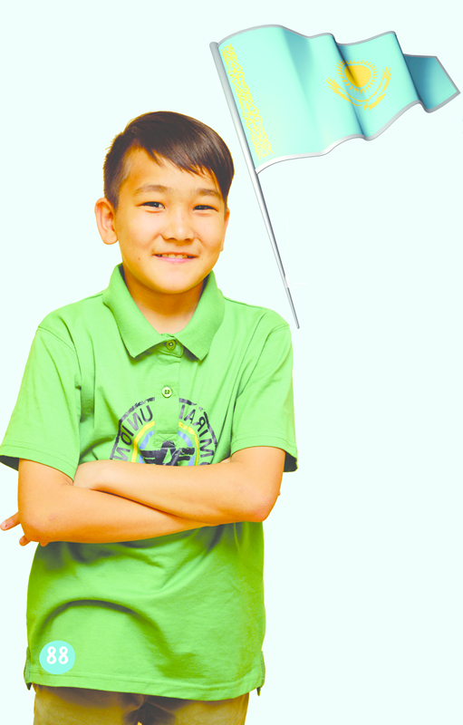
1. Listen, point and read.
This is my flag! It's a blue and yellow.

Slide 4
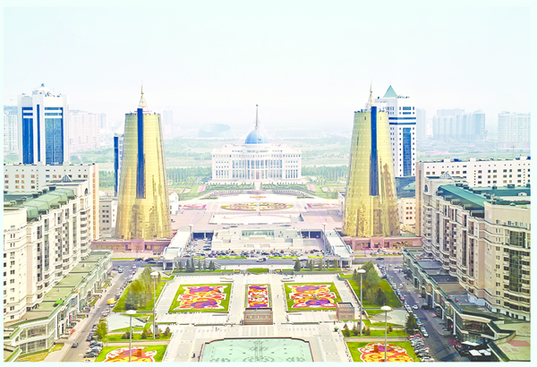
This is Astana! It is the capital city of Kazakhstan.

Slide 5

The people of Kazakhstan are from many cultures. We are live happily together!

Slide 6
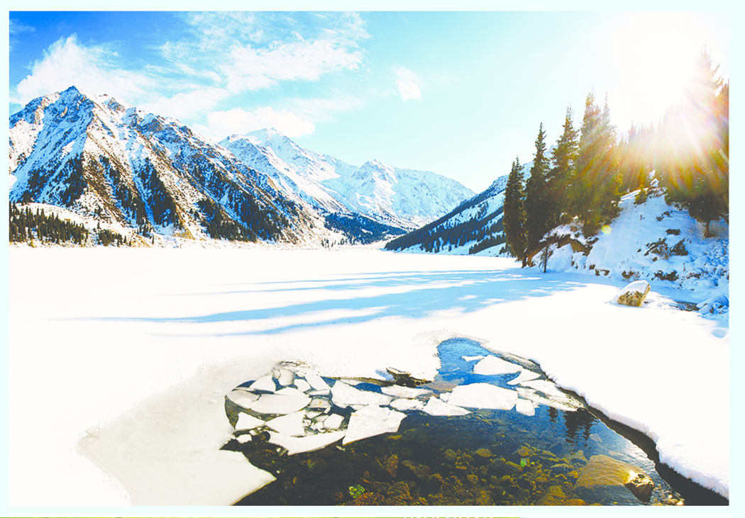
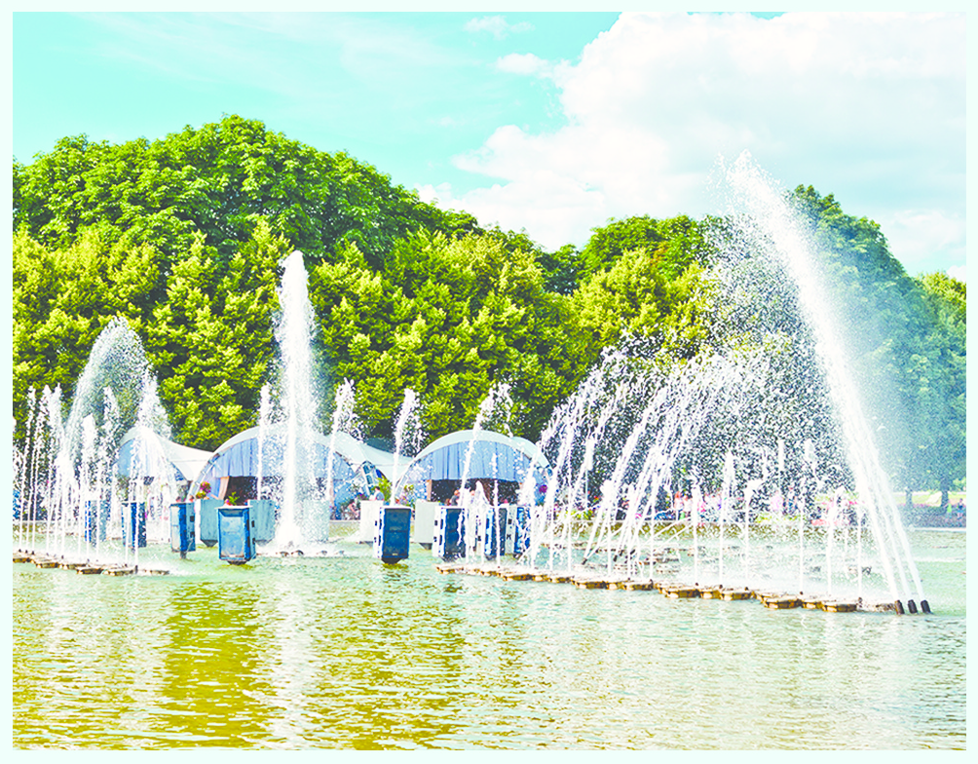

Kazakhstan is a very beautiful country with lots of rivers, mountains and lakes.
There are a lot of things to see in Kazakhstan! This is Gorki Park in Almaty.

Slide 7

In order to build positive atmosphere, learners will draw their handhold and write their wishes on it.F.e.
I am a patriot of Kazakhstan

Slide 8
New words:Жаңа сөздер
Country(кантри) – eл
Capital city(кәпитал сити) – бас қала
People(пиипл) – адамдар
Culture(калтшэ) – мәдениет
Rivers(ривэс) – өзендер
Mountains(маунтинс) – таулар
Lakes(лейкc)– көлдер

Slide 9
Home task:
Answer the questions. (сұрақтарға жауап береміз)
1.What country is this?
2.What is the capital city of Kazakhstan?
3.Which cities do you know?
4. Who is the president of Kazakhstan?
Learn by heart new words (жаңа сөздерді жаттау)

