Slide 1
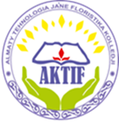
Алматы қаласы Білім басқармасы
МКҚК «Алматы флористика және технология колледжі»
Оспангалиева Гүлгерім
Төленқызы
Ағылшын тілі
2-курс

Slide 2
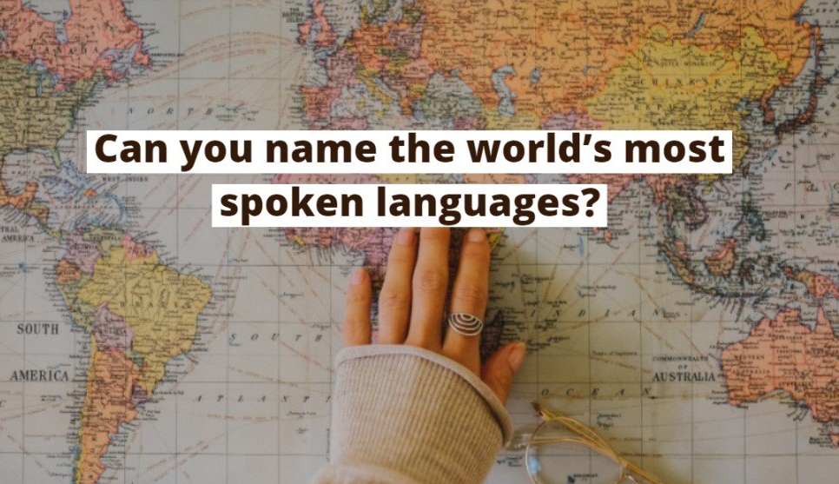

Slide 4
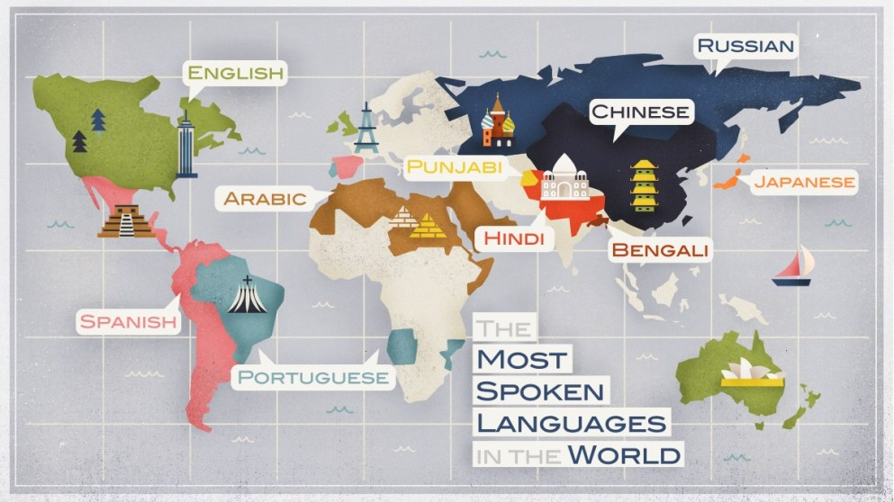

Slide 5
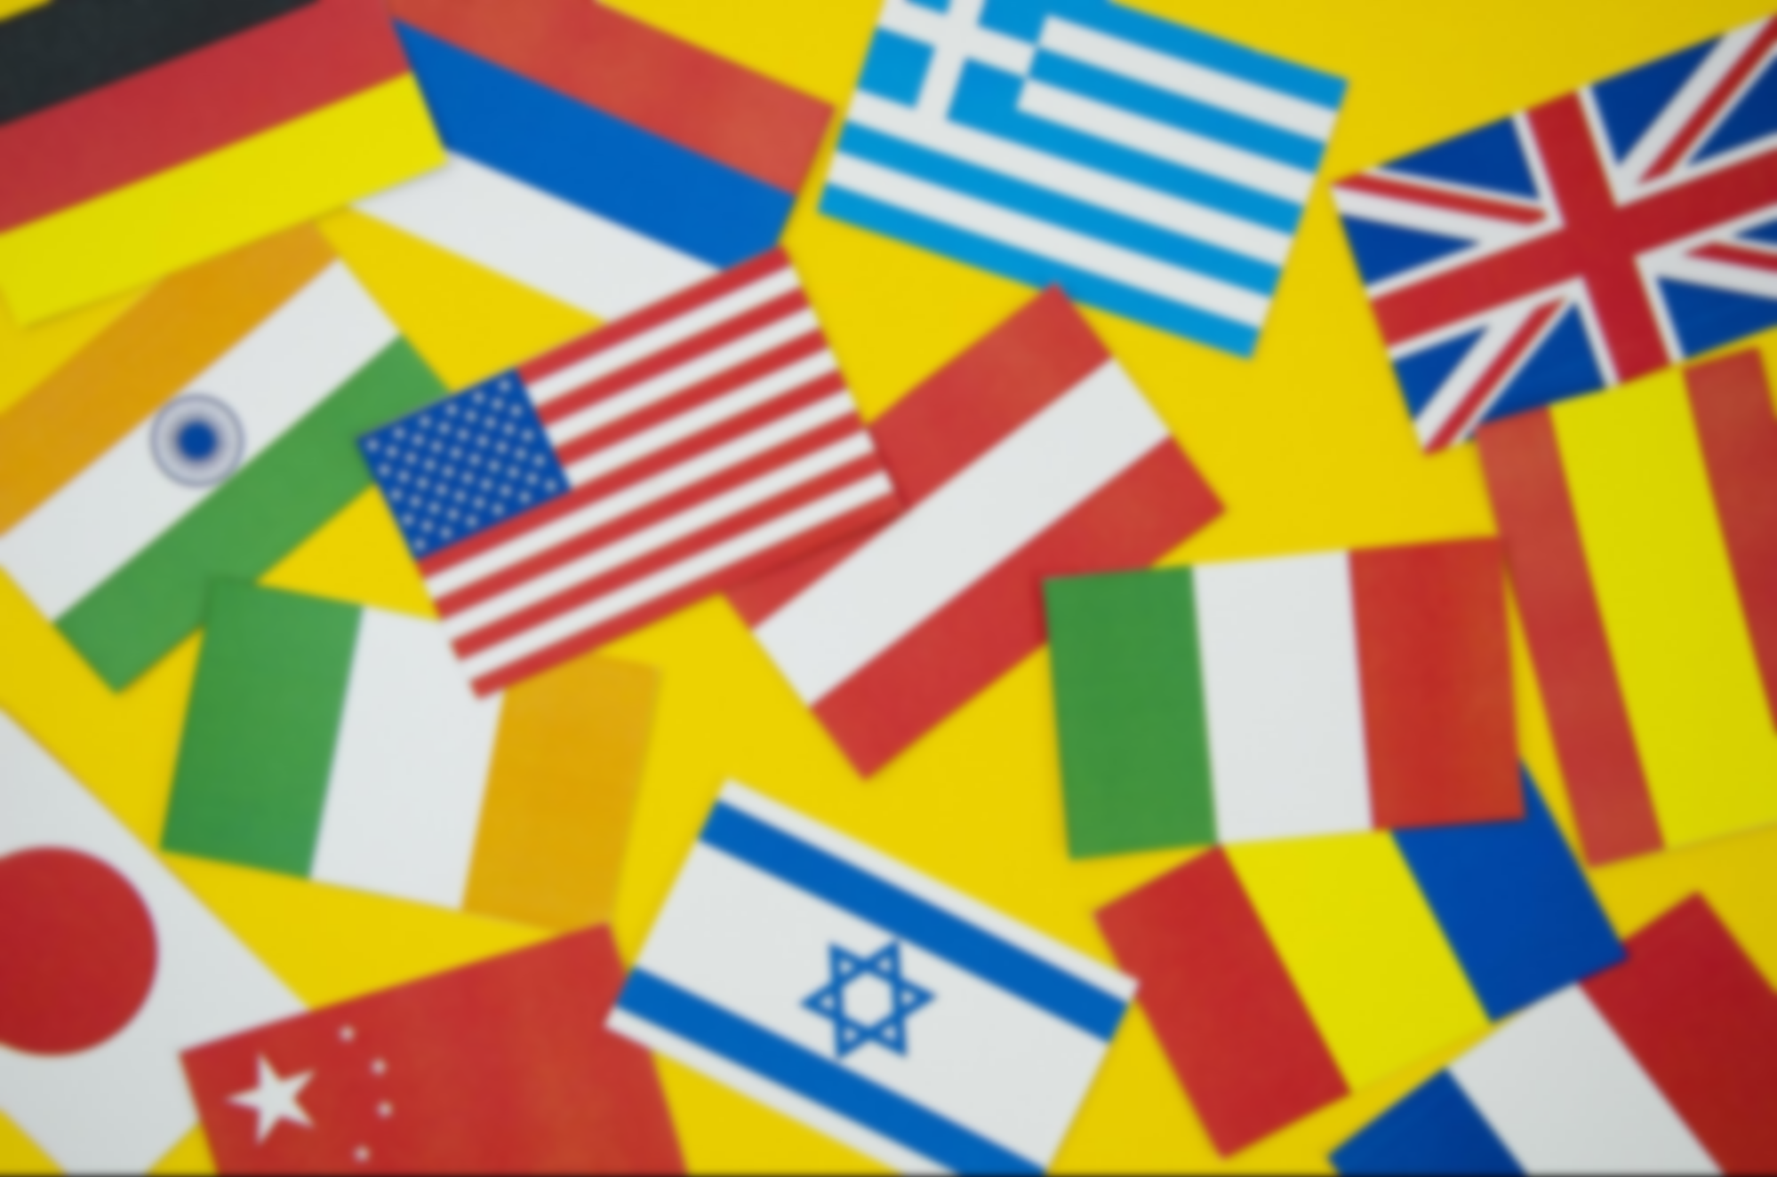
What is the most spoken language in the world?

Slide 8
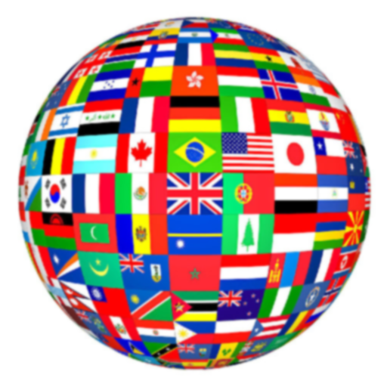
English is the language of communication

Slide 9
Learning aims:
1) educational | to enlarge knowledge of students about the English language to improve knowledge of students about the most spoken languages in the world to enrich the vocabulary of students on the basis of the proposed texts and information.
2) developing | to develop interest of students to the subject of the English language to improve reading, writing, listening skills.
3) teaching | to educate respect mother tongue and other languages to foster a tolerant attitude towards representatives of other cultures and ethnics.

Slide 10
HISTORY OF ENGLISH LANGUAGE
BORROWED WORDS IN ENGLISH
INTERESTING FACTS ABOUT THE ENGLISH LANGUAGE

Slide 11
Vocabulary
English | Kazakh | Russian
Mother tongue | ана тілі | родной язык
United Nations | Біріккен Ұлттар Ұйымы | Организация Объединенных Наций
original | бастапқы | первоначальный
to borrow | кірігу | заимствовать
to crowd out | ығыстыру | вытеснять
to exist | бар болу | существовать
trader | саудагерлер | купец
church | шіркеу | церковь
medieval | орта ғасырларда | средневековый

Slide 12
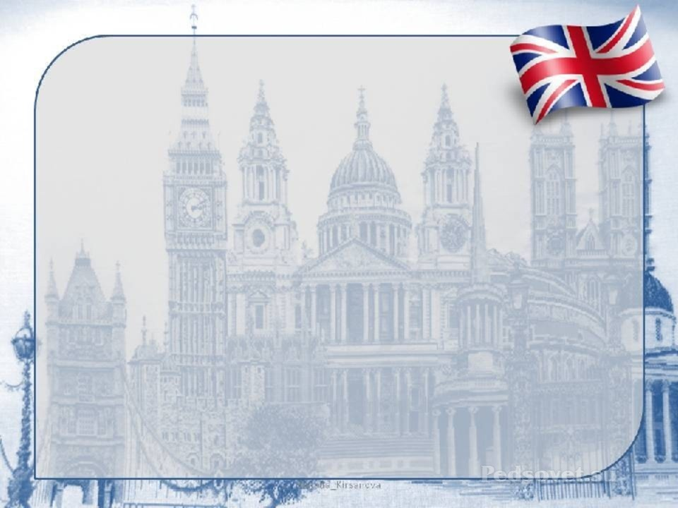
HISTORY OF ENGLISH LANGUAGE
The name “English” comes from the “Angles”, Germanic people who settled in Britain in the first millennium A.D.. They ultimately derived their name from Anglen, region in northern Germany, and of course they gave their name to the area now known as England.
English is West Germanic language that was first spoken in early medieval England.
English has developed over the course of more than 1,400 years

Slide 13
WRITING SYSTEM
Since the 9th century, English has been written in a Latin alphabet (also called Roman alphabet).
Modern English alphabet contains 26 letters of the Latin script.
Earlier Old English texts in Anglo-Saxon runes are only short inscriptions. The great majority of literary works in Old English that survive to today are written in the Roman alphabet.

Slide 14
Indo-European
Germanic
LANGUAGE FAMILY
West Germanic
Anglo-Frisian
English

Slide 15
BORROWED WORDS IN ENGLISH
French | Italian | Spanish | Chinese | Dutch
cream | umbrella | cigar | tea | skate
coffee | broccoli | tornado | ketchup | yacht
card | barista | alligator | chop chop | bow
habit | solo | tango | kowtow | cruiser
liberal | pasta | burrito | typhoon | cookie
sport | balloon | adobe | brainwash | boss
war | rocket | vanilla | tycoon | quack

Slide 16
INTERESTING FACTS ABOUT THE ENGLISH LANGUAGE
“Go!” is the shortest grammatically correct sentence in English.
The original name for butterfly was flutterby.
About 4,000 words are added to the dictionary each year.
The two most common words in English are I and you.
The most common adjective used in English is ‘good’.
The most commonly used noun is ‘time’.
Over 80% of the information stored on computers worldwide is in English.
90% of English text consists of just 1000 words.
There are 24 different dialects of English in the US.
The word ‘Goodbye’ originally comes from an Old English phrase meaning ‘god be with you’.
The first English dictionary was written in 1755.
The oldest English word that is still in use is ‘town’
Shakespeare Added Over a Thousand New Words to the English Language

Slide 17
ENGLISH is used either as the main or one of the official languages in 105 countries around the world, which include USA, UK, Canada, Australia, New Zealand, India, Pakistan, Hong Kong, South Africa, etc.

Slide 18
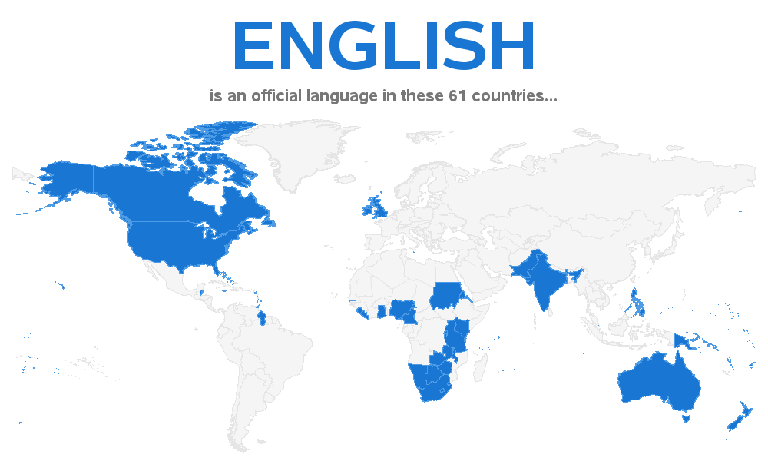

Slide 19
Questions
1. In what countries is English spoken as the mother tongue? 2. From what languages are some English words borrowed? 3. What English words that came from all parts of the world do you know? 4. Which family of languages does the English language belong to?

