Slide 1
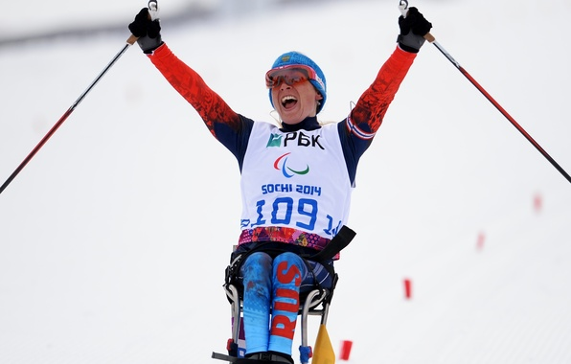
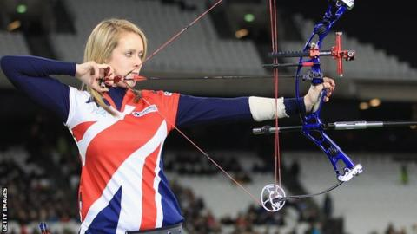
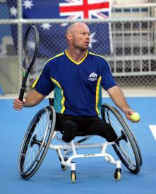
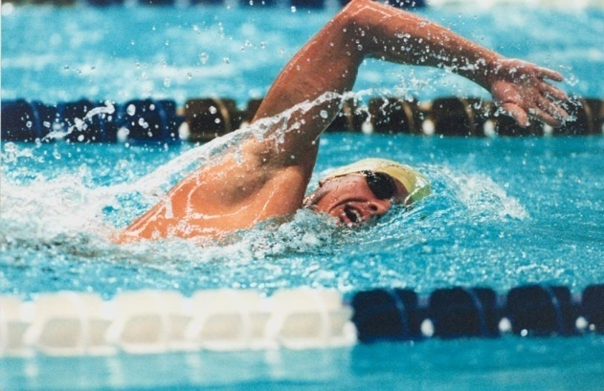
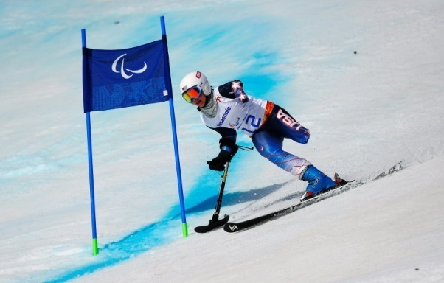
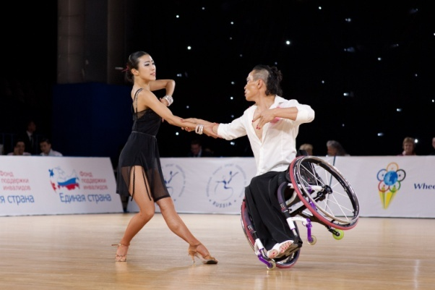
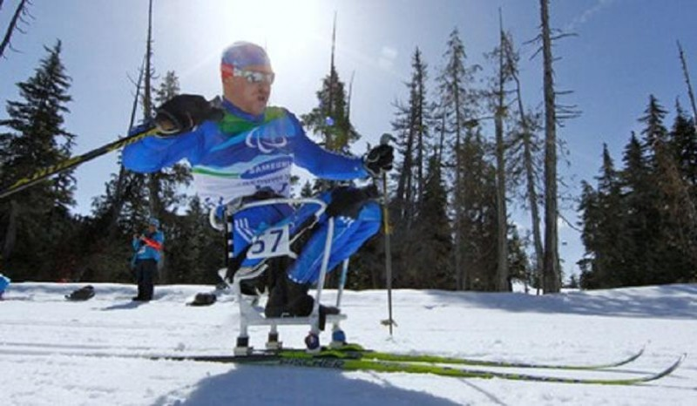
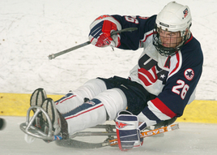
A paralympic champion

Slide 2
Warm-up: Jumbled words (put the words in order to make sport words):
Staklalbeb basketball
Frusnig _________
Llovyelalb _________
Idwngrsunfi __________
Oduj __________
Owlbgin ___________
Glycinc ___________
Iksnig ___________
Dabsokatinreg ___________
Ibanndoorwsg ___________
Labebsal ___________
(Self- assessment

Slide 3
Warm-up: Jumbled words (put the words in order to make sport words):
Staklalbeb basketball
Frusnig surfing
Llovyelalb volleyball
Idwngrsunfi windsurfing
Oduj judo
Owlbgin bowling
Glycinc cycling
Iksnig skiing
Dabsokatinreg skateboarding
Ibanndoorwsg snowboarding
Labebsal baseball
(Self- assessment)

Slide 4
New words
Medal – төс белгі
Hurt – ауыру (боль)
Get injured – жарақат алу
Brave - батыл
Strong - мықты
Team – команда, топ
Push - соққы
Wheelchair – мүгедектер арбасы
Slowly - ақырын
Quickly - жылдам
Loudly – қатты

Slide 5
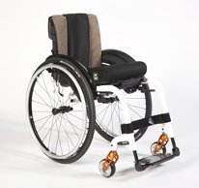
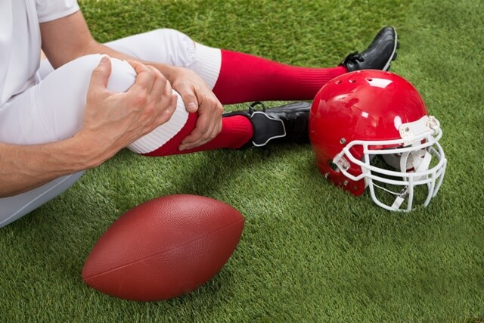
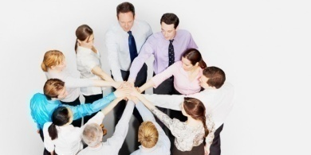
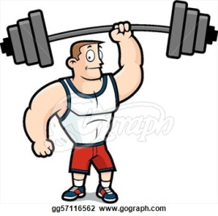
Match the pictures with the words
get injured
medal
team
wheelchair
strong

Slide 6
Match the pictures with the words
get injured
medal
team
wheelchair
strong

Slide 7
Pre – reading task
Q and A strategy
1.What do you know about the paralympic Games?
2. Who competes in them?
3.Do you know somebody who participate in paralympic games?

Slide 8
Video

Slide 9
Read the text “A paralympic champion”

Slide 10
True or false. Correct the false sentences.
1. Tatyana has got strong arms and legs.
2. She started using a wheelchair when she was very young.
3. Wheelchair racing wasn’t her only sport.
4. She was a teenager in 2004.
5. She doesn’t compete in long races.
6. She trains for two hours a day.

Slide 11
True or false. Correct the false sentences.
1. Tatyana has got strong arms and legs. False
2. She started using a wheelchair when she was very young. False
3. Wheelchair racing wasn’t her only sport. True
4. She was a teenager in 2004. True
5. She doesn’t compete in long races. False
6. She trains for two hours a day. False

Slide 12
Descriptor: a learner
Reads and understands the text
Matches the questions with the answers.
Does True or False sentences

