Slide 1
Almaty region
Talgar district village Erkin school № 26
Subject :English language
Teacher: Minyazheva Zhadyra
The theme of the lesson:
Is there… | Are there…?
Grade: 6

Slide 2



Slide 3
Lesson objectives:
6.C2 use speaking and listening skills to provide sensitive feedback to peers
6.UE14 use prepositions to talk about time and location use prepositions like to describe things and about to denote topic use prepositions of direction to, into, out of, from, towards and there is / there are on a limited range of familiar general and curricular topics familiar general and curricular topics

Slide 4
Assessment criteria
There is a Self – assessment
Checklist
At the end of the lesson

Slide 5
We are going to:
* Practicing asking and answering questions about the place you live

Slide 6
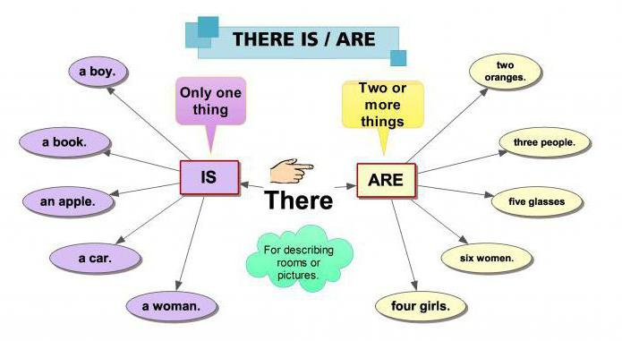

Slide 7
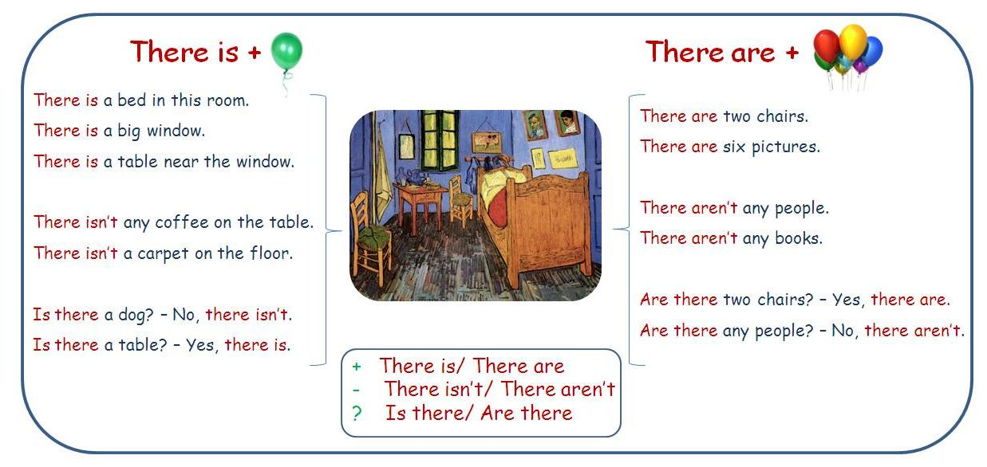
.

Slide 8
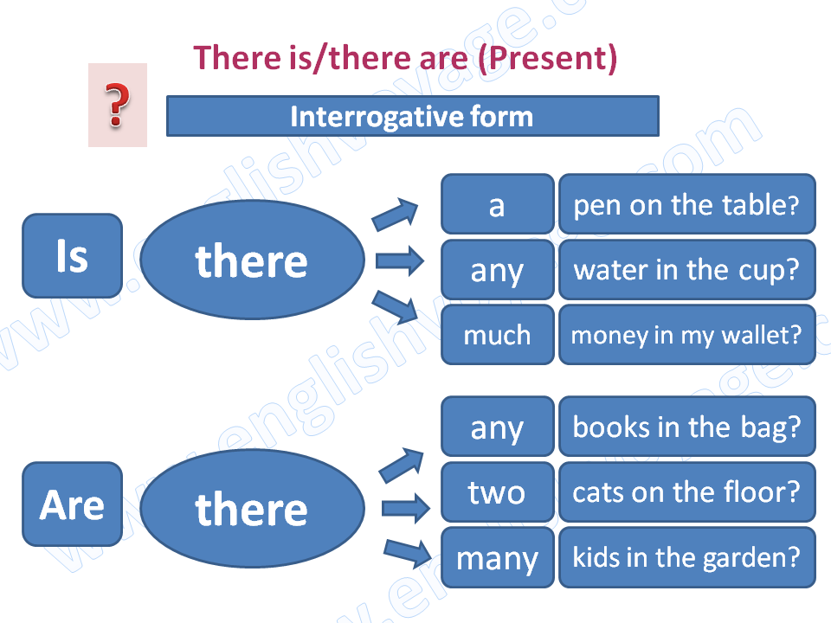
Is there…? Are there…?

Slide 9
Ex 3 Complete the questions with Is there \ Are there. Give short answers. p95 (practicing )
1 ___ a park or a garden in your town?
2 ___ any old buildings in your town?
3 ___ any mountains near your town?
4 ___ a river in your town?
5 ___ any shops near your school?
6 How many restaurants ___ in your town?
7 How many houses ___ in your street?

Slide 10
USE OF ENGLISH :
“ Is there…\ Are there…?”
make dialogue
Ex 5 p 95

Slide 11
Write affirmative ✓ and negative ✗ sentences using there is / there are.
Use a, an, some or any.
supermarket ✓
There’s a supermarket.
1. schools ✓
____________________________________________
2. cafes X
_____________________________________________
3. train stations ✓
_____________________________________________
4. cinema X
_____________________________________________
5. library next to the cinema ✓
______________________________________________
6. café near the school X
________________________________________________
7. bus station ✓
________________________________________________

Slide 12
Homework:
Make dialogue use of todays lesson

Slide 13

Student Self-assessment Checklist Reflection.
Tick if you can do this abilities.
I can talk use of there is…\there are….____
I can tell some words about places ____
I can understand when we use Is there…/Are there…?___
I can speak about my country___

Slide 14

The lesson is over!!!
See you next lesson!

