Slide 1

SEASONS OF THE YEAR

Slide 2
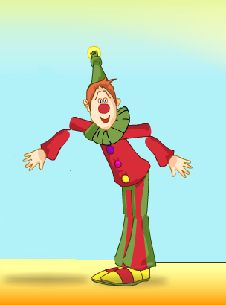

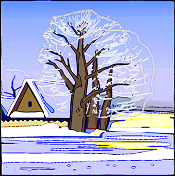
How many seasons
do you know?
What are they?

Slide 3


There are 4 seasons and 12 months in a year. They are:
Winter, Spring, Summer and Autumn
June,
July,
August
}
}
September,
October,
November
March,
April,
May
}
}
December,
January,
February,

Slide 4

Match the words and their transcriptions
January
February
March
April
May
June
[mα:t∫]
[‘eıprəl]
[‘februərı]
[‘dʒænjuərı]
[dʒu:n]
[meı]

Slide 5
ПУТАНИЦА
psring -
umerms –
autmun -
iterwn -

Slide 6
Let’s read a poem!
Spring is green,
Summer is bright,
Autumn is yellow,
Winter is white.

Slide 7
Spring comes after ...................
Summer comes after ................
Autumn comes after …………
Winter comes after ………….

Slide 8
Найди слова
springbrightsummerwhiteyellowwintergreenautumn

Slide 9
ЗАПОМНИ:
Названия месяцев всегда пишутся с заглавной буквы

Slide 10
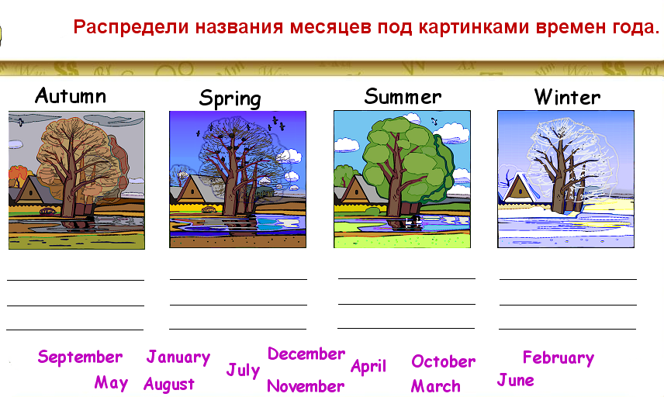

Slide 11
Назови месяцы
в алфавитном порядке
April
June
August
March
December
May
November
February
October
January
September
July

Slide 12
Найди лишнеe слово
autumn, September, winter, spring, summer
December, January, June, February
March, April, July, May

Slide 13
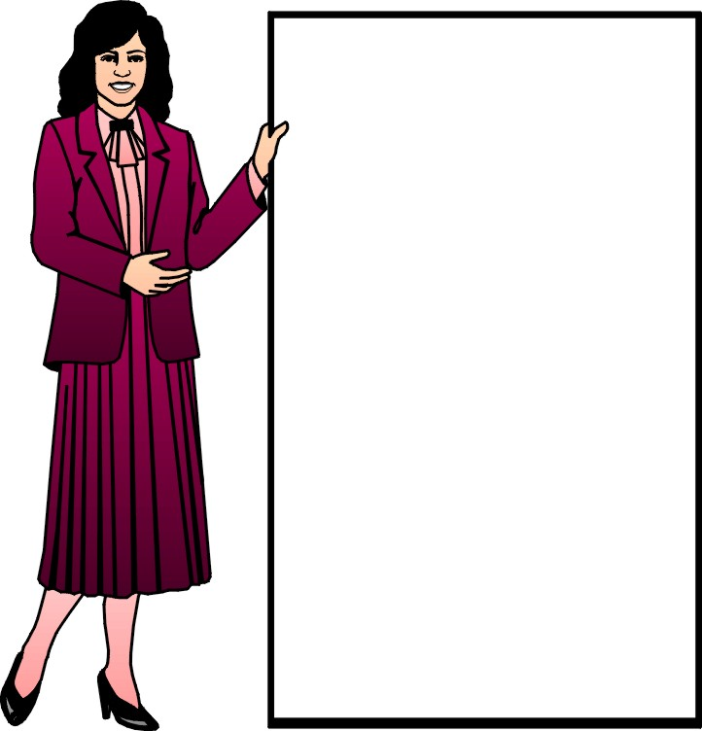
Запомни: in winter- зимой in summer- летом in spring- весной in autumn- осенью символ обозначает время действия

Slide 14
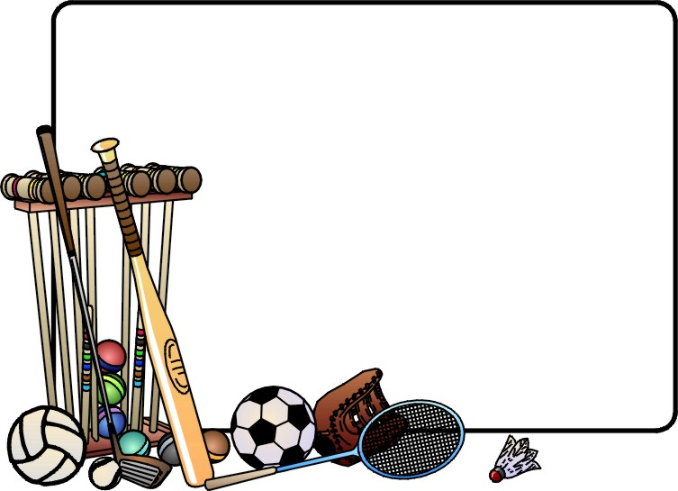
Когда Том занимается своими любимыми делами?
Tom plays tennis in Summer.
He swims in July.
He goes to the forest in September.

Slide 15
Что ты делаешь зимой, весной, летом, осенью?
I play football …
I ski …
I ride a bike …
I walk in the forest …

Slide 16
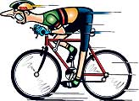

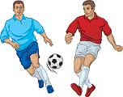

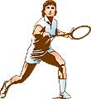




Let’s make a dialogue!
What can you do
in summer, winter or at any season?

Slide 17
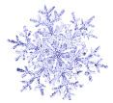




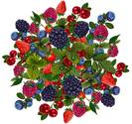

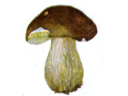
WHEN IS YOUR BIRTHDAY ?
December
January
February
My birthday
is
on the …of…
March
April
May
June
July
August
September
October
November

