Slide 1


Hello pupils!

Slide 2



Slide 3
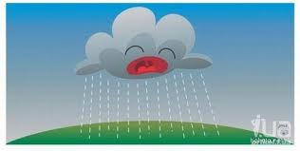


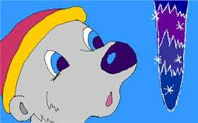


погода
Weather

Slide 4

New words

Slide 5
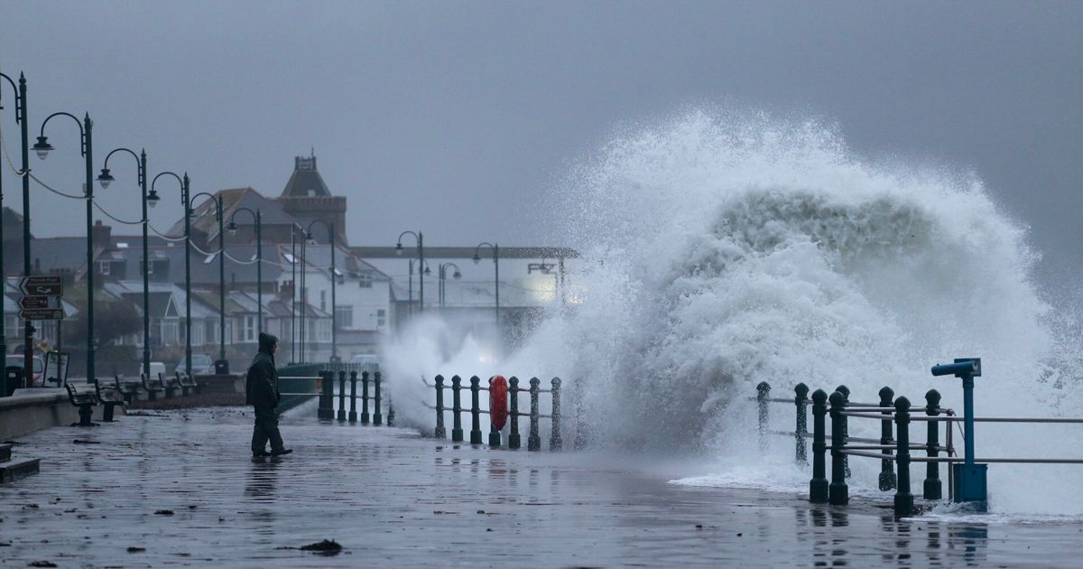
Storm-дауыл

Slide 6
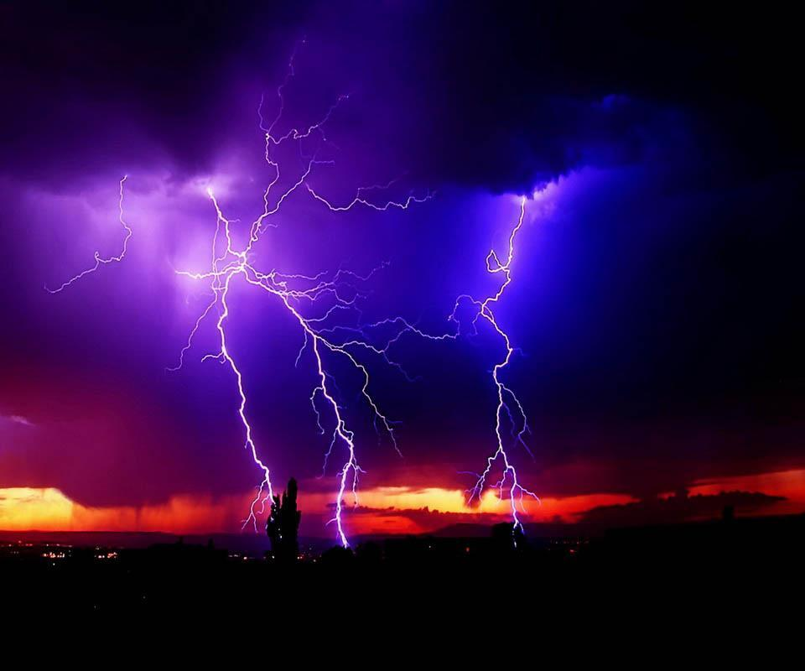
Thunder and lightning-
Күн күркіреуі найзағай

Slide 7
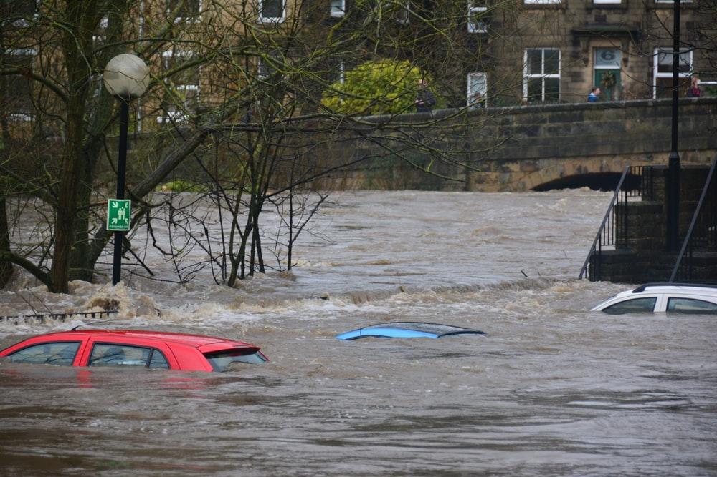
Flood-су тасқыны

Slide 8
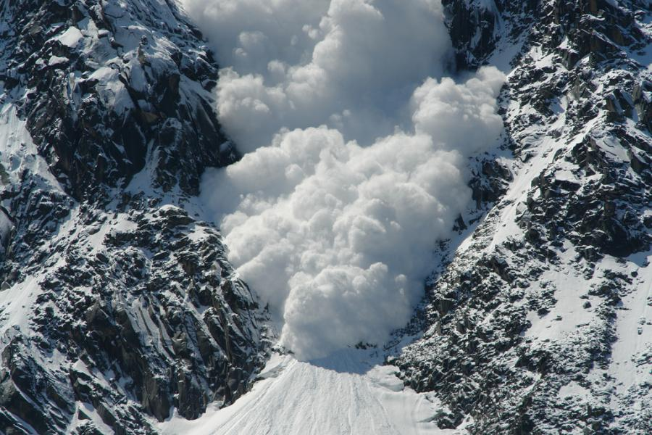
Avalanche-көшкін

Slide 9
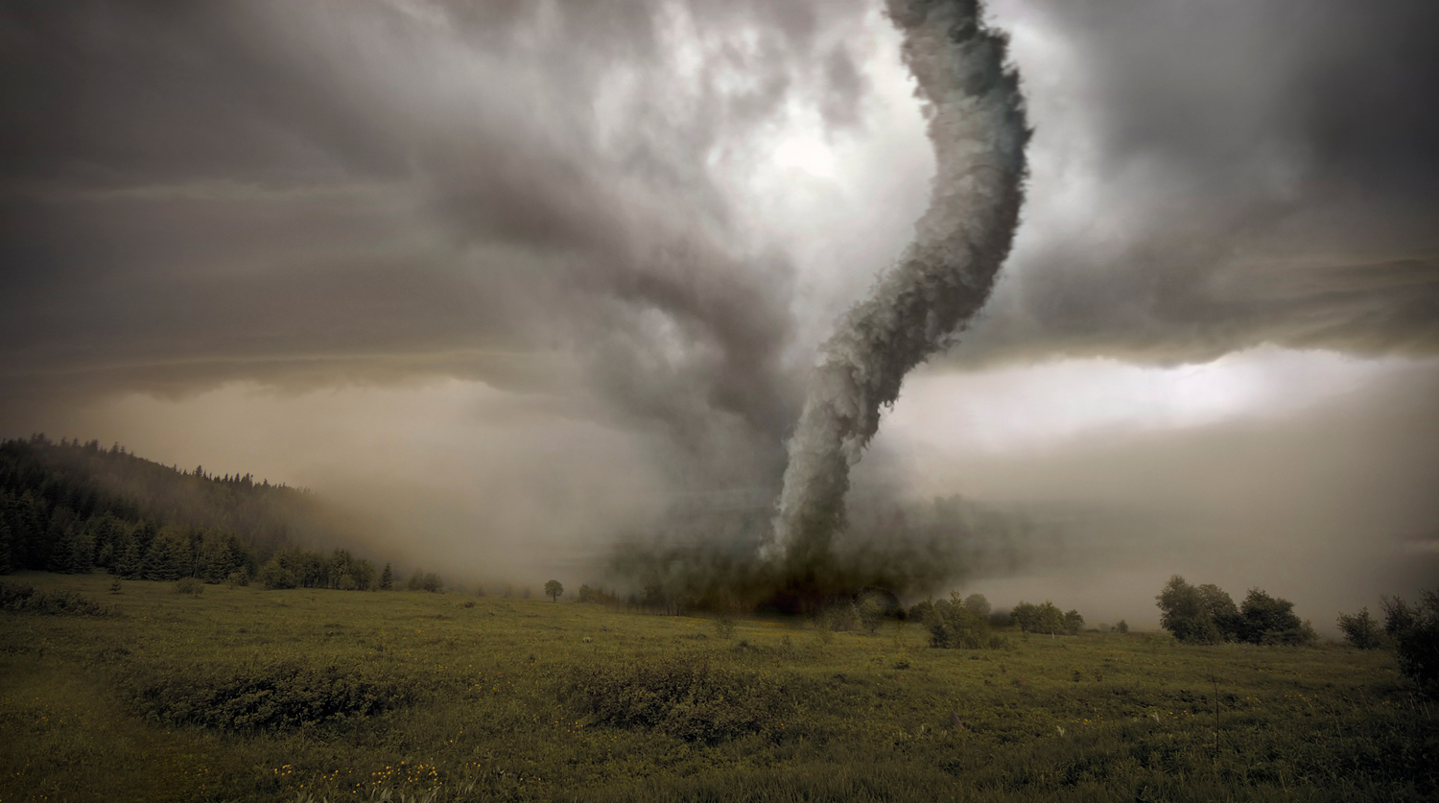
Tornado-қатты құйын

Slide 10
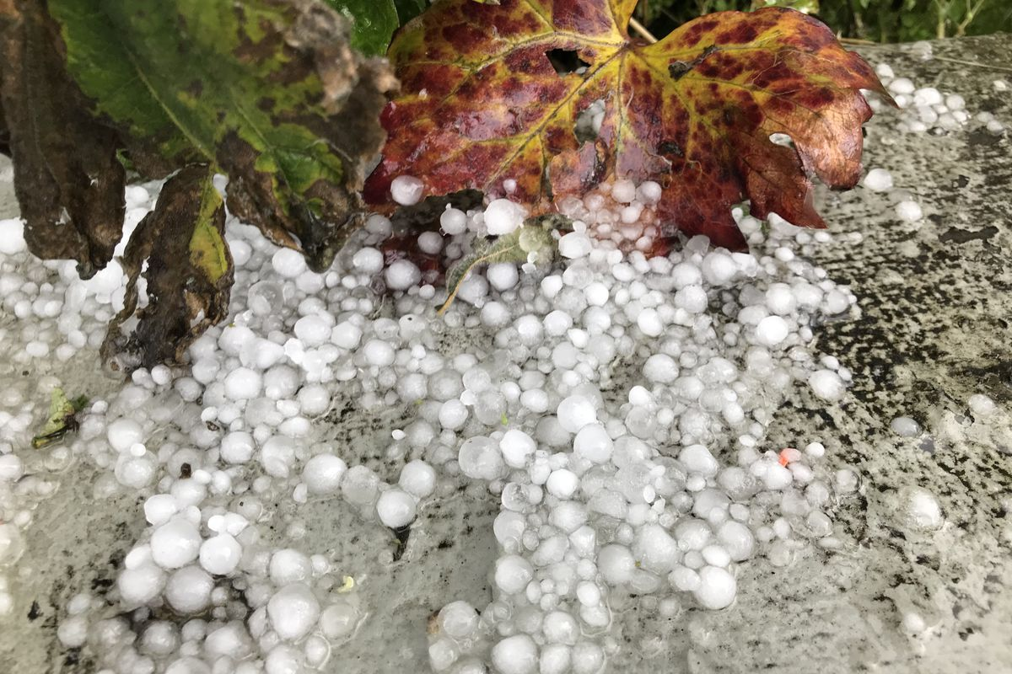
Hail-бұршақ

Slide 11
Modal verb “Can” request
We use “can” in these ways:
– to ask for something
– to ask to do something
– to ask other people to do things for us.
“Can I open the window in here?”
“Can we sit here?”
“Can I have two coffees and a coke, please?”
“Can you help me?”
“Can” модаль етістігі ауызекі тілде іс-әрекеттің рұқсат етілуін де білдіреді.
Can I go out, dad? No, you can't.
Әке, сыртқа шығуыма бола ма? Жоқ болмайды.

Slide 12
Task 1. Make the right sentence
1.email\you\an\Can\send\for me, please?
2. all\Can\ close\ you\ windows, please?\the
3. give\ Can\me \ you\a book?
4. take\Can\chair\ I\this\please?
5. you\help\Can\me?

Slide 13




2. Avalanche .
Какая погода
Weather
3. Tornado
1. Hail
4. Storm
5. Flood .
6. Thunder and lightning

Slide 14
Flood storm thunder and lightning avalanche tornado hail

Slide 15


Slide 16
Group work. Read and match
c
It’s hot and sunny.
It’s raining.
It’s windy.
It’s cold.
It’s snowing.
It’s cloudy.
I can’t swim today.
I can fly my kite.
We can have a picnic.
We can build a snowman.
I can’t see the sun.
We can’t play football.
f
b
a
d
e

Slide 17
Pair work
1. Our house is full of water after the ……….
2. We haven`t got electricity at home after the ………
3. I`m afraid of ………
4. There`s a …… coming.

Slide 18

Reflection

Slide 19




