Slide 1
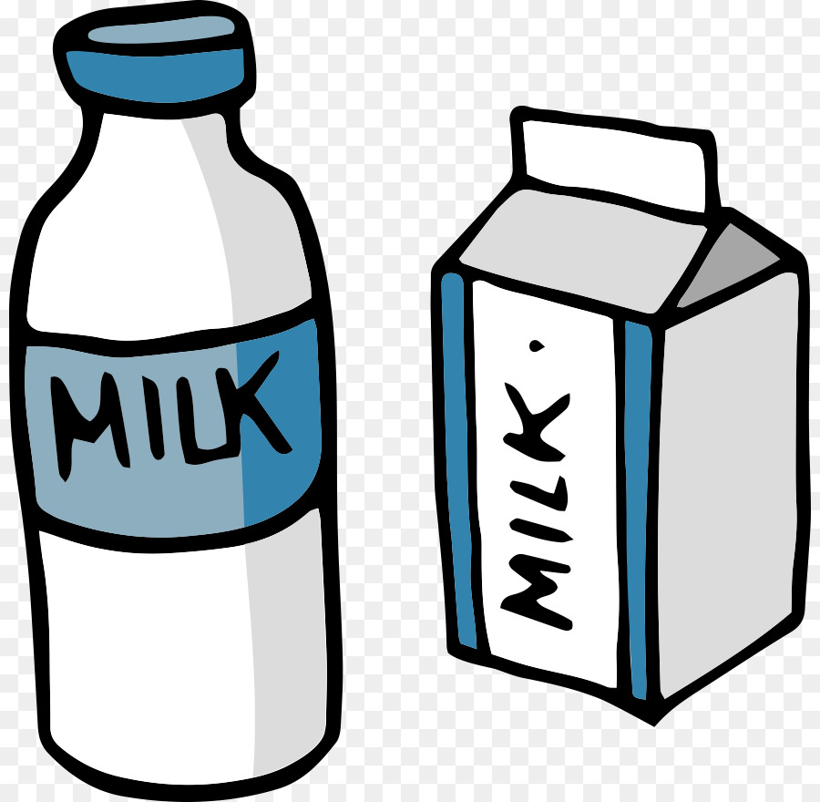

Milk

Slide 2

Egg

Slide 3

Juice

Slide 4
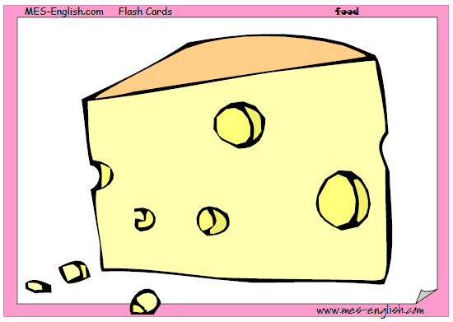
Cheese

Slide 5
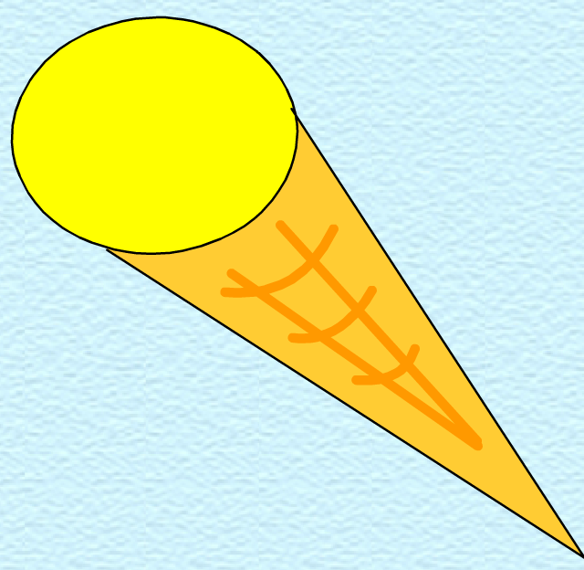
Ice cream

Slide 6
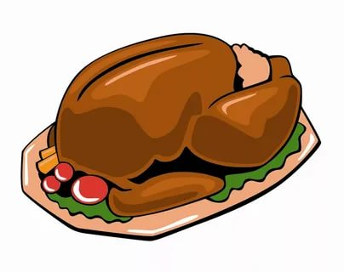
Chicken

Slide 7
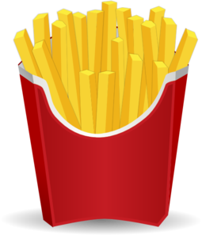
Chips

Slide 8
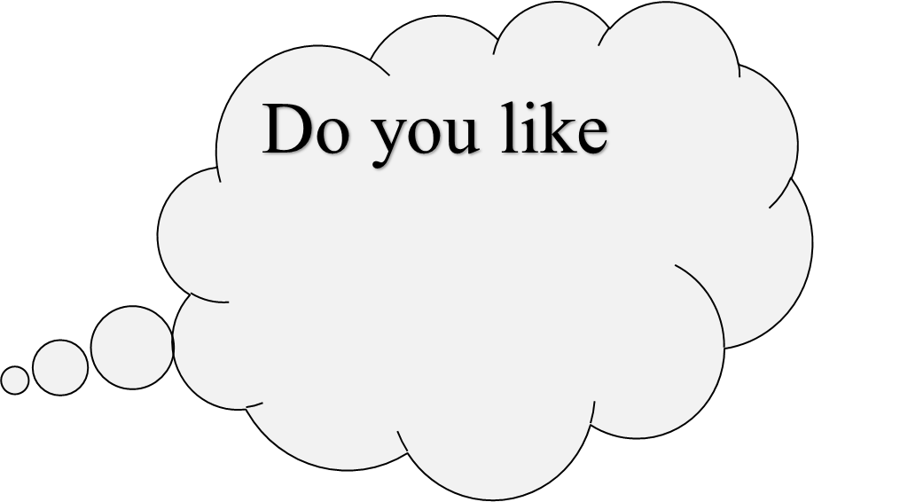


Slide 9


Do you like

Slide 10
Do you like

Slide 11

Do you like

Slide 12

Do you like

