Slide 1

The 3 rd of December
The theme Environmental problems
Notes:
The theme

Slide 2
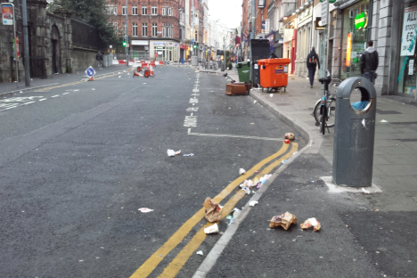
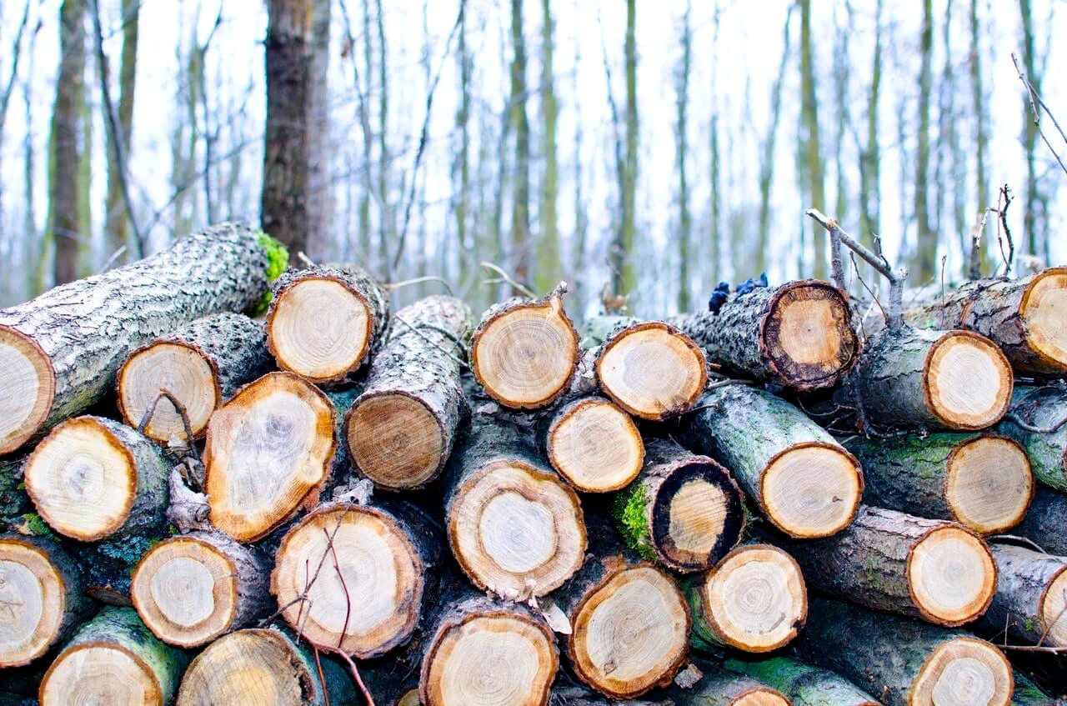
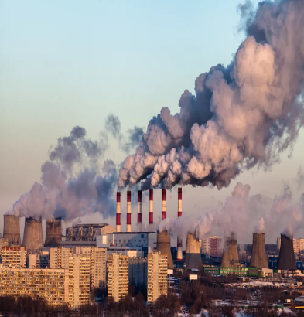
Look at the litter on the street
Look at the stumps of the cut-down trees,
Look at the pollution in the air,
Look at the way we just don’t care

Slide 3
For example: Planting trees will help solve the problem of deforestation.
1.Wasting energy
2.Animals facing extinction
3.Deforestation
4.Polluted beaches.

Slide 4
1. Turning off the power when they are not in use will help solve the problem of wasting energy.
2 Protecting endangered species will help solve the problem of animals facing extinction.
3 Cleaning up beaches will help solve the problem of polluted beaches.
4 Using public transport will help solve the problem of air pollution in cities.

Slide 5
What should we do?
What shouldn’t we do?

Slide 6
What shouldn’t we do?
What should we do?
Plant trees,
turn of the light when we leave
the room,
keep our village tidy,
grow flowers ,
clean up beaches
Kill animals,
wasting energy,
polluted beaches,
pollute water,
cut down trees.
Notes:
What shouldn’t we do?

Slide 7
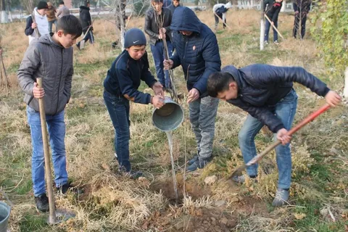
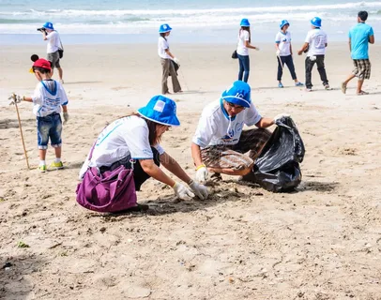

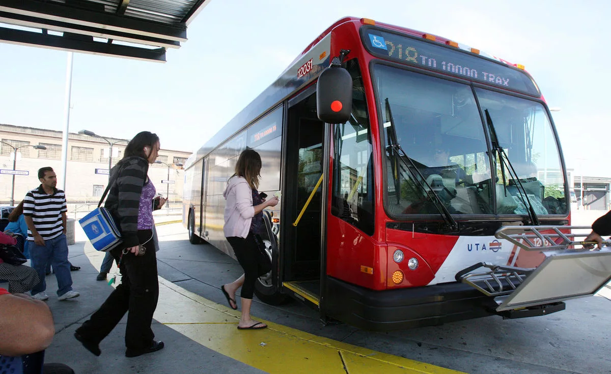
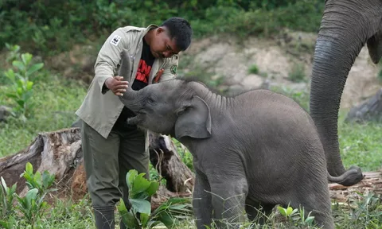

Slide 8

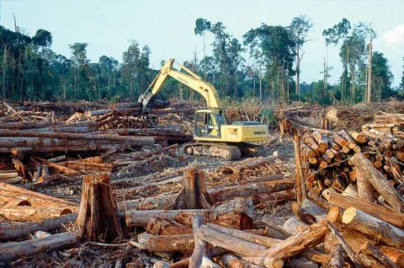
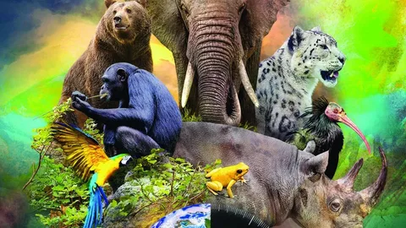
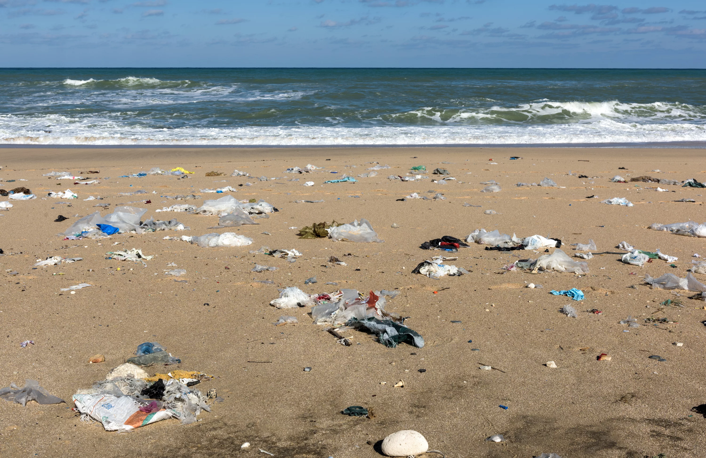
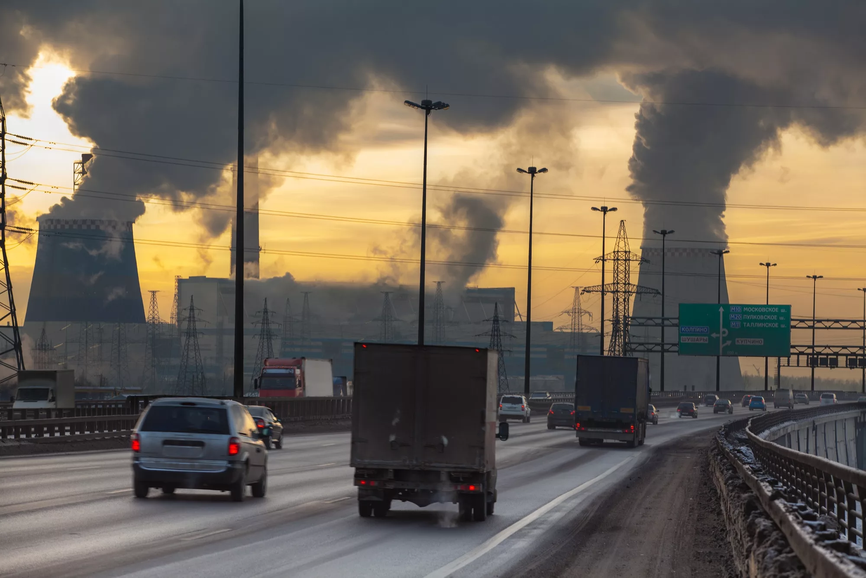

Slide 9
1.What can you do every day to help the environment?
2. What is the biggest environmental problem?
3. What should people do to care for the environment?
4. What's happening to forests in the world?

