Slide 1
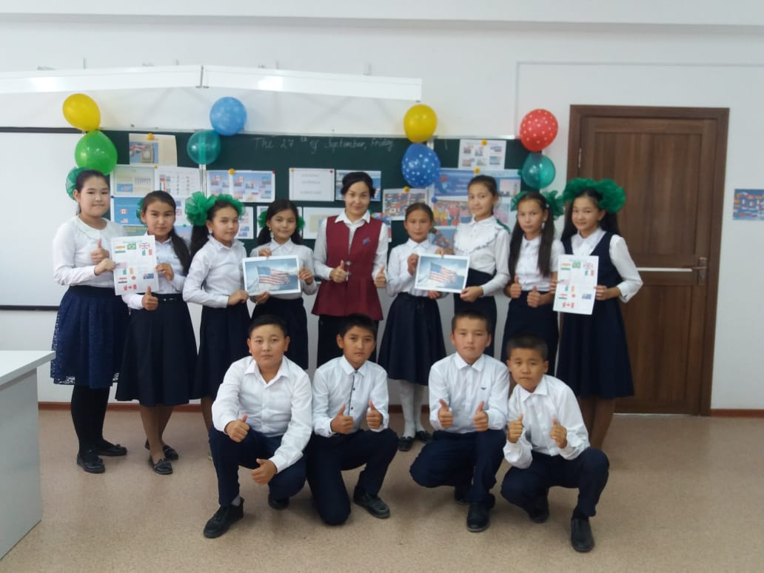
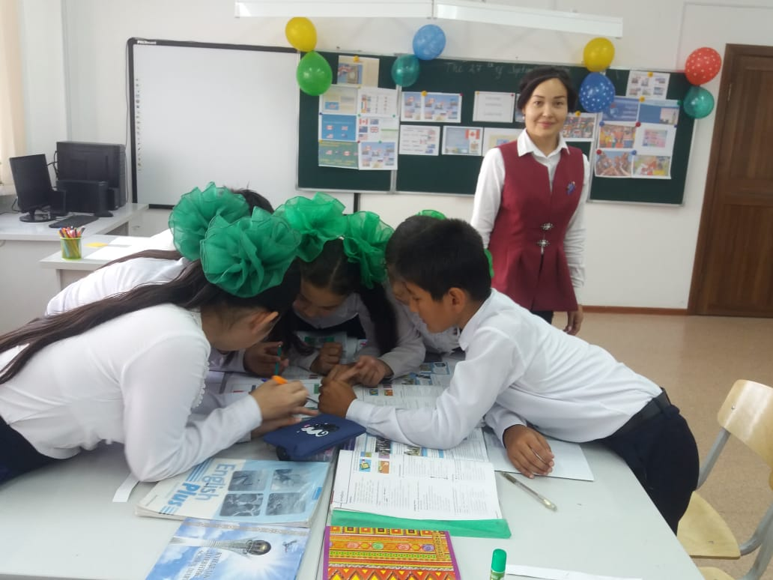
«Kolashy secondry school»
Open lesson: A description of a wildlife photo
Grade: 6 «Ә»
Teacher name: Kutlimuratova Guzal

Slide 2
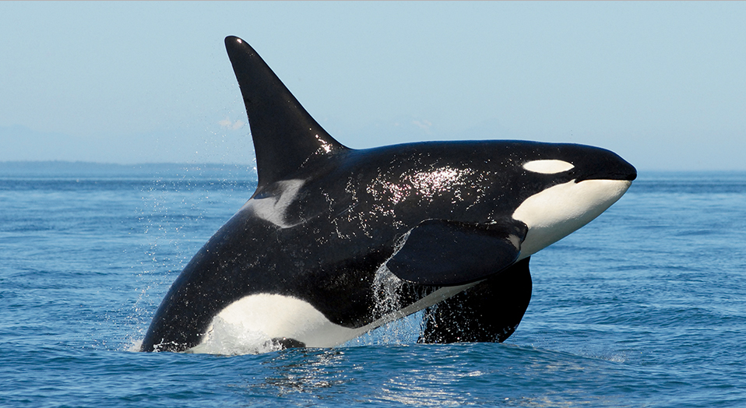
The killer whale or orca (Orcinus orca) is a toothed whale belonging to the oceanic dolphin family, of which it is the largest member.
Speaking about Red list animals: The orca
( Kосатка)
The animals in this photo are orcas or “killer whales”. In fact, an orca is not whale, but a type of dolphin. Here they are swimming
In a group near the shore. Maybe they are huntihg
for seals. Orcas live in all of the worlds oceans.
They hunt and play in groups. They are aggressive
And they usually eat fish, squid, seals and turtles.
Females have one baby, called a calf, every two
Or three years.

Slide 3
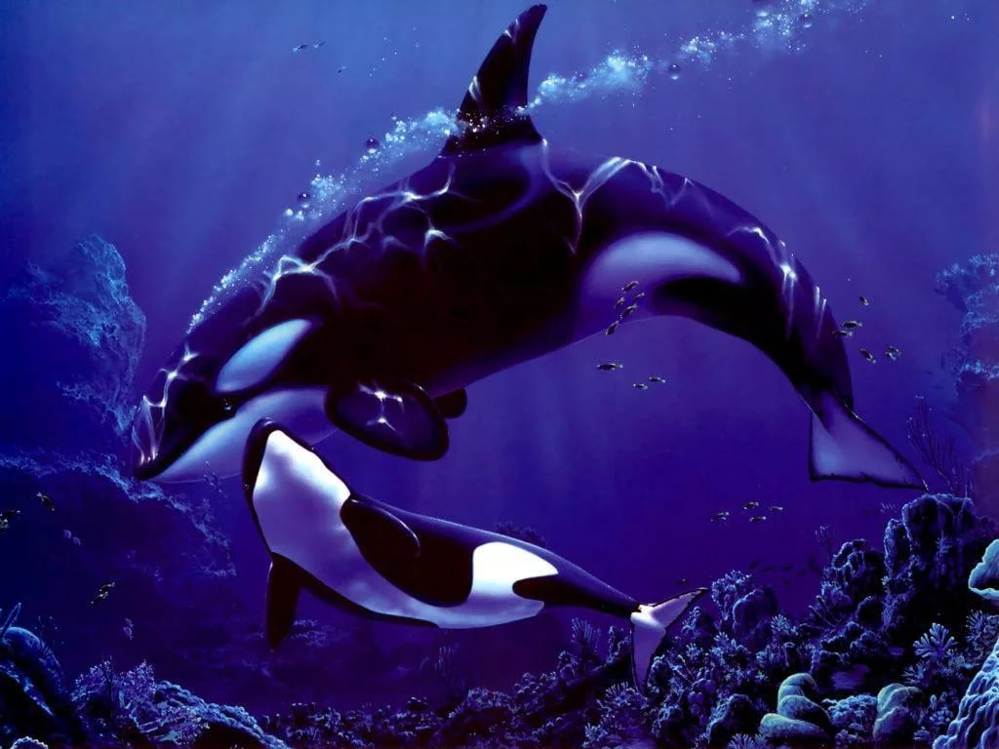
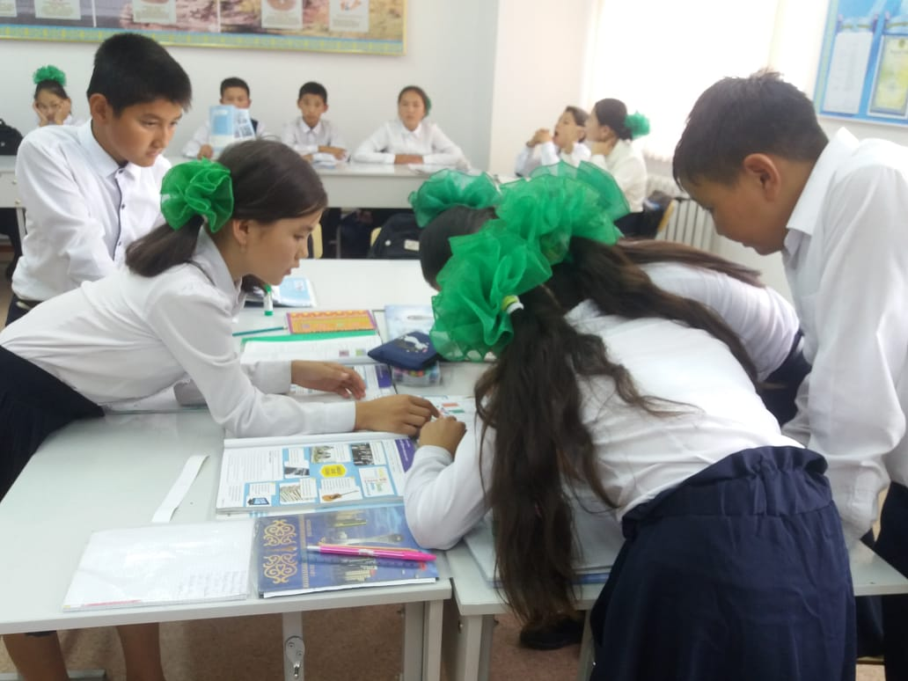
Answers: 1. or 2.but 3.and 4. because 5. also
Linking words: because, and, also, but, or.
Put a right linking word:
1.These animals are orcas___ "killer whales".
2.An orca is not a whale,______ a type of dolphin.
3.They are aggressive___ they eat fish.
4.They are in danger___ there is a pollution in the sea.
5.They ____ die in fishing nets.

Slide 4
Read the modal text and answer the questions.
1.Which paragraph describes the life and habitat of the orca? Which describes a problem?
2. Do orcas live in groups?
3.What do orcas live in groups?
4. How often do females have calves?
5. Why are they becoming extinct?

Slide 5
