Slide 1
The theme of our lesson:
My country: National parks.
Animals and plants.
Form 6 “A”
Teacher: Abduova M.M

Slide 2
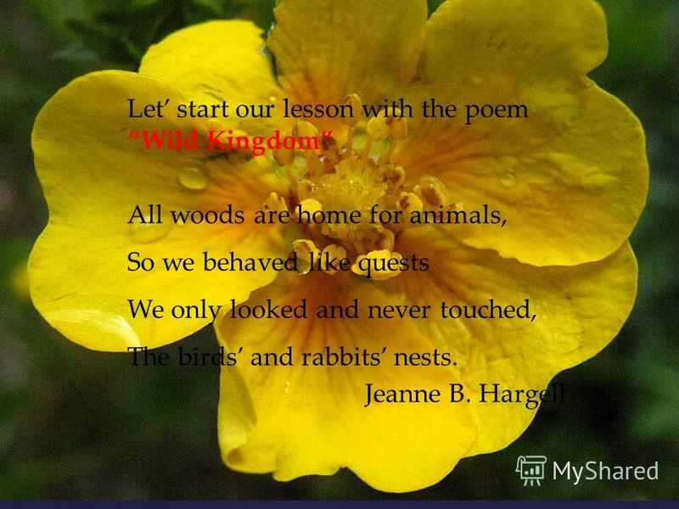
Phonetic drill
The earth is a garden
It’s a beautiful place
For all living creatures
For all the human races

Slide 3

WB p.29

Slide 4
Read.
Wildlife
Unique nature as home to trees
Animals
Birds

Slide 5
The theme of our lesson:
My country: National parks.
Animals and plants.

Slide 6
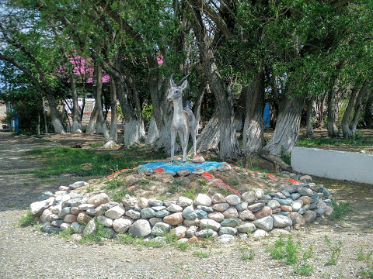
Аltyn-Emel

Slide 7
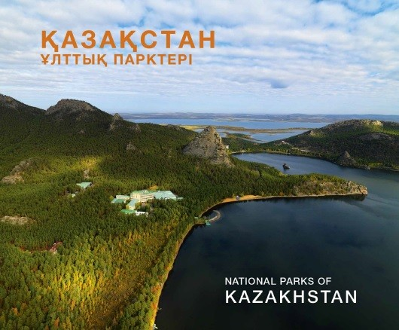

Slide 8
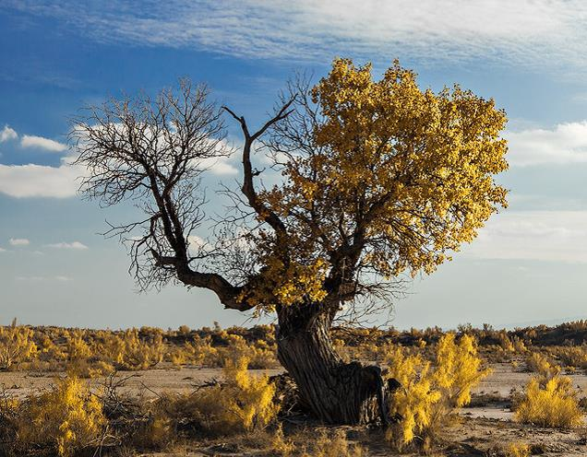

Slide 9
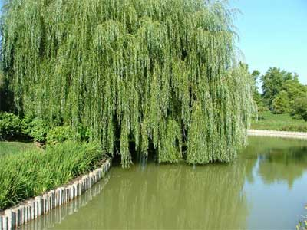

Slide 10
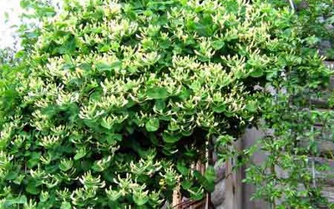

Slide 11
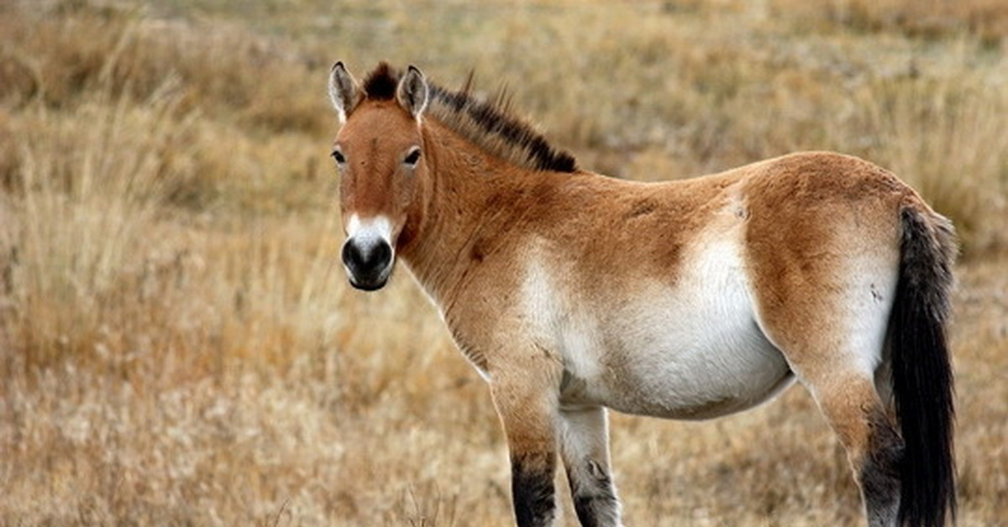

Slide 12
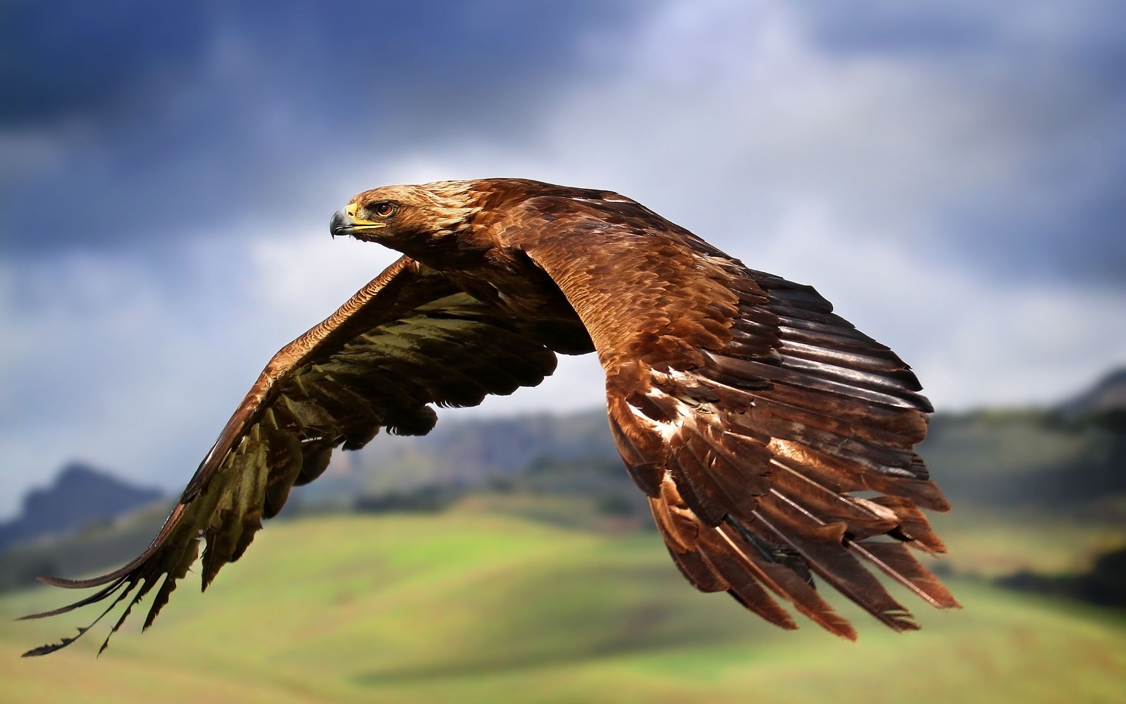

Slide 13
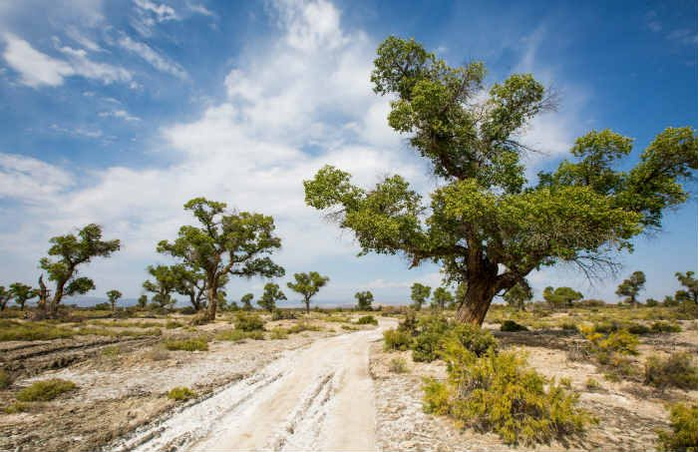

Slide 14
New words
Invertebrate|ɪnvəːtɪbrət|безпозвоночный,омыртқа-сыз
Reptile |rɛptʌɪl|рептилия,бауырымен жорғалаушы
Amphibian |amˈfɪbɪən|амфибия
Mammal |mam(ə)l|млекопитающее,сүтқоректілер
Rare|reə| редкий, сирек кездеседі
Extinct |ɪkˈstɪŋkt| потухший,жойылған
Landscape [lan(d)skeɪp] пейзаж, көрініс
Vertebrate[vəːtɪbrət] позвоночный, омыртқалы

Slide 15
Watching a video
Altyn-Emel National Park.

Slide 16
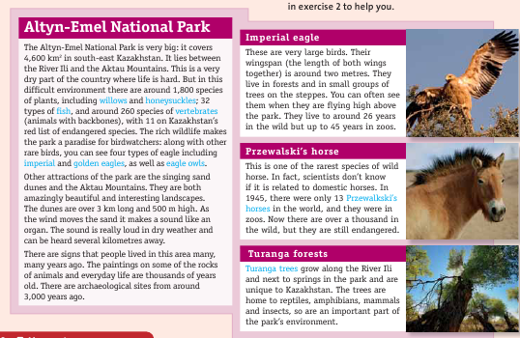
Reading.Work with text.

Slide 17
Reading.
Altyn-Emel National Park
The Altyn-Emel National Park is very big: it covers 4,600 km in south-east Kazakhstan. It lies between the River Ili and the Aktau Mountains. This is a very together) is around two metres. They dry part of the country where life is hard. But in this difficult environment there are around 1,800sp species of plants, including willows and honeysuckles, 32 types of fish and around 260species of vertebrates. They are both amazingly beautiful and interesting landscapes. The eagles including imperial an golden eagles, as well as eagle owls. Imperial eagle is a very large bird. Their wingspan (the length of both wings together) is around 2 metres. They live in forests and in small groups of trees on the steppes. They live to around 26 years in the wild but up to 45 years in zoos. Przewalski’s horse this is one the rarest species of wild horse. Now there are over thousand in the wild, but they are still endangered. Turanga trees grow along the river Ile. The trees are home to reptiles, amphibians, mammals and insects.

Slide 18
Magic box
Аnswer the questions
1. What is the name of the national park?
2. Where is it?
3. What is the landscape like?
4 . What animals and plants do you ﬁnd there?
5.What unusual sights can you see in the park?
6 .What are some of the unusual animals and plants in the park?

Slide 19
Working with the board.
Exercise 3 p.40

Slide 20
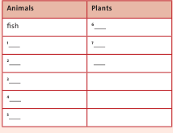
Ex 3 p. 40. Put the words from the text in the correct column.

Slide 21
Lets think
What should we do to save the nature?
What shouldn’t we do to save the nature?

Slide 22
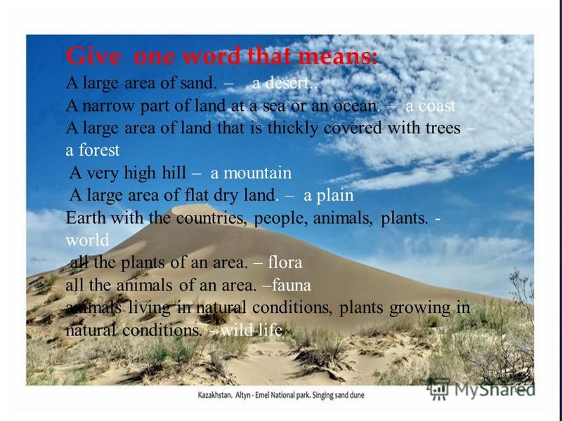

Slide 23
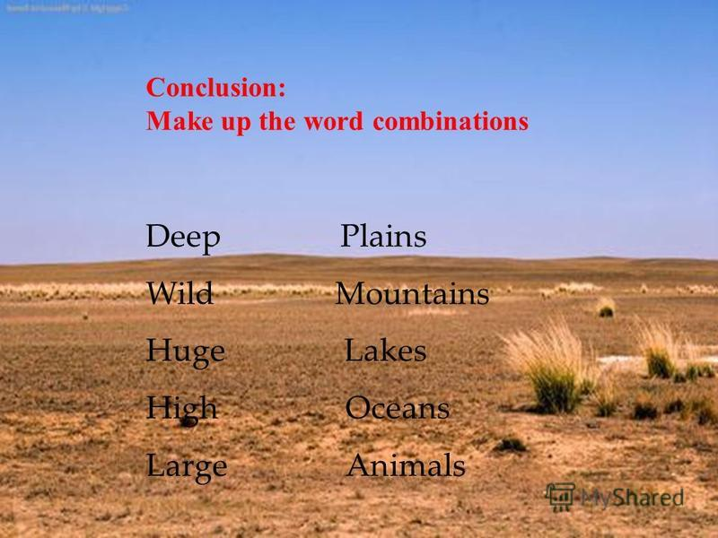

Slide 24

What I knew?
What I have learn?
I want to know

Slide 25
Home task
Write about one national park.

