Slide 1

Professions
8-11 grades

Slide 2


Slide 3
Foreign language: two foreign languages
The bachelor may, in accordance with the established procedure, carry out professional activities in accordance with the received fundamental and specialized foreign language training in the specialty in the post:
- Teachers of two foreign languages ​​of the secondary school (two European or European and one of the Eastern languages) with the corresponding entry in the diploma:
- teacher of English and German;
- teacher of English and French (or Spanish, Italian) languages;
- teacher of German and English;
- teacher of German and French (or Spanish, Italian) languages;
- teacher of French and English;
- teacher of French and German;
- teacher of English and Arabic (or Turkish, Chinese, Japanese, Korean, etc.) languages;
- teacher of German and Arabic (or Turkish, Chinese, Japanese, Korean, etc.) languages;
- teacher of French and Arabic (or Turkish, Chinese, Japanese, Korean, etc.) languages.
- teachers of two foreign languages ​​of a specialized school (with in-depth study of foreign languages ​​and schools with teaching a number of subjects in a foreign language);
- teachers of two foreign languages ​​of secondary technical and professional educational organizations.

Slide 4
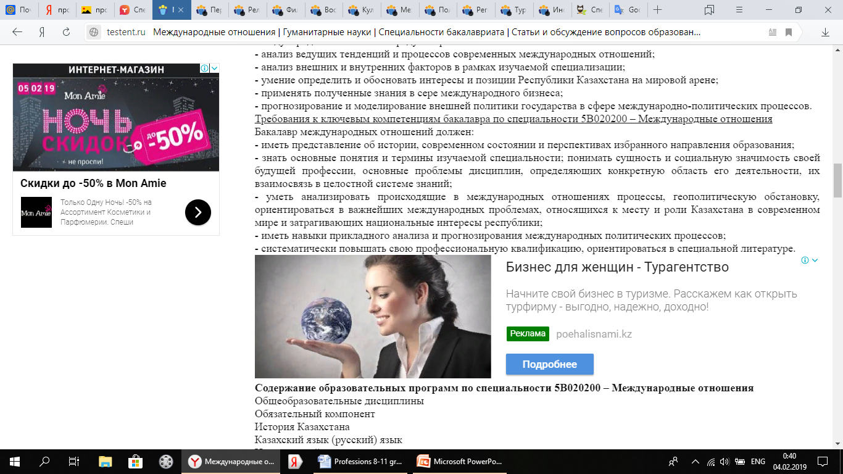
International relationships
Graduate-bachelor of international relations prepared for work in the Ministry of Foreign Affairs of the Republic of Kazakhstan, various government bodies and organizations of the Republic of Kazakhstan working in the field of foreign policy relations, world politics, international organizations, transnational corporations in the following positions: Referent, expert, analyst, consultant in the field of international relations, foreign policy columnist, translator (translator-referent) in the relevant foreign language (s), while working in the state these bodies and organizations, an employee of scientific and educational organizations of the Republic of Kazakhstan and the positions provided for the replacement of specialists with higher special education with typical nomenclature positions, etc.

Slide 5
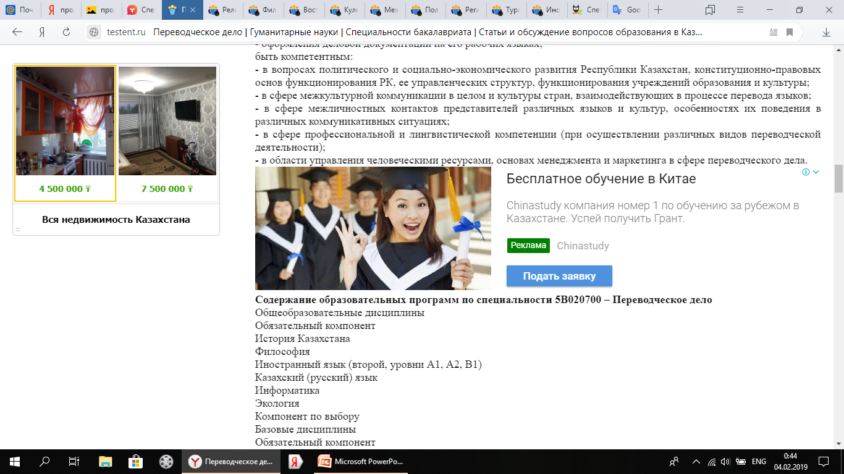
Translation business
Graduate of the bachelor degree in specialty 5B020700 - Translation Studies is prepared for work in the following areas:
- administrative and managerial sphere;
- Education and science;
- the sphere of culture and intercultural communication; ? - the sphere of international relations;
- the scope of publishing;
- The scope of the media;
- Information and analytical sphere in other areas.

Slide 6
Religious studies
Graduate Bachelor degree in 5B020600 - Religious studies prepared for professional activities in the field of history and theory of religion, religious and philosophical problems of human existence and modern civilization, in the system of government, the media.

Slide 7
Philology: foreign philology
The bachelor-philologist may, in accordance with the established procedure, carry out his professional activity in the field of philological education as a teacher of foreign languages and literature in secondary specialized and vocational, secondary vocational education institutions of the humanities. The bachelor of philology can also work in scientific organizations of the corresponding profile as a philologist - junior researcher.

Slide 8
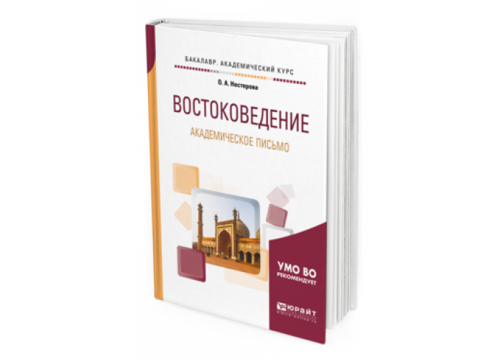
Oriental Studies
Academic degree and qualification: Bachelor of Oriental Studies with a specialization:
Orientalist-philologist, teacher of Oriental language and literature, translator-referent; Orientalist-historian, teacher of history, translator-referent.

Slide 9
Culturology
The activity of the specialist is focused on the scientific study of the dynamics of culture, manifested in various areas of society and social institutions, on ensuring the activities of governing bodies in the government readiness for continuous learning, acquiring new knowledge, making independent decisions, making skills be one of your vital interests

Slide 10

Tourism
The sphere of professional activity of the bachelor in the specialty 050902 - Tourism is the tourism and hospitality industry, as well as science, education, government regulation and other spheres of human activity, directly or indirectly related to tourism.

