Slide 1

Алматы қаласы
Наурызбай ауданы
№174 мектеп-гимназия
Республикалық семинар аясында ағылшын тілі пәнінен өткен ашық сабақ.
Тақырыбы: Transport and travelling
Ағылшын тілі пәнінің мұғалімі: Алмабаева Гульнур Ислямгазыевна

Slide 2

"If we teach today the way we were taught yesterday, we'll steal from children tomorrow"
John Dewey
№ 174 School-gymnasium
English lesson
Theme: The places of interest in Kazakhstan
Grade 7
2018

Slide 3
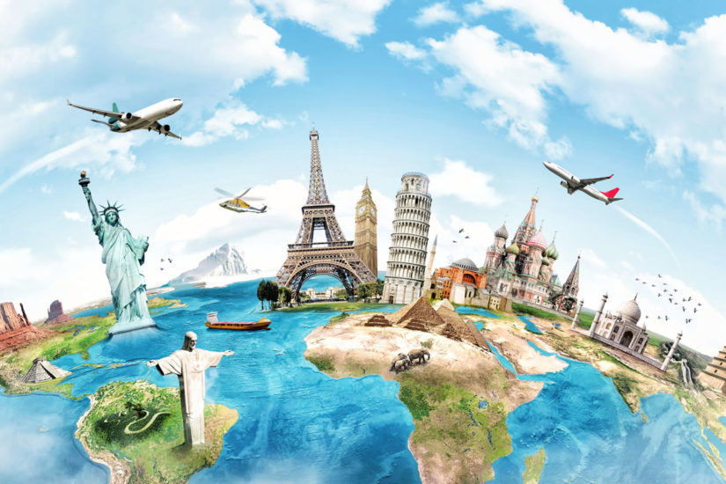

English

Slide 4
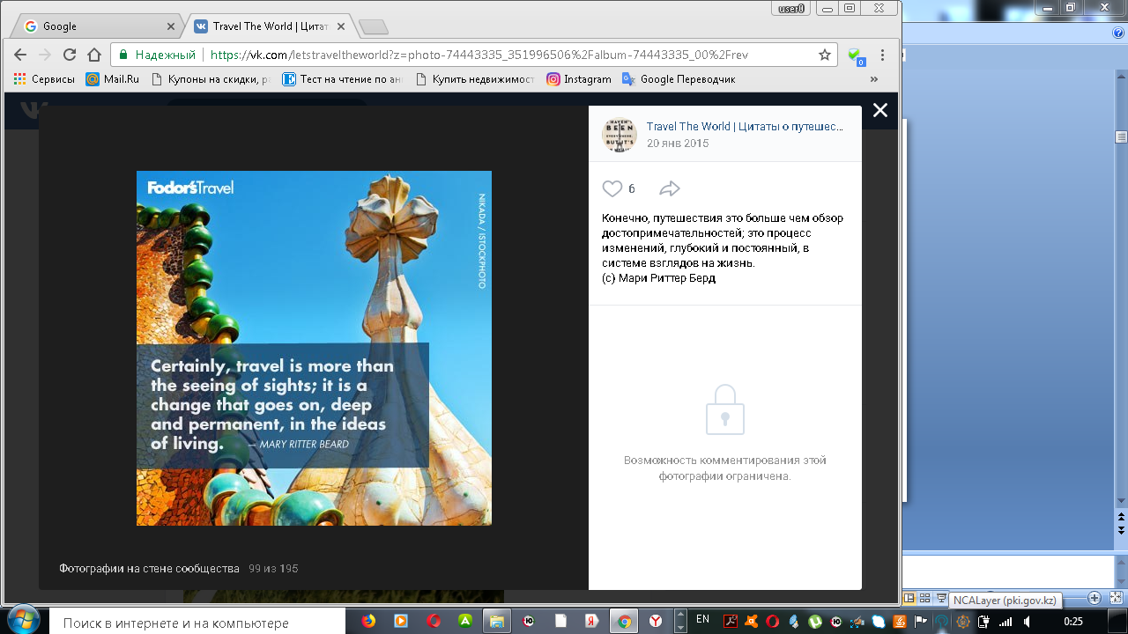
Warming up

Slide 5

Watching the video

Slide 6
The theme of the lesson
Transport and travelling

Slide 7
Lesson objectives
To learn vocabulary for travel and transport
Listen to people talking about travelling
Talk about travelling in different situations
Recognize the main information in a short carefully articulated talk on dialogue

Slide 8

Brainstorming
Why do people travel?

Slide 9
II. Brainstorming Give your reasons…
Why do people travel?

Slide 10
Groups
By strategy:
Whole picture
1 Group
Kazakhstan
Group
Great Britain

Slide 11

New words
Arrive at your destination
Көздеген жерге жету
Go abroad
шетелге бару
Go backpacking
Туристік сапарға шығу
Hire a car
Көлік жалдау
Reserve a seat
Орын алу
See the sights
Көрікті жерлерді аралау
Take a cab
Таксимен жол жүру
Travel by rail
Теміржол көлігімен жол жүру

Slide 12
Task 1.
Descriptor a learner
-Carefully listen to the audio material
-Match the new words and phrases with the photos

Slide 13
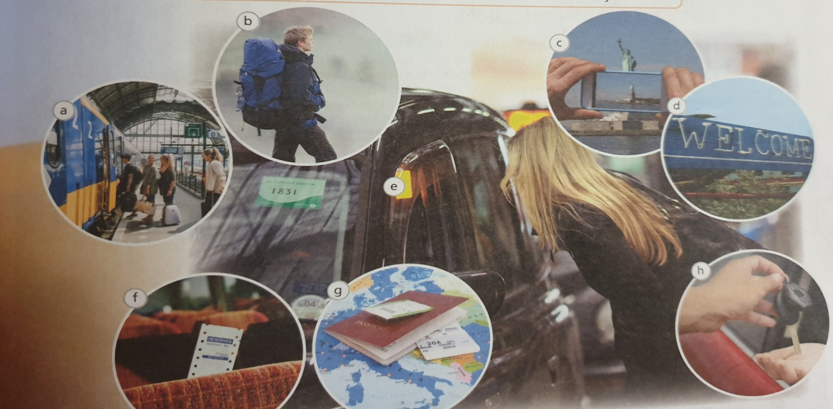
Vocabulary. Match the photos from A till H.
Listen and check! (SB page 73)
See the sights
Go backpacking
Travel by rail
Arrive at your destination
Take a cab
Go abroad
Reserve a car
Hire a car

Slide 14
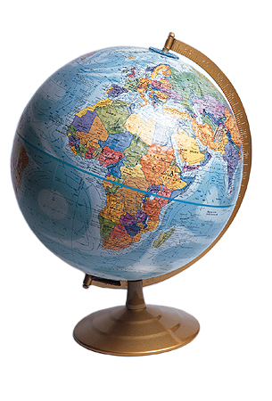
Task 2.
Descriptor :
a learners learn to practice the new phrases.
Complete the sentences with new phrases

Slide 15
Ex 2 p 79 Complete the sentences from exercise 1.
1. You need a passport when you….
2. It’s been a long journey but soon you’ll…. and can relax
3.The train is always very busy so you should ……………before you travel
4.I love trains so I…………….when ever I can
5.If you……….you carry everything on your back as you travel.
6.If you want to……..you have to stand by the side of the road.

Slide 16
Keys of exercise 2.
1. You need a passport when you go abroad
2. It’s been a long journey but soon you’ll reach your destination and can relax
3.The train is always very busy so you should reserve a seat before you travel
4.I love trains so I travel by rail when ever I can
5.If you go backpacking you carry everything on your back as you travel.
6.If you want to take a cab you have to stand by the side of the road.

Slide 17
Bilimland recourse.
Task 3.
Descriptor :
- a learners learn to put words by transport categories.
- a learners learn to realize the importance of transports

Slide 18

Group the words according to the categories in the mind map.
BILIMLAND RESOURSE

Slide 19


Travelling
Teacher: Now students, today we’ ll make long journey from Kazakhstan to Great Britain by bus. On our way we can see a lot of sights of Kazakhstan then when we arrive Great Britain we’ll see the sights of Great Britain too. So let’s begin our journey.
1-st group. Kazakhstan.
2-nd group. Great Britain.

Slide 20

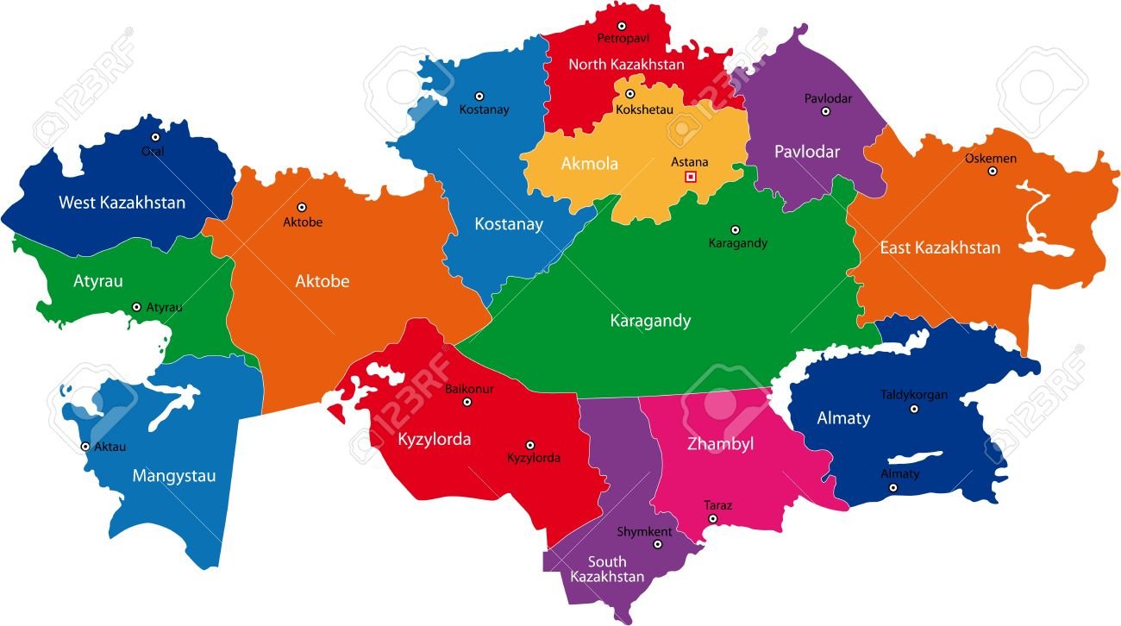
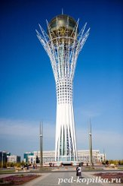
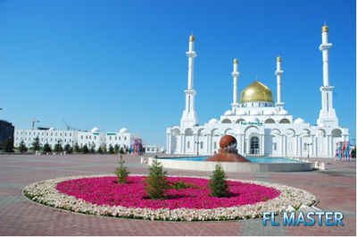
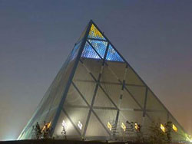
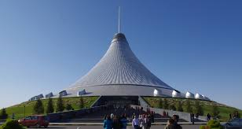
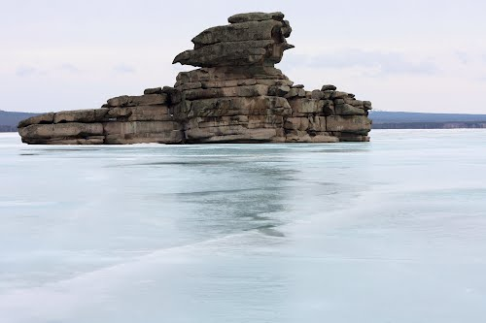
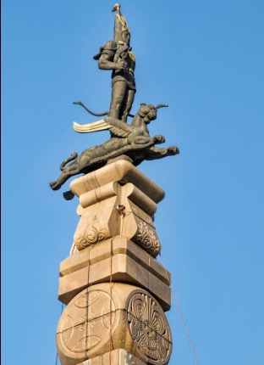
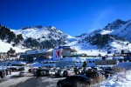
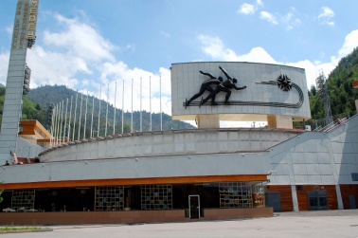
Find the place of modern sights

Slide 21
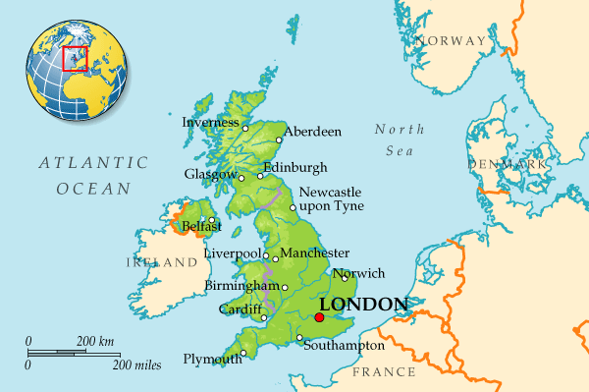



Slide 22
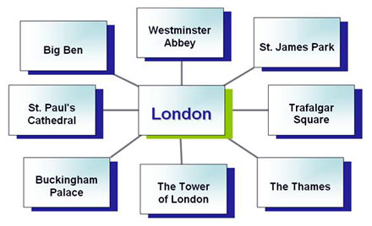
Name
the sights of
London

Slide 23
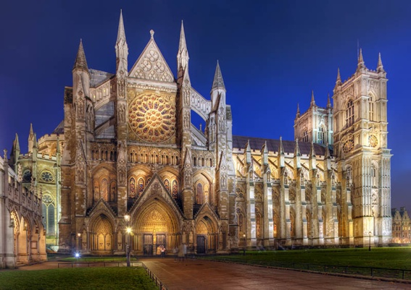
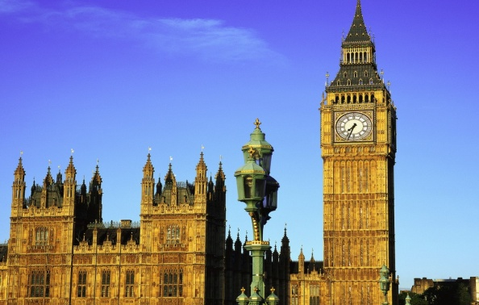
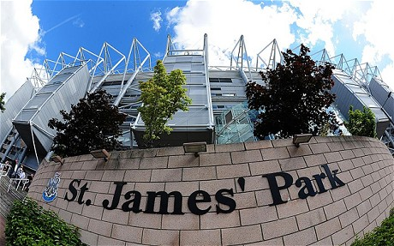
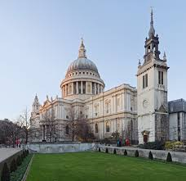
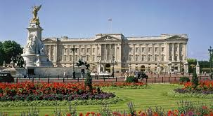
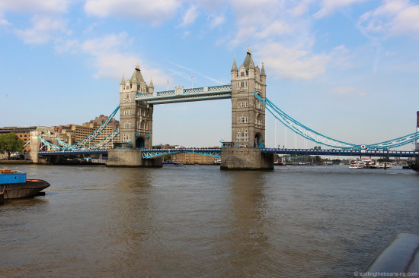
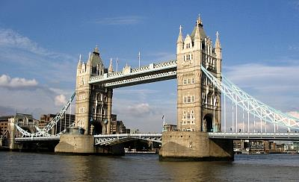

Slide 24
The venn diagram
Kazakhstan
Great Britain
Things in
common

Slide 25
GAME about sightseeing places of GB
2_ GAME.ppt

Slide 26
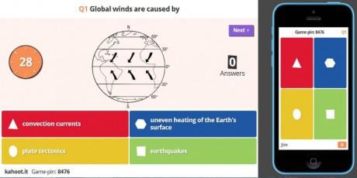
Lets check our knowledge by the application Kahoot

Slide 27
Extra task.
Match the sentences.
.
1. The houses of Parliament is
2. Baiterek
3. Big-Ben is
4. Buckinham Palace
5. Astana is
6. Duman Entertainment centre
has
7. The tower of London
8. Akh Orda
a) the second coldest capital in the world.
b) a big aquarium with over 2000 sea animals.
c) the building which British Parliament sits.
d) is a Tower, Astana’s most famous landmark.
e) one of the famous clocks in the world,
symbol of London.
f) is the official residence of the Queen.
g) is the official workplace of the President of
Kazakhstan
h) is a very old building, now it is a museum.

Slide 28


Slide 29



Concluding stage.
b/ Evaluation of students answers.
c/ marking students by criteria
Congratulations
You are best pupils!

Slide 30



T: the lesson is over.
Good bye!

