Slide 1
LEXICOGRAPHY.
TYPES OF DICTIONARIES
ИЯК18-01 Таспанбет Дана

Slide 2
Lexicography is the theory and practice of compiling dictionaries, is an important branch of applied linguistics.
The term dictionary is used to denote a book listing words of a language with their meanings and often with data regarding pronunciation, usage and/or origin.

Slide 3
According to the language used
they can be:
unilingual (monolingual) - dictionaries in which the words and their definitions belong to the same language
bilingual or translation dictionaries are those that explain words by giving their equivalents in another language.
multilingual or polyglot dictionaries are not numerous, they serve chiefly the purpose of comparing synonyms and terminology in various languages

Slide 4
According to the nature of word entry
There are general and special dictionaries.
General represent the vocabulary as a whole.
Special dictionaries cover a specific part of the vocabulary.
There are dictionaries of synonyms and antonyms, dictionaries of neologisms and slang, pronouncing and so on.

Slide 5
Dictionaries may be classified into linguistic and non-linguistic.
The latter are dictionaries giving information on all branches of knowledge, the encyclopaedias. They deal not with words, but with facts and concepts.
“The Encyclopaedia Britannica”
“The Encyclopaedia Americana”.
There exist also biographical dictionaries and many minor encyclopaedias.

Slide 6
Specialized Dictionaries
phraseological
new words dictionaries
dictionaries of slang
pronouncing
reverse (words are arranged in alphabetical order starting with the end)
etymological
ideographic
rhyme dictionaries
concordances

Slide 7
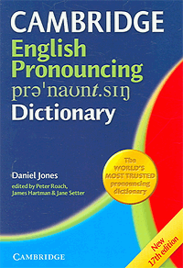
pronouncing
The English Pronouncing Dictionary (EPD) is one of the most well-known works on English pronunciation. Its first edition, published in 1917 and written by Daniel Jones, used symbols of the International Phonetic Alphabet to represent the pronunciations of English words.

Slide 8
reverse
A reverse dictionary is a dictionary organized in a non-standard order, i.e. the organization is based upon sorting each entry word upon its last letter and the subsequent letters proceeding toward the beginning of that word.
Reverse dictionaries of this type were historically difficult to produce before the advent of the electronic computer and have become more common since the first computer sorted one (Stahl and Scavnicky's Reverse Spanish Dictionary) appeared in 1974.

Slide 9
etymological
An etymological dictionary discusses the etymology of the words listed.
Etymological dictionaries are the product of research in historical linguistics.

Slide 10
ideographic
A conceptual dictionary (also ideographic or ideological dictionary) is a dictionary that groups words by concept or semantic relation instead of arranging them in alphabetical order. Examples of conceptual dictionaries are picture dictionaries, thesauri, and visual dictionaries.

Slide 11
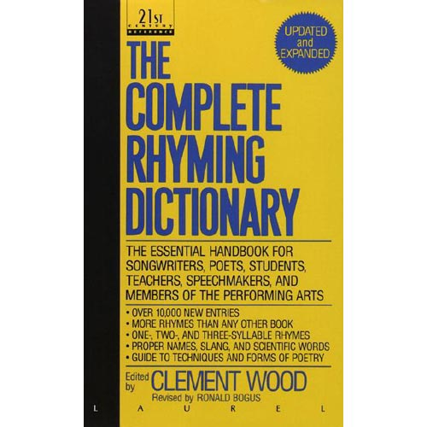
rhyme dictionaries
A rhyming dictionary is a specialist dictionary designed for use in writing poetry and lyrics. In a rhyming dictionary, words are categorized into equivalence classes that consist of words which rhyme with one another.
They will also typically support several different kinds of rhymes, and possibly also alliteration as well.
Walker's Rhyming Dictionary, one of the oldest, lists words in alphabetical order of the reversed word, with an appendix covering the differently spelled but homo-phonic endings.

Slide 12
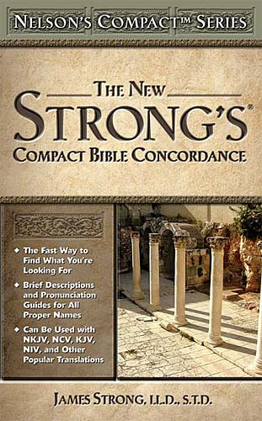
concordances
It is an alphabetical list of the principal words used in a book or body of work, with their immediate contexts.
Because of the time and difficulty and expense involved in creating a concordance in the pre-computer era, only works of special importance, such as the Vedas, Bible, Qur'an or the works of Shakespeare, had concordances prepared for them.

