Slide 1


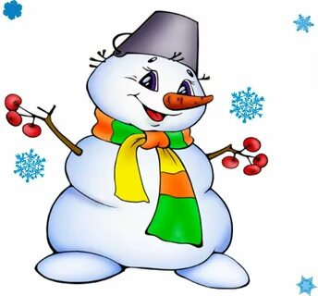
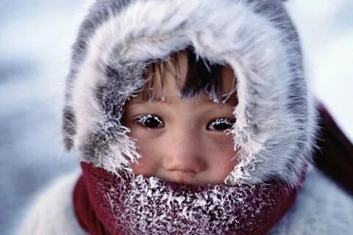
What can you see at this slide ? Look and name the theme of our lesson.
4 pictures and 1 word

Slide 2
WINTER
To introduce about informatin of winter
To introduse with words to the topic
To practise conversations with the help of game

Slide 3
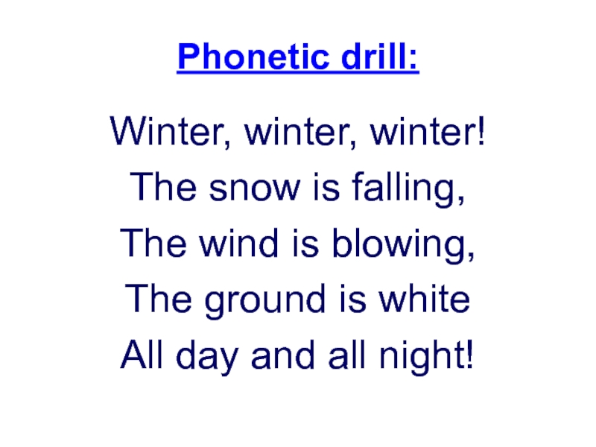
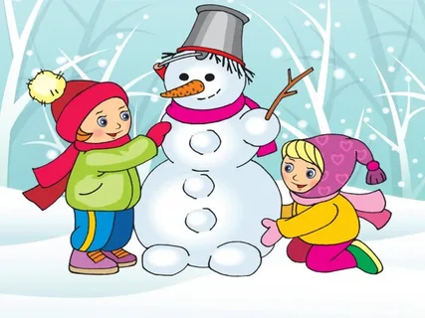

Slide 4
WINTER [УИНТЭ] ЗИМА
SNOW [СНОУ] СНЕГ
SNOWMAN [СНОУМЭН] СНЕГОВИК
IT’S COLD [ИТС КОЛД] ХОЛОДНО
NEW YEAR [НЬЮ ИЯ] НОВЫЙ ГОД
SCARF [СКАФ] ШАРФ

Slide 5

What months of winter do you know?
MONTHS
DECEMBER-ДЕКАБРЬ
JANUARY -ЯНВАРЬ
FEBRUARY-ФЕВРАЛЬ

Slide 6


What holidays are there in winter in our country??
HOLIDAYS
INDEPENDENT DAY
NEW YEAR

Slide 7
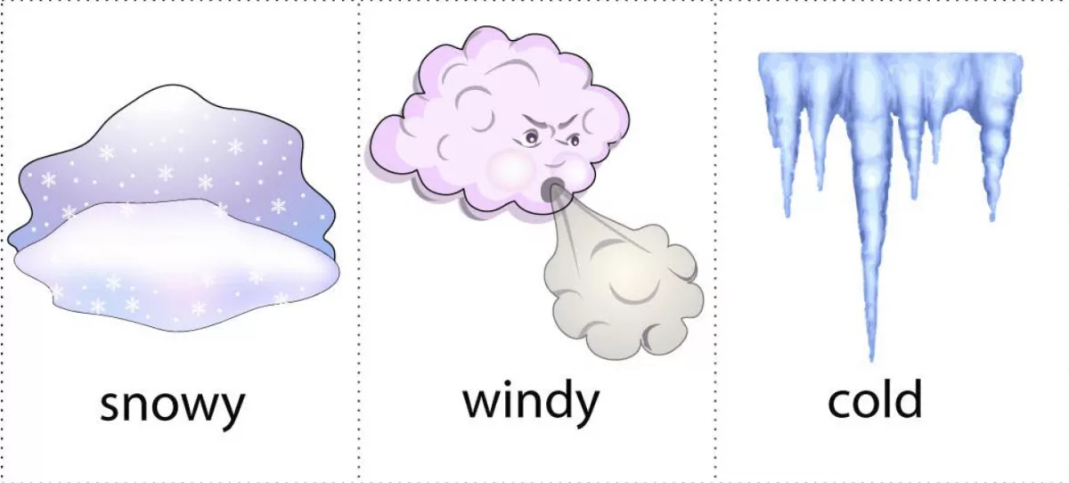
HOW IS THE WEATHER IN WINTER?

Slide 8




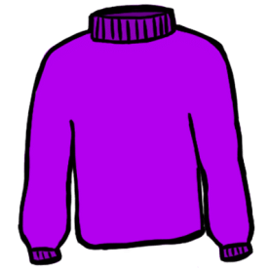


WHAT DO YOU WEAR?
BOOTS
RAINCOAT
GLOVES
SCARF
JUMPER
HAT
JACKET

Slide 9

http://www.kindersite.org/Directory/DirectoryFrame.htm

